Slide 1



Artificial intelligence in MS
Chiara Cordero
Dipartimento di Scienza e Tecnologia del Farmaco
Università di Torino

Slide 2

6th International Mass Spectrometry School
Agenda
Definitions
Artificial Intelligence
The omics context and the role of MS
Type of AI approaches in food omics area
The Gestalt concept in analytical science
Application of AI concepts in omic workflows
Pattern recognition
Computer Vision and Augmented visualization
Artificial Intelligence smelling
Practical example
-> Shelling nuts: an omics approach to unravel hazelnut quality and flavor
by advanced chromatographic fingerprinting
Cagliari (Italy), September 17-22, 2023

Slide 3

6th International Mass Spectrometry School
Definitions
Artificial Intelligence
Artificial Intelligence
Artificial intelligence (AI) refers to the development and implementation of computer systems or machines that possess the ability to perform tasks that typically require human intelligence.
It is a broad field of study and practice that aims to create intelligent machines capable of perceiving, reasoning, learning, and problem-solving.
AI in MS applications
AI techniques, particularly machine learning and data analysis algorithms, are being integrated with mass spectrometry to enhance the interpretation and analysis of complex data generated by these instruments.
1. Spectral Interpretation
2. Peak Detection and Deconvolution
3. Pattern Recognition
4. Data Analysis and Classification
5. Optimization of Instrument Parameters
Cagliari (Italy), September 17-22, 2023

Slide 4
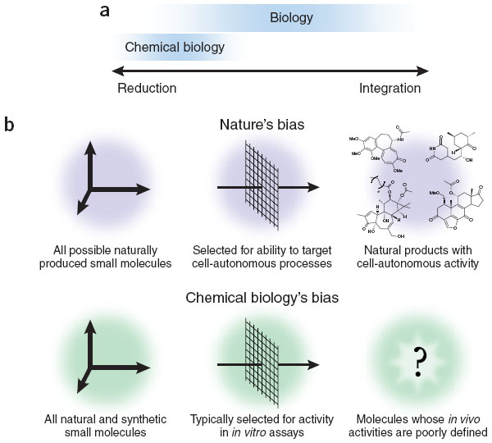
6th International Mass Spectrometry School
Definitions
The omics context and the role of MS
Decoding biological phenomena
Reductionists
Integrationists
Adapted from: Randall T. Peterson Commentary on Nature Chemical Biology 4, 635 (2008)
“…Chemical biology and systems biology have grown and evolved in parallel during the past decade, but the mindsets of the two disciplines remain quite different. As the inevitable intersections between the disciplines become more frequent, chemical biology has an opportunity to assimilate the most powerful ideas from systems biology.
Can the integrationist mindset of systems biology liberate chemical biology from the compulsion to reduce everything to individual small molecule-target pairings?...”
Randall T. Peterson Commentary on Nature Chemical Biology 4, 635 (2008)
Cagliari (Italy), September 17-22, 2023

Slide 5
6th International Mass Spectrometry School
Definitions
The omics context and the role of MS
“…Chemical biology and systems biology have grown and evolved in parallel during the past decade, but the mindsets of the two disciplines remain quite different. As the inevitable intersections between the disciplines become more frequent, chemical biology has an opportunity to assimilate the most powerful ideas from systems biology.
Can the integrationist mindset of systems biology liberate chemical biology from the compulsion to reduce everything to individual small molecule-target pairings?...”
Randall T. Peterson Commentary on Nature Chemical Biology 4, 635 (2008)
Analytical chemistry
“… A persistent research frontier is the analytical chemistry of the mixtures of chemical substances generated by living organisms.
The problems of separation, molecular identification, and quantification of these mixtures are enormous.
They are the ultimate molecular mishmash.
The challenges they offer have demanded, and produced, many new concepts in chemical measurement science…”
Royce Murray , Editorial on Analytical Chemistry 63 (7), 379a (1991)
Cagliari (Italy), September 17-22, 2023

Slide 6
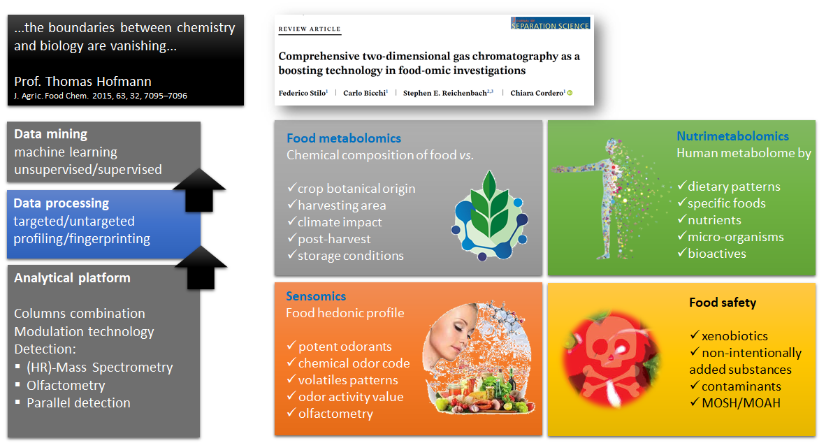
6th International Mass Spectrometry School
Definitions
The omics context and the role of MS
Cagliari (Italy), September 17-22, 2023

Slide 7
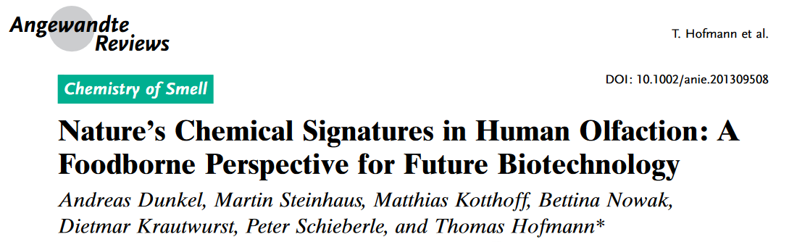



6th International Mass Spectrometry School
Definitions
The omics context and the role of MS
Pattern recognition and Computer Vision
"... is a field of artificial intelligence (AI) that enables computers and systems to derive meaningful information from digital images....— and take actions or make recommendations based on that information.
If AI enables computers to think, computer vision enables them to see, observe and understand."¹
Artificial Intelligence smelling
Context: Sensomics²
Principle: key-odorants and odorants patterns evoke specific smells/aroma qualities while contributing to define the overall flavor perception of a food - identity
Methods: extract, isolate, quantify potent odorants by reliable and robust methodologies
Outcome: Sensomics-Based Expert System³ (SEBES) that predicts key-aroma signatures of food without using human olfaction.
1. https://www.ibm.com/topics/computer-vision
2. Dunkel, A.; Steinhaus, M.; Kotthoff, M.; Nowak, B.; Krautwurst, D.; Schieberle, P.; Hofmann, T. Angew. Chemie - Int. Ed. 53 (28) (2014) 7124–7143.
3. Nicolotti, L.; Mall, V.; Schieberle, P. J. Agric. Food Chem., 67 (2019) 4011–4022
Cagliari (Italy), September 17-22, 2023

Slide 8
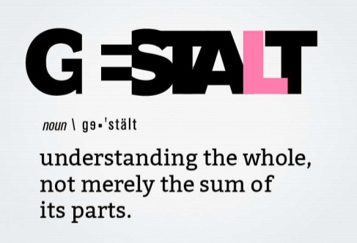
6th International Mass Spectrometry School
Definitions
The Gestalt concept in analytical science
Is comprehensive two-dimensional chromatography coupled to mass spectrometry and automated sample-prep worthy to be used in food omic workflows?
Is …something that is made of many parts and yet is somehow more than or different from the combination of its parts¹… useful
Cagliari (Italy), September 17-22, 2023

Slide 9
6th International Mass Spectrometry School
Definitions
The Gestalt concept in analytical science
Comprehensive 2D GC
Separation power (peak capacity) is given by the product of the two chromatographic dimensions (GC×GC)¹
Independent (almost) displacement in both dimensions produces rational retention patterns for homologue series¹
Band compression (in space - for thermal modulators) produces signal-to-noise ratio enhancement - sensitivity
Bi-dimensional peak patterns exploits a 3D space where fingerprinting could be more accurate that in a 2D space (as for 1D-GC profiles)
[1] Giddings, J.C. (1987), Concepts and comparisons in multidimensional separation. J. High Resol. Chromatogr., 10: 319-323.
Cagliari (Italy), September 17-22, 2023

Slide 10
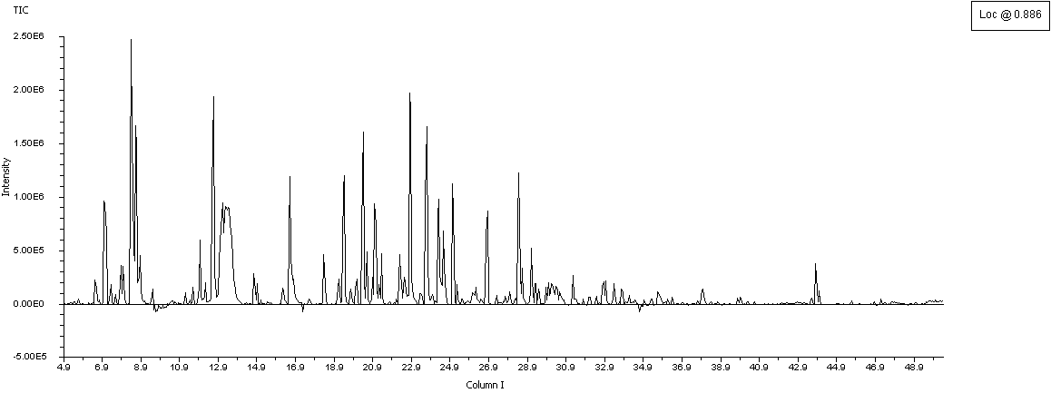

6th International Mass Spectrometry School
Definitions
The Gestalt concept in analytical science
Conventional 1D GC
[1] Harrigan G., Goodacre R. (2003) Metabolic profiling: its role in biomarker discovery and gene function analysis. Kluwer Academic Publishers: Boston
[2] S.E. Reichenbach et al. J. Chromatogr. A 1226 (2012) 140– 148
[3] Stilo, F., Bicchi, C., Jimenez-Carvelo, A.M., Cuadros-Rodriguez, L., Reichenbach, S.E., Cordero, C. TrAC Trends Anal. Chem. 134 (2021) 116133
[4] Giddings, J. C. (1995) J. Chromatogr. A. 703, 3–15.
Profiling¹
detailed analysis of the chemical pattern
Limits
high chemical dimensionality⁴
complexity of food samples
isomers/isobars might co-elute and analytes discrimination becomes challenging
Need of multiple dimensions (separation / detection) to explore compositional complexity⁴
Target(ed) analysis²
GC-MS metadata (retention and spectra)
analytes identity and amount
Chromatographic fingerprinting^{1,3}
general and rapid high-throughput screening -> discriminate/classify samples
Cagliari (Italy), September 17-22, 2023

Slide 11


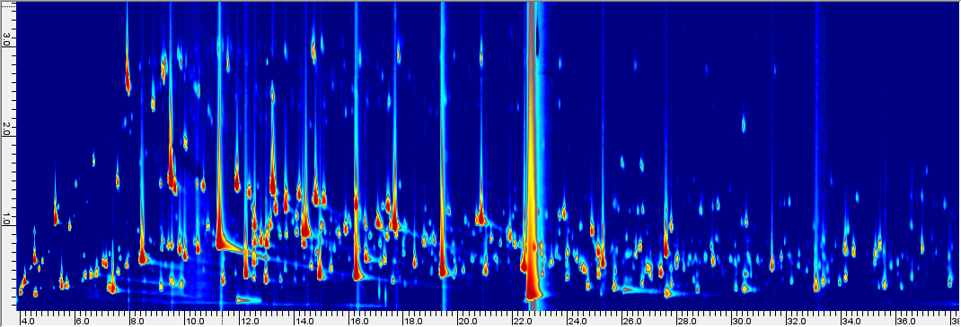

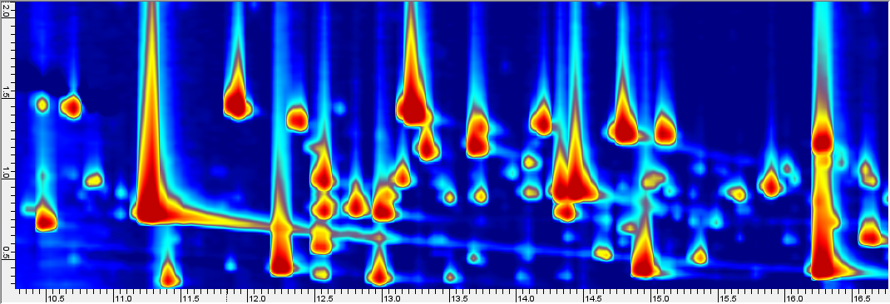
6th International Mass Spectrometry School
Conventional 1D GC
Definitions
The Gestalt concept in analytical science
Comprehensive 2D GC
“High resolution” profiling
GC×GC separation power
accurate quantitative profiling
2D/3D Chromatographic fingerprinting¹
pattern recognition (forensics)
comprehensive sample comparison
Group-Type Analysis
Rational retention logic
Ordered elution patterns
[1] Stilo, F., Bicchi, C., Jimenez-Carvelo, A. M., Cuadros-Rodriguez, L., Reichenbach, S. E., & Cordero, C. (2021). TrAC Trends in Analytical Chemistry, 134, 116133.
Cagliari (Italy), September 17-22, 2023

Slide 12
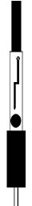
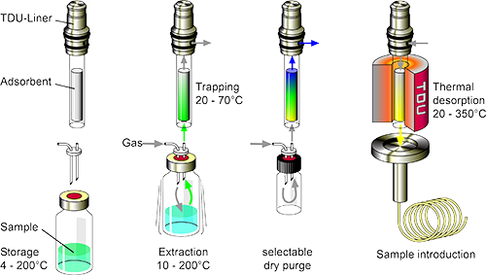
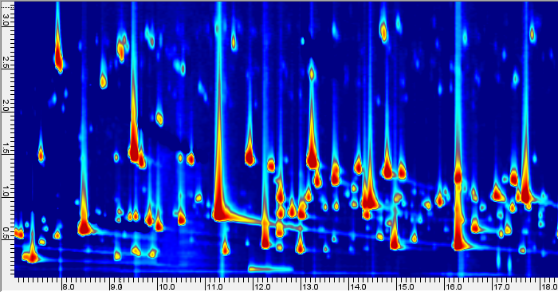

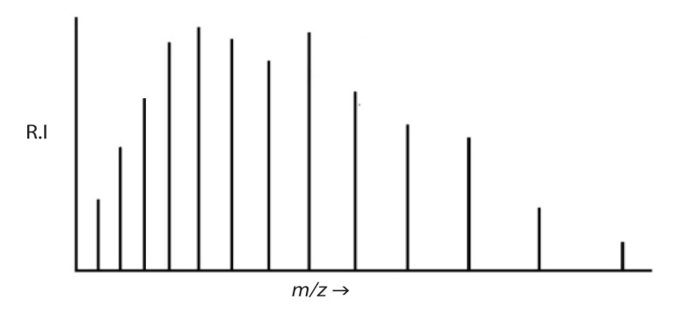
6th International Mass Spectrometry School
Definitions
The Gestalt concept in analytical science
Information dimensions
spectral signature (identity)
volatility/polarity
sensory descriptor (bio-assay)
Chemical dimensions
Sample dimensionality¹
rationalized separation patterns
limit co-elutions
Inj
MS FID
Inj
Sniffing port
MS detector
Det1
Det2
Loop Type modulator
²D
¹D
²D
¹D
²D – polarity/volatility
GC(O)×GC-MS
³D - MS Spectrum
GC×GC
GC×2GC-MS/FID
GC×GC
2x²D
¹D
Sample prep - GC×2GC-MS/FID
Sample prep - GC(O)×GC-MS
⁴D - FID
¹D - volatility separation
⁴D - Odor
[1] J.C. Giddings J. Chromatogr. A 703(1995) 3–15.
Cagliari (Italy), September 17-22, 2023

Slide 13
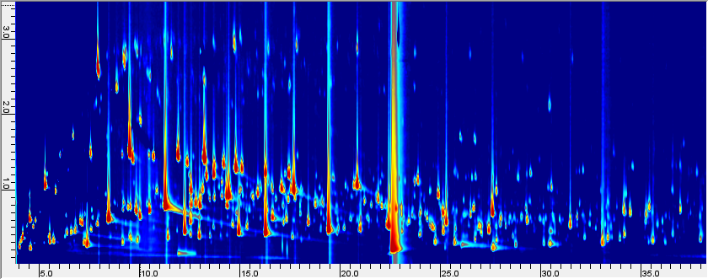
6th International Mass Spectrometry School
Definitions
The Gestalt concept in analytical science
Raw hazelnut volatiles - Rancid sample Origin Turkey
HS-SPME (CAR/PDMS/DVB) - 125 mg - 50°C/50 min
²D - volatility separation (DB17)
Chemical dimensions
¹D - polarity/volatility separation (PEG / Carbowax)
About 700 detectable features (2D peaks) over 20 S/N
Of them 250 reliably identified by 70 eV spectrum and I^{T} coherence
Various chemical classes highly correlated with autoxidation processes , enzymatic peroxidation,
aroma compounds and potent odorants
Cagliari (Italy), September 17-22, 2023

Slide 14
6th International Mass Spectrometry School
Definitions
The Gestalt concept in analytical science
Raw hazelnut volatiles - Rancid sample Origin Turkey HS-SPME (CAR/PDMS/DVB) - 125 mg - 50°C/50 min
Information dimensions
n-alkanes primary alcohols fatty acids saturated aldehydes unsaturated aldehydes monoterpenes
Cagliari (Italy), September 17-22, 2023

Slide 15
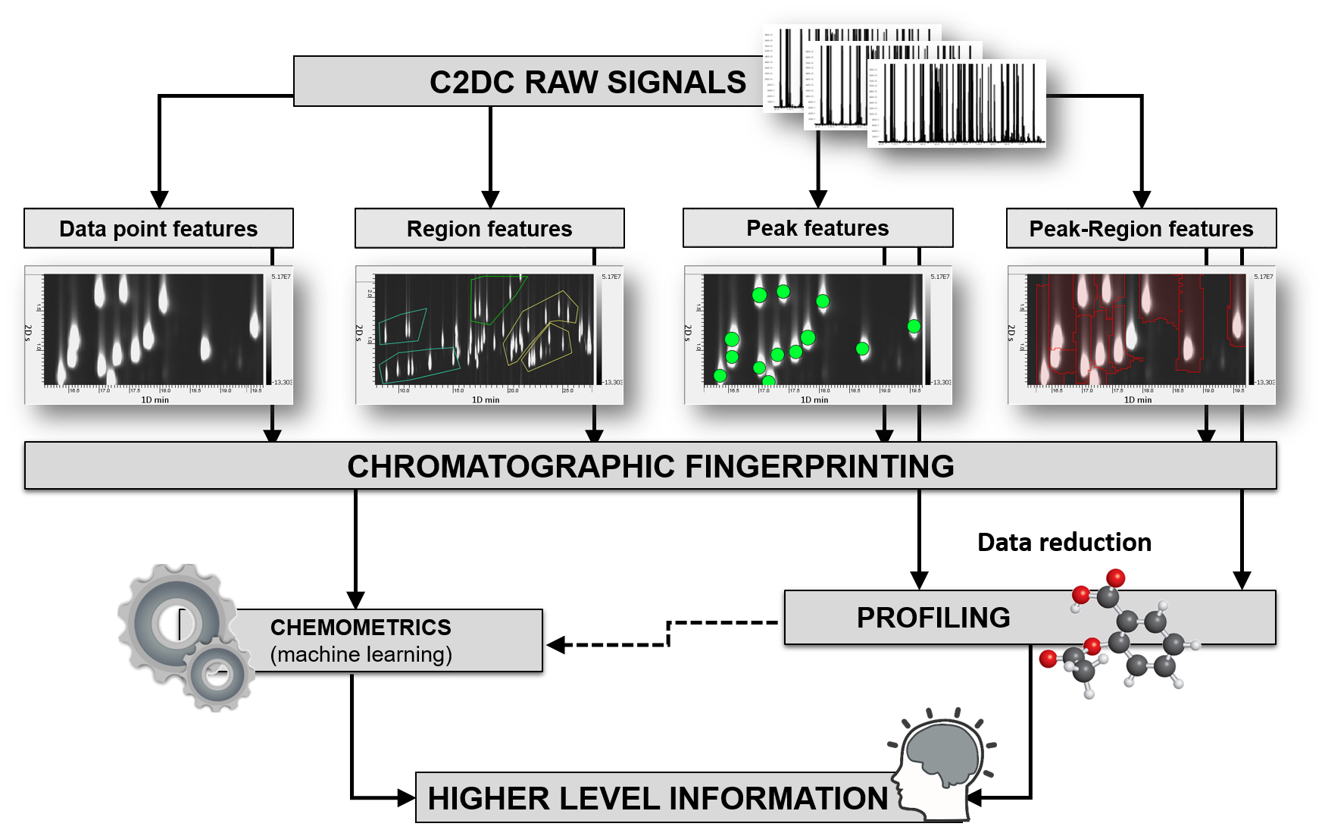
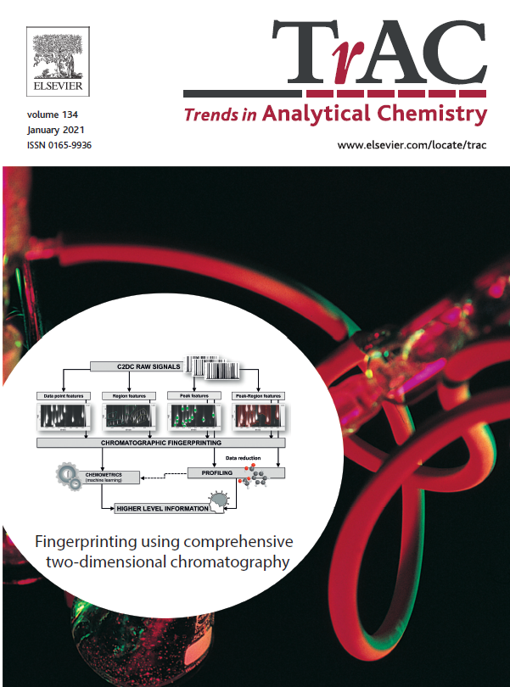
6th International Mass Spectrometry School
Application of AI
Pattern recognition
Data processing
Data analysis
Cagliari (Italy), September 17-22, 2023

Slide 16


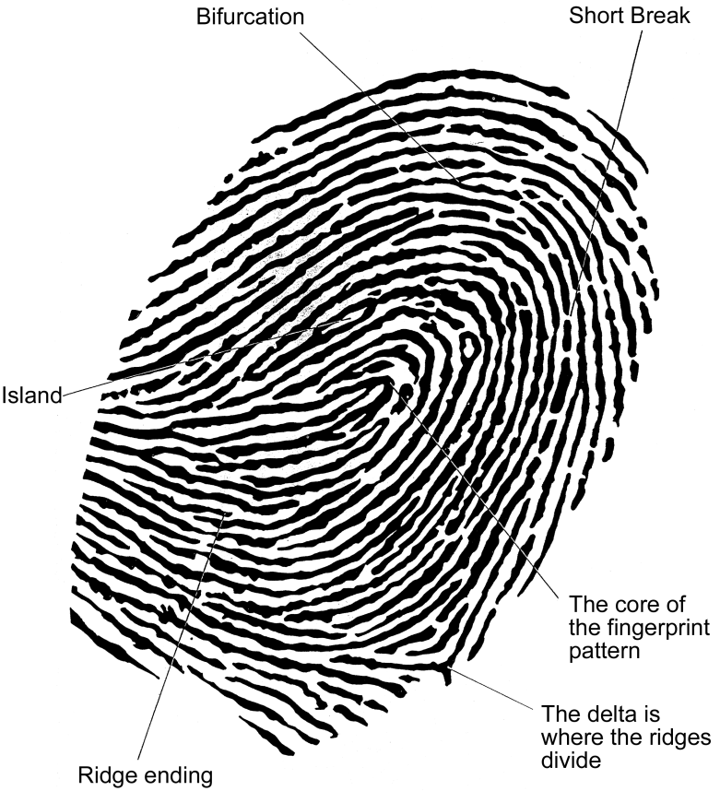
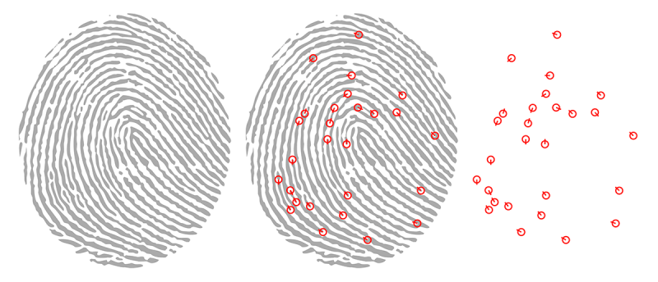
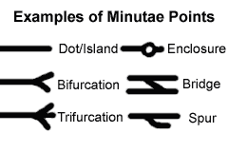
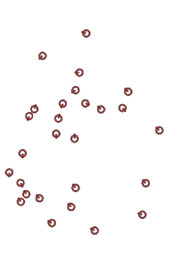
6th International Mass Spectrometry School
Application of AI
Pattern recognition
A fingerprint is the pattern of ridges and valleys on the surface of a fingertip
-> Everyone has unique fingerprints
Crime scene fingerprint
Database fingerprints
MATCH
bifurcation
lake
termination
spur
point
Cagliari (Italy), September 17-22, 2023

Slide 17
6th International Mass Spectrometry School
Application of AI
Pattern recognition
Untargeted - Targeted
Targeted - minutiae
UT - extended investigation
bifurcation
bifurcation
lake
lake
termination
termination
spur
spur
point
point
Cagliari (Italy), September 17-22, 2023

Slide 18
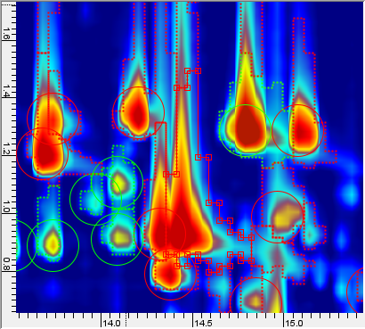
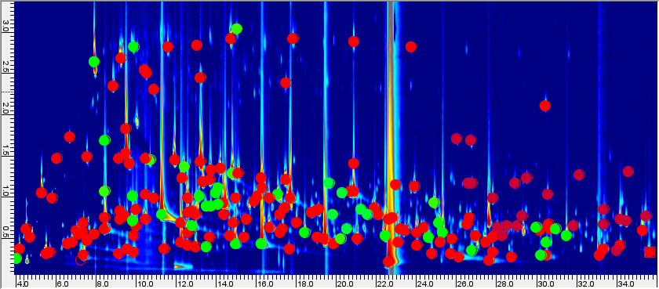
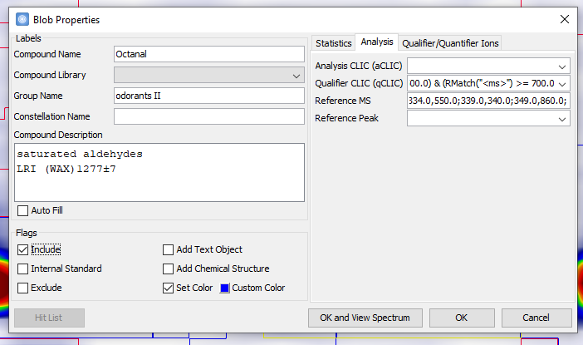
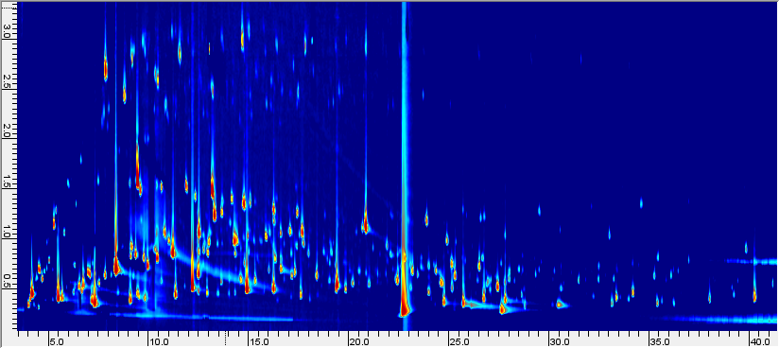
6th International Mass Spectrometry School
Application of AI
Pattern recognition
Untargeted/Targeted Fingerprinting¹⁻⁴ - comprehensive mapping
Target Template Construction (GC Image™)
file import , rasterization, colorization
baseline correction
2D peaks (blobs) detection and integration
Linear Retention Index (LRI) calibration
compound identification (NIST Algorithm)
build of template of known target peaks
2D plot
visualization
Raw hazelnut volatiles - Giresun Region harvest 2020 -HS-SPME (CAR/PDMS/DVB) - 125 mg - 50°C/50 min
GC×GC chromatograms are pre-targeted by locating known analytes and collecting their metadata (MS response, MS fragmentation, LRI, chemical names, informative role etc..). Unknowns are annotated and cross-matched by automatic processing.
[1] Magagna, F., Valverde-Som, L., Ruíz-Samblás, C., Cuadros-Rodríguez, L., Reichenbach, S. E., Bicchi, C., & Cordero, C. (2016). Analytica Chimica Acta, 936, 245–258.
[2] Reichenbach, S. E., Tian, X., Tao, Q., Ledford, E. B., Wu, Z., & Fiehn, O. (2011). Talanta, 83(4), 1279–1288
[3] Reichenbach, S. E., Zini, C. A., Nicolli, K. P., Welke, J. E., Cordero, C., & Tao, Q. (2019). Journal of Chromatography A, 1595, 158–167
[4] Cordero, C., Guglielmetti, A., Bicchi, C., Liberto, E., Baroux, L., Merle, P., … Reichenbach, S. E. (2019). Journal of Chromatography A, 1597, 132–141
Cagliari (Italy), September 17-22, 2023

Slide 19
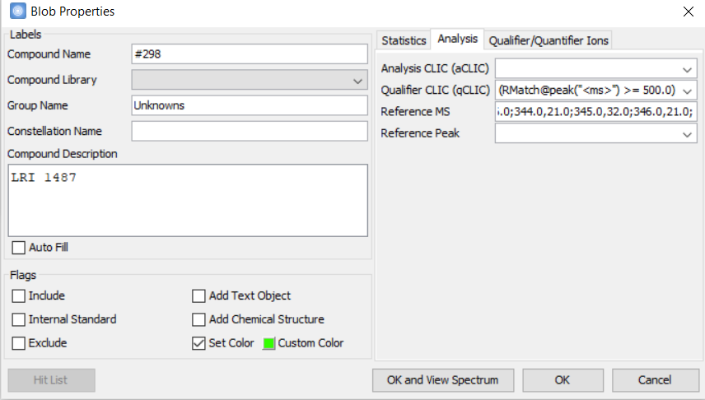
6th International Mass Spectrometry School
Application of AI
Untargeted/Targeted Fingerprinting¹⁻⁴ - comprehensive mapping
Pattern recognition
Known feature
Target analytes
Unknown feature
Untargeted analytes
Cagliari (Italy), September 17-22, 2023

Slide 20
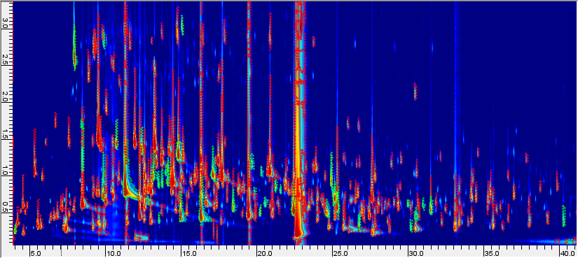
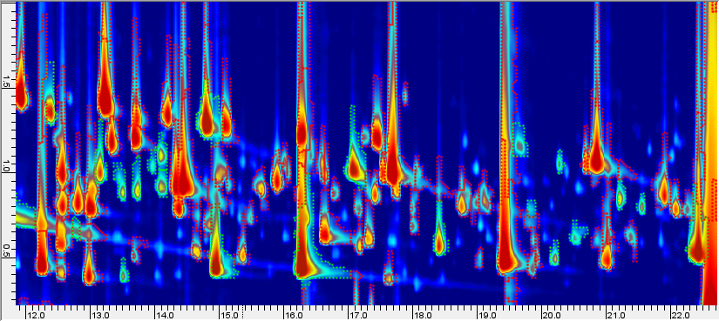
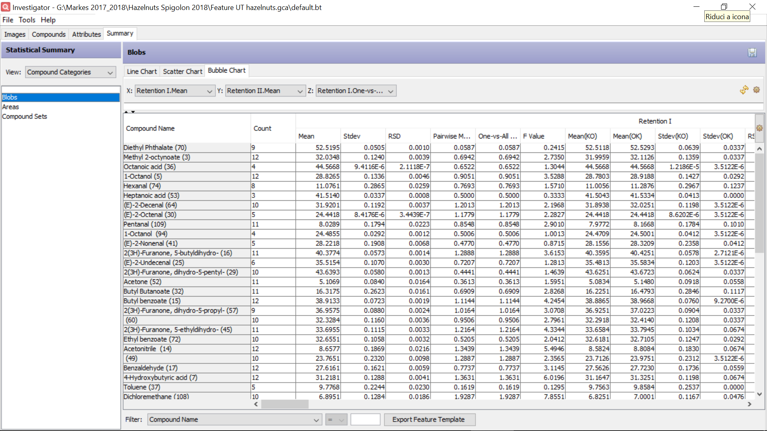
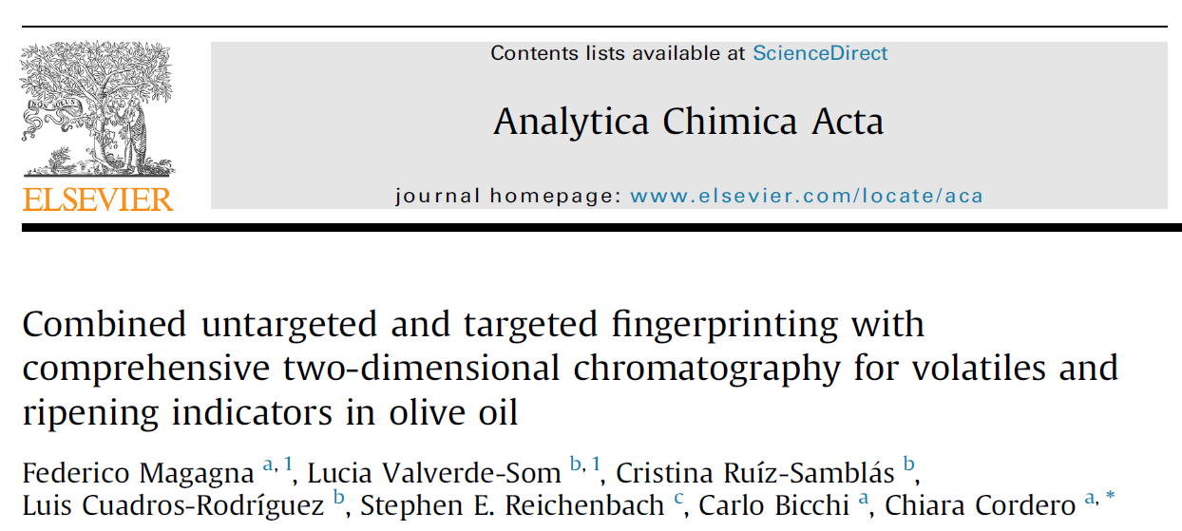
6th International Mass Spectrometry School
Application of AI
Pattern recognition
Targeted and untargeted peak(-region) features are cross-aligned between all samples and metadata collected for further processing.
Cagliari (Italy), September 17-22, 2023

Slide 21
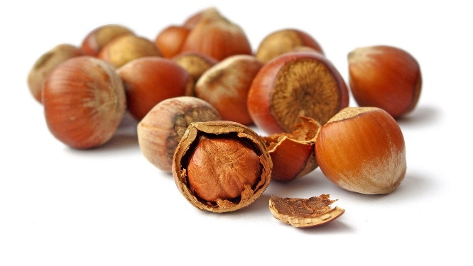
6th International Mass Spectrometry School
Application of AI
Computer vision and AI smelling
Raw ingredient for confectionery products
Turkey is the leading producer (about 75% of world production) Italy follows as second in the ranking
Industrial partner world leader in the production of confectionery products based on hazelnuts
Need for objective evaluation of quality
Quality assessment at industrial level focuses on morphological aspects, presence of damaged kernels, perceivable sensory defects (mould, rancid, cimiciato, stale etc..)
Step-ahead in quality assessment
molecular resolution probes:
qualification (oxidation status, shelf-life storage effectiveness, bacterial and mold grow)
identitation¹ (cultivar, origin, harvest area)
definition of aroma potential²
AI decision makers
Computer Vision in defected hazelnuts VOCs patterns
Smelling machine - aroma blueprint
Aroma precursors pattern
Corylus avellana L.
1. Cuadros-Rodríguez, L.; Ruiz-Samblás, C.; Valverde-Som, L.; Pérez-Castaño, E.; González-Casado, A. Anal. Chim. Acta 2016, 909, 9–23.
2. Cialiè Rosso, M.; Mazzucotelli, M.; Bicchi, C.; Charron, M.; Manini, F.; Menta, R.; Fontana, M.; Reichenbach, S. E.; Cordero, C. J. Chromatogr. A 2020, 1614 (460739)
Cagliari (Italy), September 17-22, 2023

Slide 22
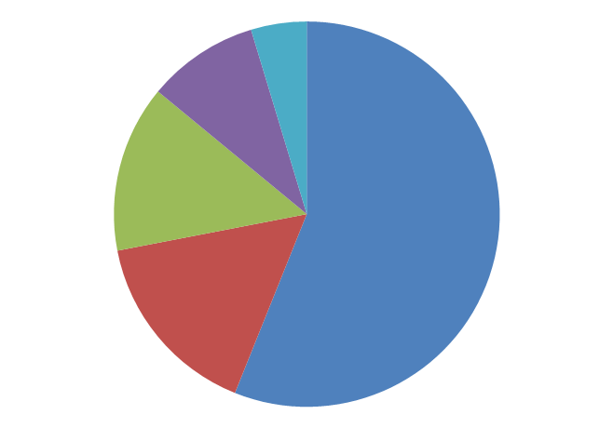

6th International Mass Spectrometry School
Application of AI
Computer vision and AI smelling
Volatiles < 0.001%
WATER (5%)
FIBER (10%)
Hydrocarbons
Terpenoids
Alcohols (linear and branched)
Carbonyl derivatives
Carboxylic acids
Esters
Lactones
PROTEINS & AMINO ACIDS (15%)
Encrypts a lot of information
geographical origin
phenotyping and chemotyping
multitrophic interactions (plants-insects)
presence of bacteria and moulds
scent and odorous compounds
distinctive aroma blueprint
FATS (60%)
CARBOHYDRATES
(17%)
Cagliari (Italy), September 17-22, 2023

Slide 23

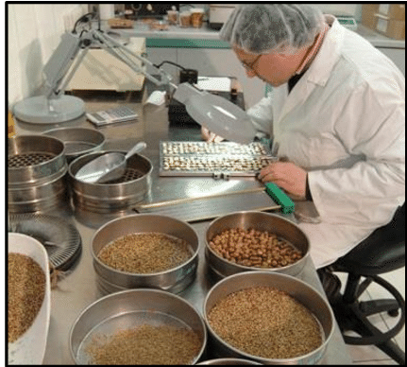
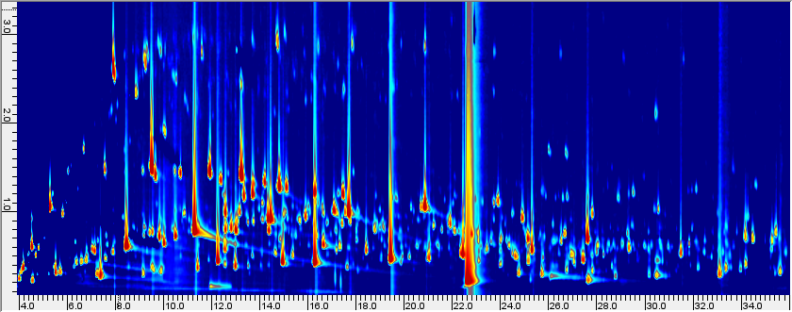
6th International Mass Spectrometry School
Application of AI
Computer vision and AI smelling
"... is a field of artificial intelligence (AI) that enables computers and systems to derive meaningful information from digital images....— and take actions or make recommendations based on that information.
If AI enables computers to think, computer vision enables them to see, observe and understand."³
Quality assessment at industrial level focuses on morphological aspects, presence of damaged kernels, perceivable sensory defects (mould, rancid, cimiciato, stale etc..)
AI decision-makers
Computer Vision in defected hazelnuts volatilome patterns
1. Dunkel, A.; Steinhaus, M.; Kotthoff, M.; Nowak, B.; Krautwurst, D.; Schieberle, P.; Hofmann, T. Angew. Chemie - Int. Ed. 53 (28) (2014) 7124–7143.
2. Nicolotti, L.; Mall, V.; Schieberle, P. J. Agric. Food Chem., 67 (2019) 4011–4022
3. https://www.ibm.com/topics/computer-vision
Cagliari (Italy), September 17-22, 2023

Slide 24






6th International Mass Spectrometry School
Application of AI
Computer vision and AI smelling
Computer Vision strategy
Classification trees
Collection of defected hazelnuts
harvest years
origin
shelf-life stage
Volatiles patterns diagnostic of spoilage
Computer Vision tools
Prompt identification of non-conform samples and confident rejection
Mould
Mould-rancid-solvent
Rancid
Rancid-stale
Solvent
Uncoded KO
Flash profiling
Good (OK)
Rancid (KO)
Spoiled (KO)
Cagliari (Italy), September 17-22, 2023

Slide 25


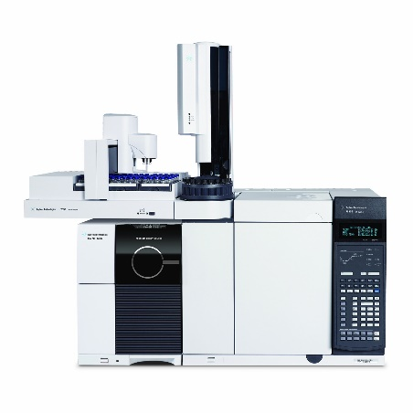
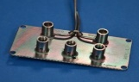
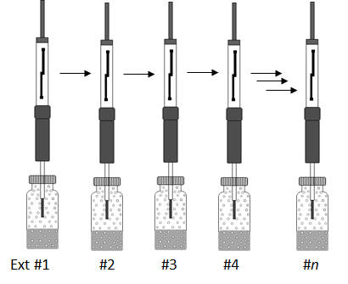
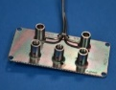
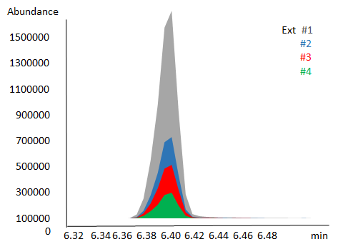
6th International Mass Spectrometry School
Application of AI
Computer vision and AI smelling
Tools
Headspace SPME
Platform
ISTDs Pre-loading
5 min
50°C
50 min
50°C
α and β-Thujone
100 mg/L (5.0 μL)
Hazelnuts
powder
0.100 g
Methyl-2-octynoate 100 mg/L (5.0 μL)
Multiple Headspace SPME - quantitation
MHS-SPME enables accurate quantitation
of several markers (ESTD and response factors)
secondary products of lipid oxidation (hexanal, heptanal, octanal, nonanal, (E)-2-octenal, (E)-2-nonenal );
key-aroma compunds (3-methylbutanal, ethyl 2-methylbutanoate, (E)-β-damascenone, 2-nonanone, heptanoic acid etc);
markers of defected hz (nonanoic acid, butyric acid, 4-heptanol, 1-pentanol, propanoic acid, 2-heptanol, pentanoic acid etc)
p_{i} p_{Aux} p_{Tee}
Tee-union
FID (70%)
MS (30%)
¹D - Polar Heavy Wax (J&W)
20 m × 0.18 mm × 0.18 µm
He carrier @ 0.4 mL/min
²D - Medium polarity OV17
1.8 m × 0.18 mm × 0.18 µm
He carrier @ 8 mL/min
Cagliari (Italy), September 17-22, 2023

Slide 26
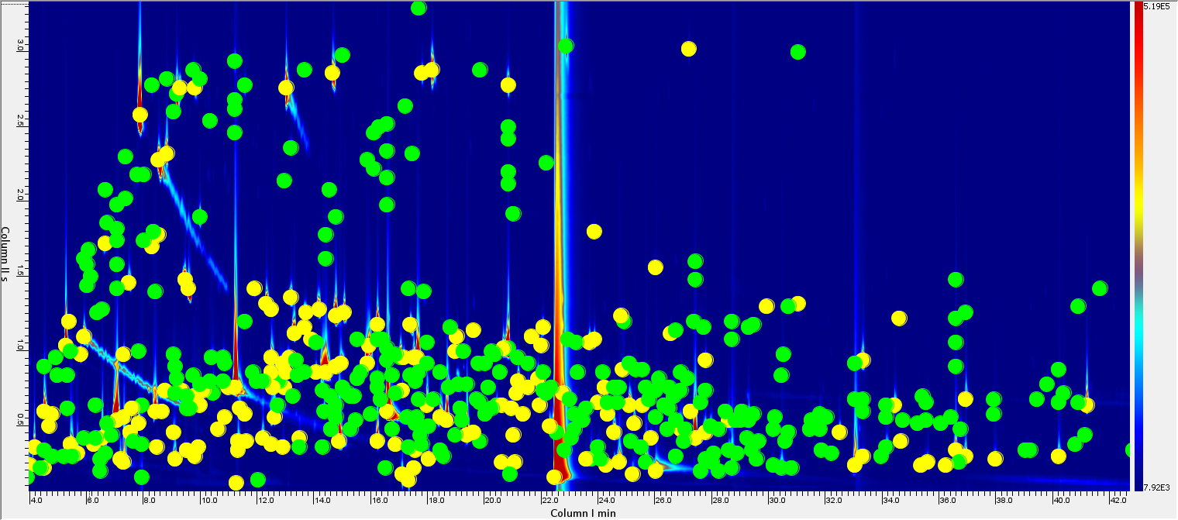
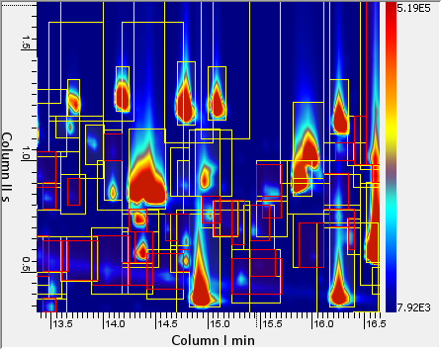
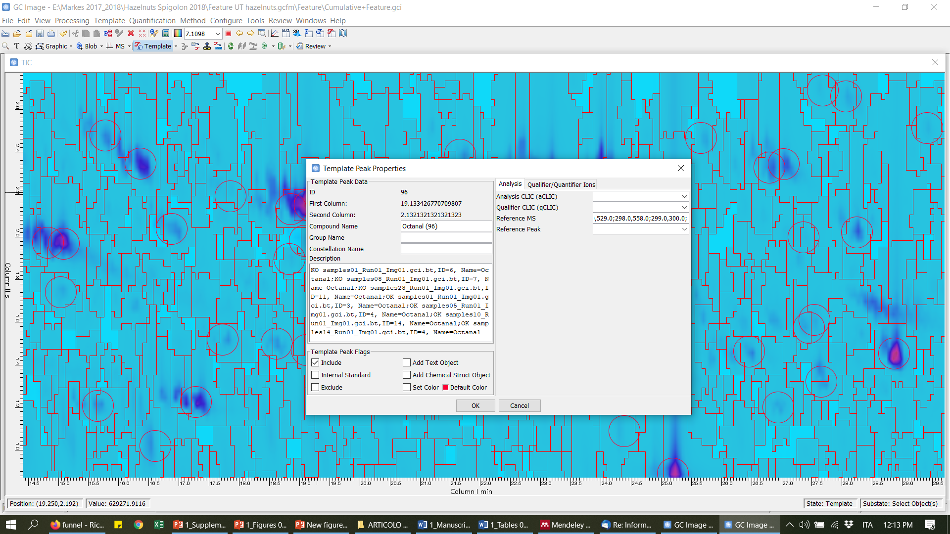
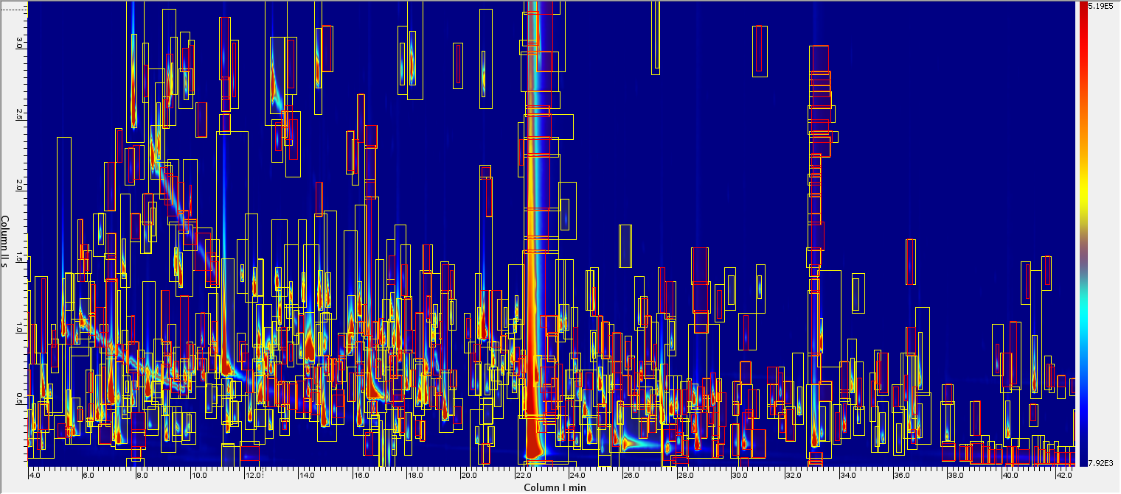
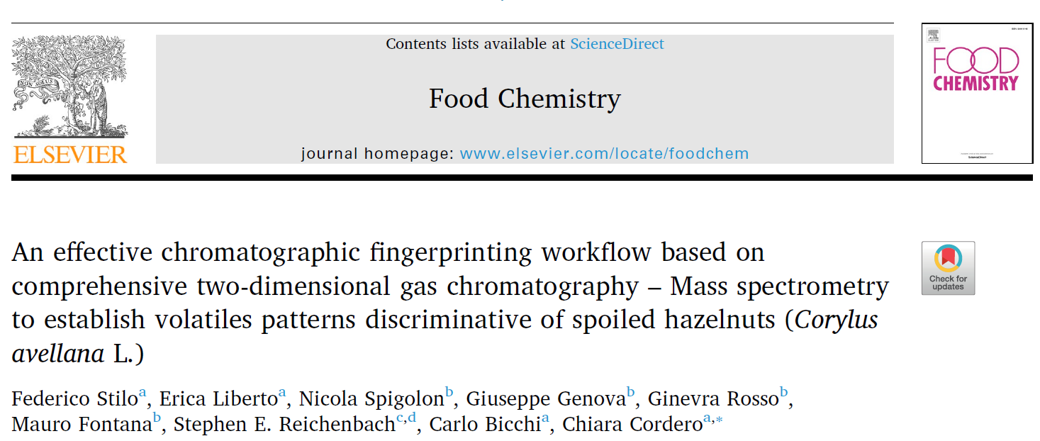
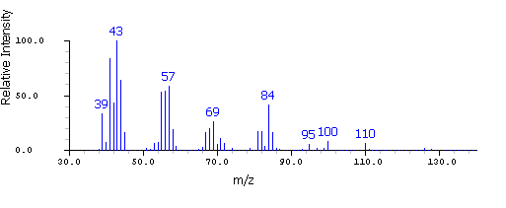
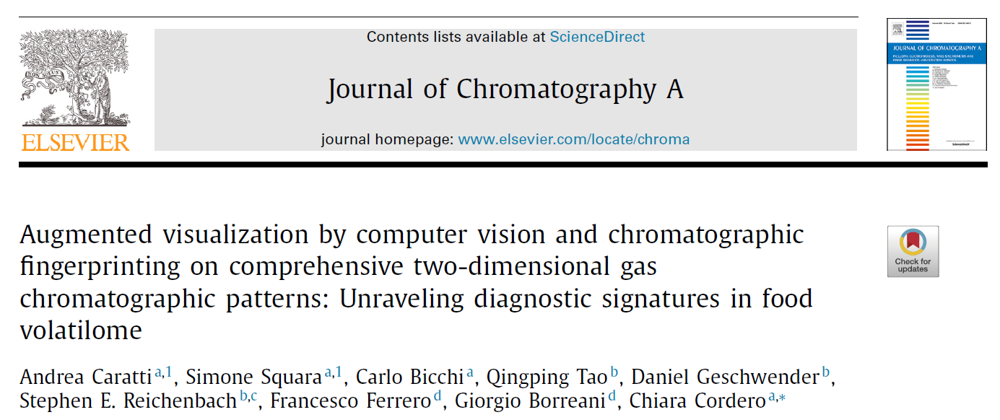
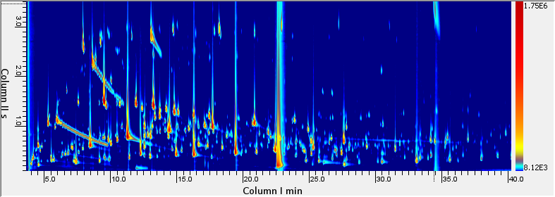
6th International Mass Spectrometry School
Application of AI
Computer vision and AI smelling
Untargeted/Targeted (UT) fingerprinting on single chromatograms
Generation of composite class-images from samples groups - one for each sensory defect
patterns re-alignment by reliable 2D peaks and raw data summation (composite image)
Cumulative class-image "Mould"
The effect of dominant variables (origin, harvest year, cultivar, shelf-life etc..) is minimized while the "signature" of mold sensory defect emphasized - easier detection
Cagliari (Italy), September 17-22, 2023

Slide 27
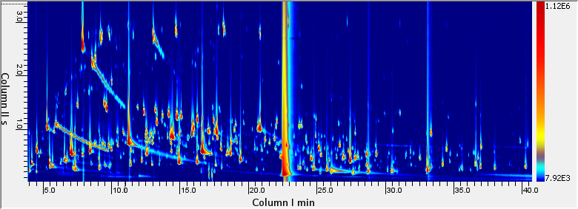
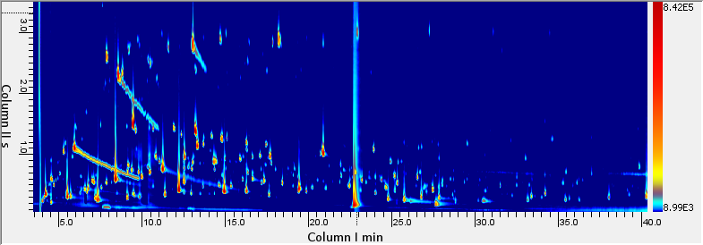
6th International Mass Spectrometry School
Application of AI
Computer vision and AI smelling
Composite class-images from samples groups - one for each sensory defect
Mould
Rancid-stale
Mould
Mould-rancid-solvent
Rancid
Rancid-stale
Solvent
Uncoded KO
Reference OK samples
Rancid
Solvent
Uncoded KO
Mould-rancid-solvent
OK samples
Cagliari (Italy), September 17-22, 2023

Slide 28

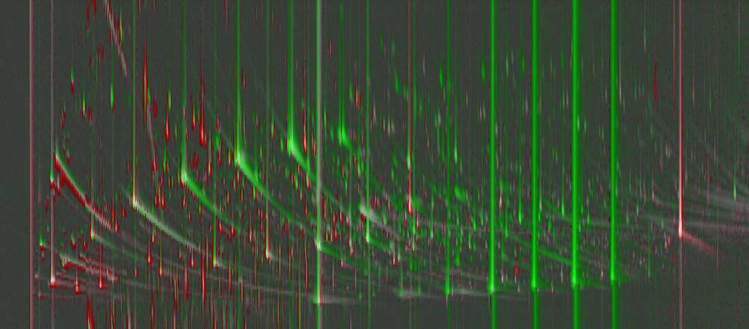
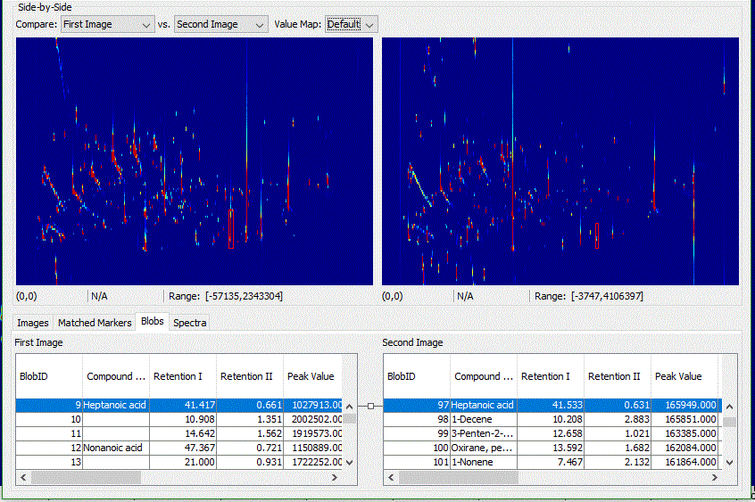
6th International Mass Spectrometry School
Application of AI
Computer vision and AI smelling
Mould
OK samples
A
Linear saturated aldehydes
Datapoint features fingerprinting combined to peak-regions UT fingerprinting
Computer vision and chemical patterns
Primary alcohols
Short-chain fatty acids
Cagliari (Italy), September 17-22, 2023

Slide 29
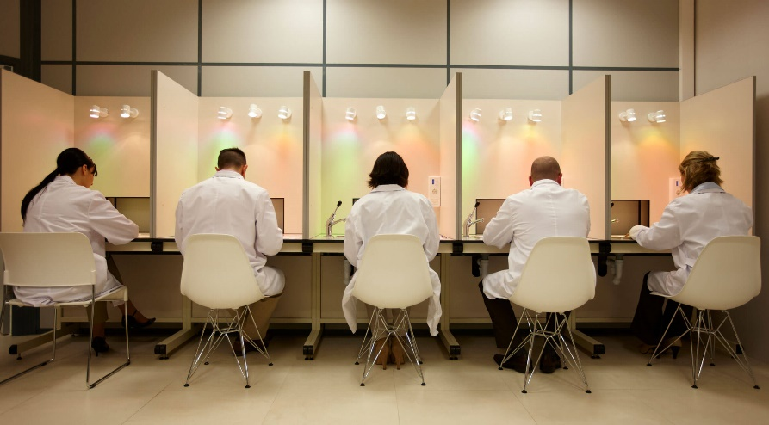
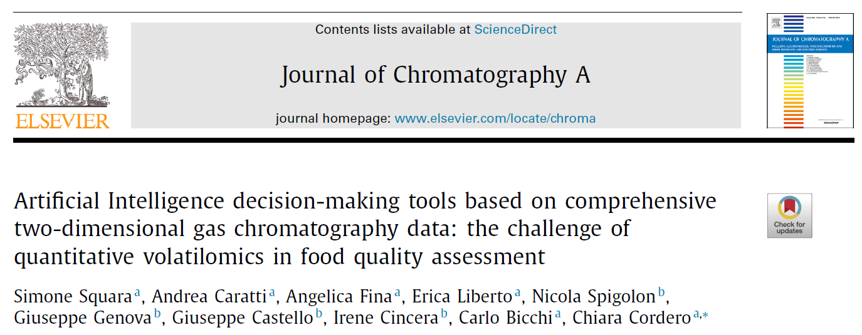
6th International Mass Spectrometry School
Application of AI
Computer vision and AI smelling
Quality assessment at industrial level focuses on morphological aspects, presence of damaged kernels, perceivable sensory defects (mould, rancid, cimiciato, stale etc..)
AI decision makers
AI Smelling machine - aroma blueprint
Cagliari (Italy), September 17-22, 2023

Slide 30

6th International Mass Spectrometry School
Application of AI
Computer vision and AI smelling
Artificial Intelligence smelling machine
Context: Sensomics¹
Principle: key-odorants and odorants patterns evoke specific smells/aroma qualities while contributing to define the overall flavor perception of a food - identity
Methods: extract, isolate, quantify potent odorants by reliable and robust methodologies
Outcome: Sensomics-Based Expert System² (SEBES) that predicts key-aroma signatures of food without using human olfaction.
[1] Dunkel, A.; Steinhaus, M.; Kotthoff, M.; Nowak, B.; Krautwurst, D.; Schieberle, P.; Hofmann, T. Angew. Chemie - Int. Ed. 53 (28) (2014) 7124–7143.
[2] Nicolotti, L.; Mall, V.; Schieberle, P. J. Agric. Food Chem., 67 (2019) 4011–4022
Cagliari (Italy), September 17-22, 2023

Slide 31

6th International Mass Spectrometry School
Application of AI
Computer vision and AI smelling
Develop a sensomics-based expert system acting as AI smelling machine
Key-aroma compounds - raw hazelnuts odorants occurring in amounts that exceed the OT (Odor Activity Value > 1).
Their omission in aroma recombinates does not reproduce the flavour blueperint of the original product.
 | ‘Tonda Romana’ | ‘Tonda Gentile’ | Akçakoca
hexanal | 3 | <1 | 8
3-methyl-4-heptanone | 141 | 126 | 93
5-methyl-(E)-2-hepten-4-one | 2 | 2 | 2
2-acetyl-1-pyrroline | 24 | 24 | 24
dimethyl trisulfide | 1 | 1 | 1
2-propionyl-1-pyrroline | 22 | 22 | 22
2-furfuryl mercaptan | 8 | 8 | 8
3-(methylthio)propionaldehyde | 15 | 15 | 15
3,5-dimethyl-2-ethylpyrazine | 1 | 1 | 1
2,3-diethyl-5-methylpyrazine | 9 | 9 | 9
3,7-dimethylocta-1,6-dien-3-ol | 12 | 12 | 12
2-acetyl-1,4,5,6-tetrahydropyridine | 46 | 46 | 46
2-acetyl-3,4,5,6-tetrahydropridine | 36 | 36 | 36
3-methylbutanoic acid | 2 | 1 | 1
(E,E)-2,4-nonadienal | 6 | 3 | 29
Aroma profile of raw hazelnuts from different cultivar/origin¹
1. Kiefl, J.; Schieberle, P. J. Agric. Food Chem. 2013, 61 (22), 5236–5244.
Cagliari (Italy), September 17-22, 2023

Slide 32


6th International Mass Spectrometry School
Application of AI
Computer vision and AI smelling
Strategy
Storage quality markers
1-heptanol (green, chemical),
2-octanol (metal, burnt), 1-octen-3-ol (mushroom), (E)-2-heptenal (fatty, almond), hexanal (leaf-like, green), heptanal (fatty), octanal (fatty) and nonanal (tallowy, fruity).
FID
Multiple Headspace SPME
Accurate quantification / ESTD and RF
FID
46 analytes
key-aromas
markers
Key-aroma compounds
Differential-flow modulator
parallel detection qMS/FID
MS TIC
Spoiled hazelnuts markers
octanoic acid positively correlated to mould; ƴ-nonalactone, ƴ-hexalactone, acetone, and 1-nonanol are decisive to classify OK and rancid samples; heptanoic and hexanoic acids and ƴ-octalactone are present in rancid-solvent and rancid-stale samples.
Cagliari (Italy), September 17-22, 2023

Slide 33

6th International Mass Spectrometry School
Application of AI
Computer vision and AI smelling
Artificial Intelligence smelling
Aroma blueprint - OAVs >1
OAVs (log scale)
OAVs (log scale)
Artificial Intelligence smelling
Aroma blueprint of spoiled hazelnuts OAVs >1
Cagliari (Italy), September 17-22, 2023

Slide 34



6th International Mass Spectrometry School
Application of AI
Pattern recognition
Computer Vision
Artificial Intelligence smelling
Good (OK)
Rancid (KO)
Spoiled (KO)
OAVs (log scale)
Cagliari (Italy), September 17-22, 2023

Slide 35




6th International Mass Spectrometry School
Application of AI
Fingerprinting/profiling by pattern recognition
Computer Vision
and Augmented Visualization
Artificial Intelligence
smelling machine
molecular resolution tool
Cagliari (Italy), September 17-22, 2023

Slide 36
6th International Mass Spectrometry School
Take home messages
Artificial Intelligence opens new opportunities in mature areas of analytical chemistry
Omics takes great advantages of AI application
Multidimensional analytical platforms implementing MS are a Gestalt
Application of AI makes effective complex tasks
Pattern recognition -> sample fingerprinting
Computer Vision and Augmented visualization -> promptly reveal samples differences and give access to compositional information
Artificial Intelligence smelling machine are a great support to panel testing and human sensory analysis
Cagliari (Italy), September 17-22, 2023

