Slide 1





A Dementia Friendly Community-led educational intervention to reduce dementia-related stigma
Daniela Berardinelli, RN, PhD student Medical Physiopathology
University of Turin, Italy
Department of Public Health and Pediatrics

Slide 2

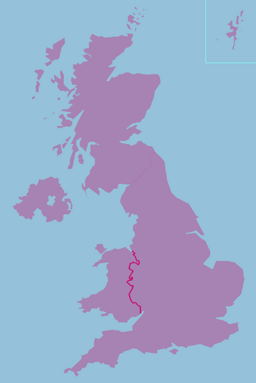
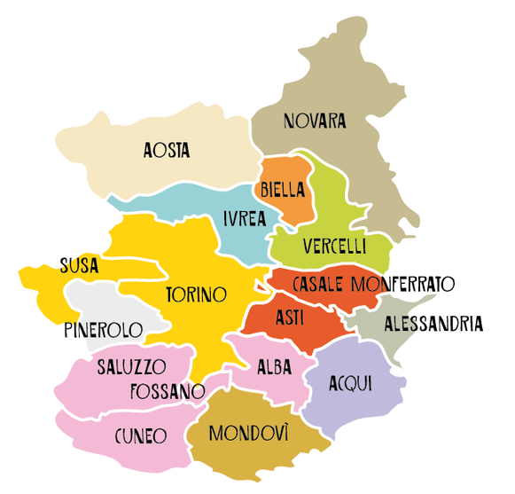





Where we started from

Slide 3

“A city, town, or village where people with dementia are understood, respected, supported, and confident that they can contribute to the life of their community. In a dementia-friendly community, residents will understand dementia, and people with dementia will feel included and involved, and have choice and control over their own lives.”

Slide 4
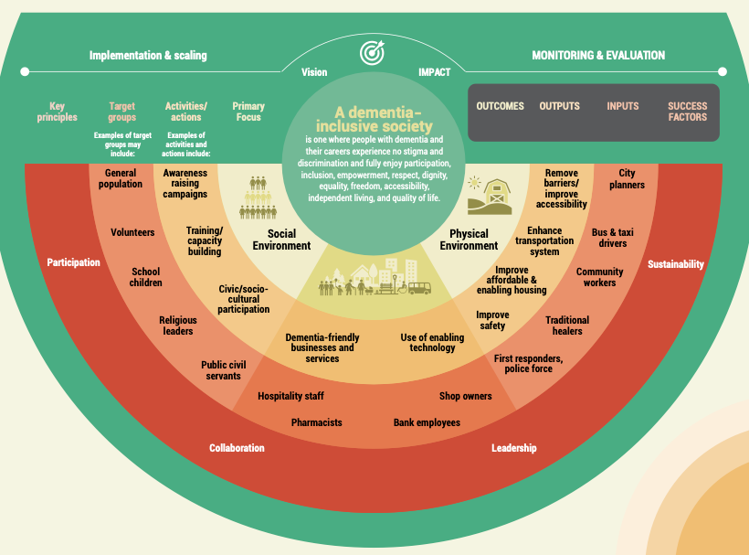
WHO TOOLKIT
for dementia-friendly initiatives (DFIs)

Slide 5
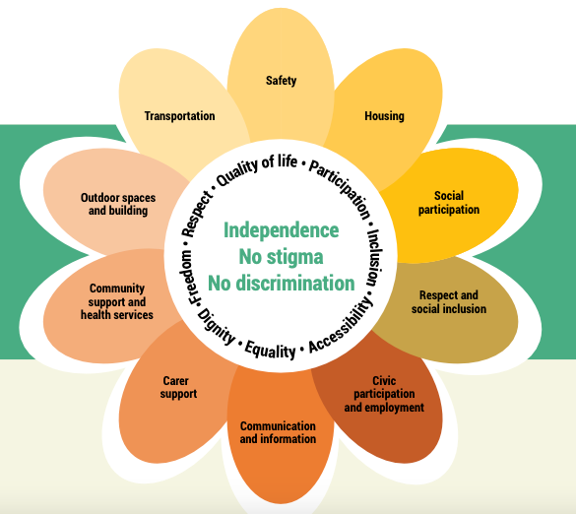

Towards a dementia
inclusive society
WHO TOOLKIT
for dementia-friendly initiatives (DFIs)

Slide 6




Slide 7

Towards a dementia inclusive society
Identify partner and stakeholders’ roles and responsibilities
Estimate resources required to
implement each activities and
strategies to coordinate these
Focus on the specific target groups
WHO TOOLKIT
for dementia-friendly initiatives (DFIs)

Slide 8
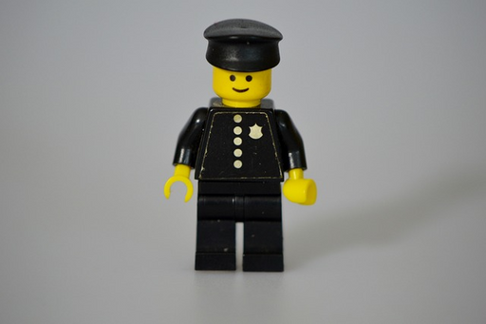


Target Groups
FIRST RESPONDERS
POLICE FORCE
PHARMACISTS
VOLUNTEERS
GENERAL POPULATION
SCHOOL STUDENTS

Slide 9


1st Educational intervention
First responders,
police force,
pharmacists, and
volunteers

Slide 10

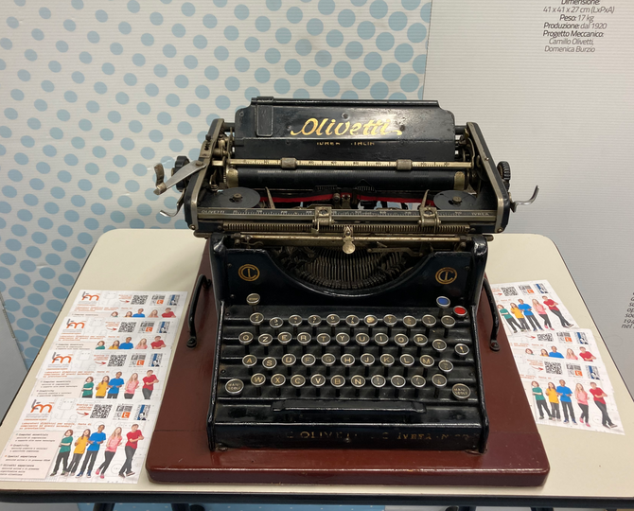
WHY
WHAT
WHERE
high frequency of possible encounters and proximity
practical examples
and ethical
communication
guidelines
University of Turin- Ivrea

Slide 11

2nd Educational
intervention
General population

Slide 12
WHY
WHAT
WHERE
Informative and supportive communication
Awareness
Engagement

Slide 13







3rd Educational intervention
School students

Slide 14

WHY
WHAT
WHERE
Building a
dementia-friendly young generation
Peer-to-peer learning and education

Slide 15


What’s next?
Dissemination and contamination

Slide 16
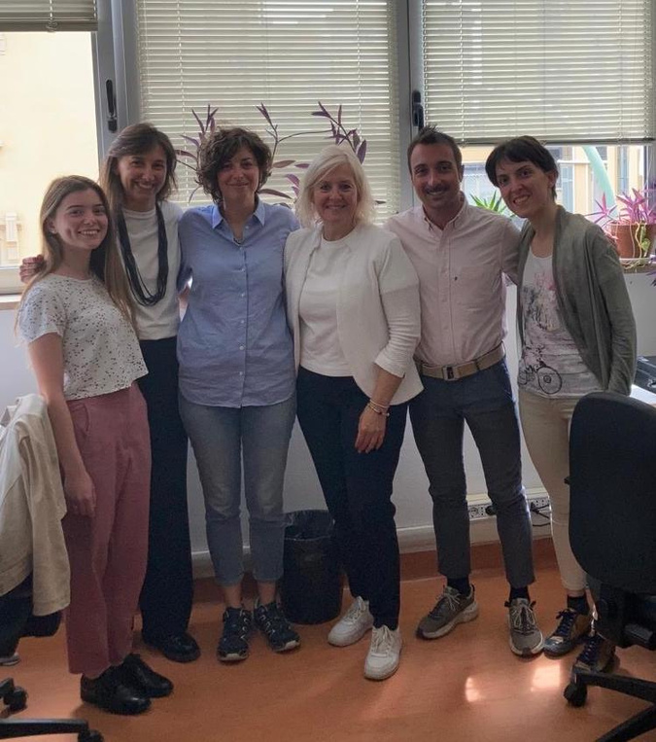
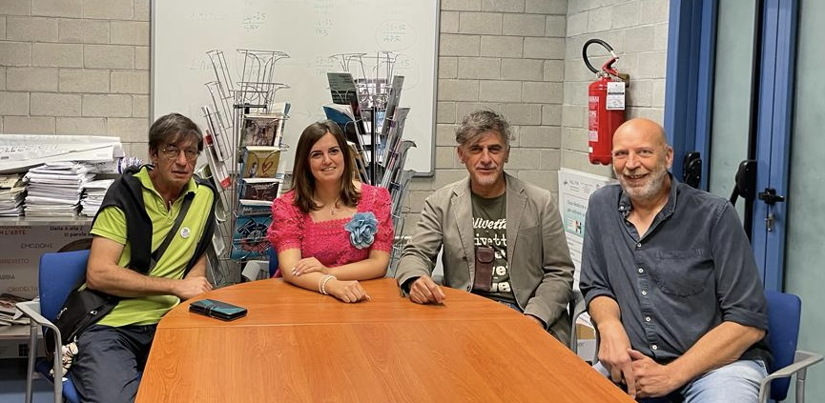
University of
Turin- Ivrea

