Slide 1
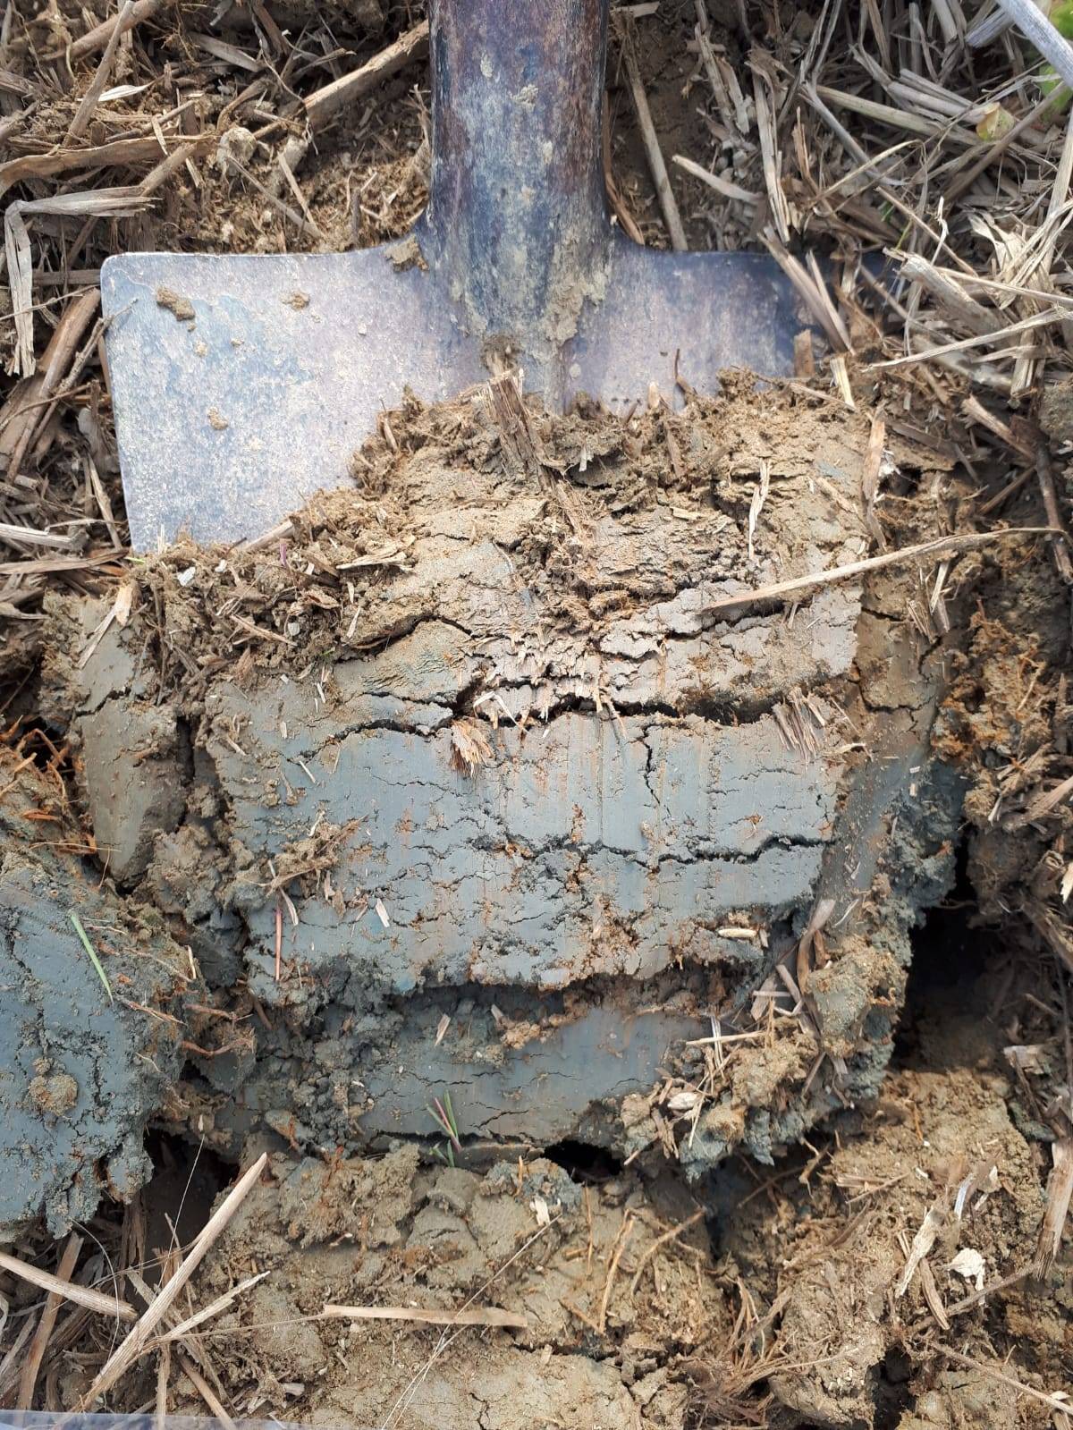






Vienna, Austria & Online | 23 - 27 May 2022
Assessing phosphorus
availability to paddy rice:
soil testing and plant responses
Martinengo S., Schiavon M., Santoro V., Said-Pullicino D., Celi L., Martin M.
Funding: P-rice Fosforo in risaia: equilibrio tra produttività e ambiente nell'ottica delle nuove pratiche agronomiche
PSR Lombardia 2014-2020

Slide 2

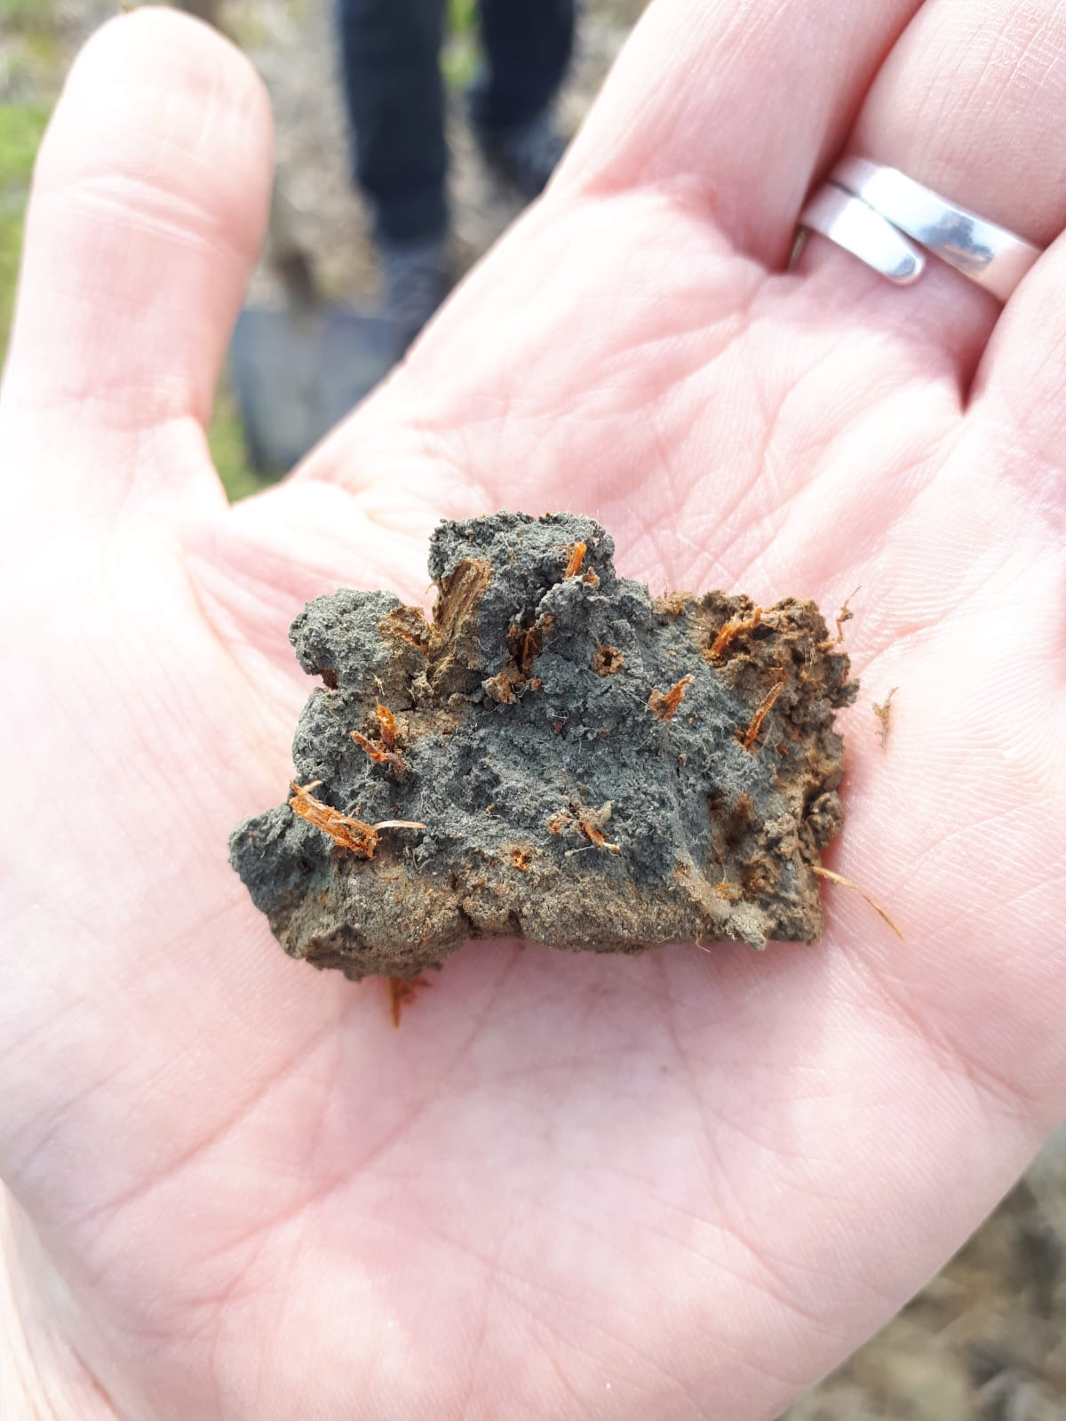

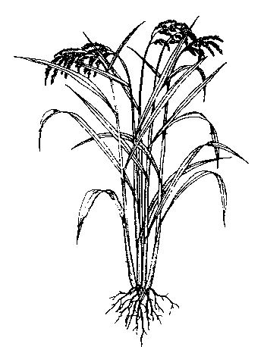
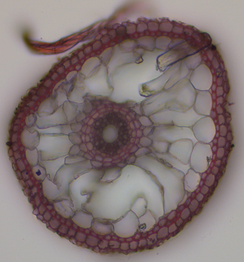
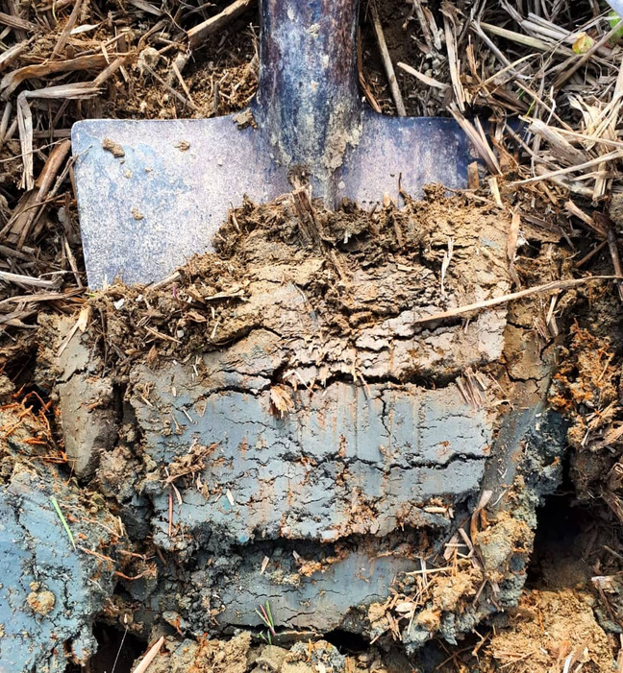
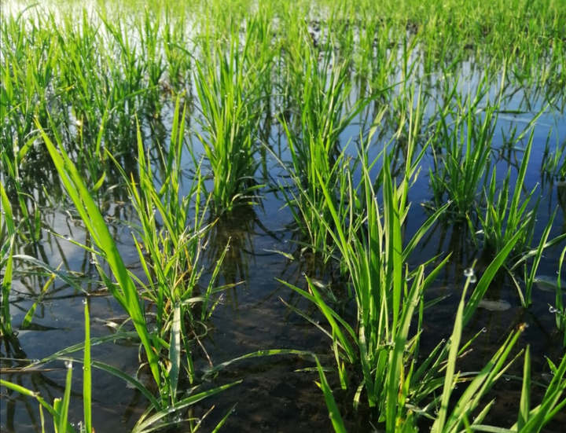
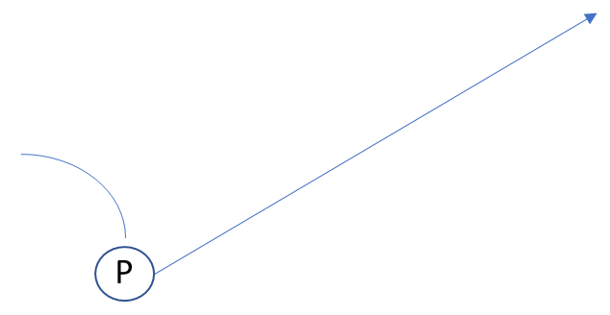
P in paddy soils and plant responses
in reducing conditions
root anatomy modification
AERENCHYMATIC TISSUES
→ Radial Oxygen Losses
which extraction method best represents P availability under reducing conditions?
Fe²⁺ → Fe³⁺
Root Fe-plaque formation
Fe-P complex at rhizospheric level
Fe
OXIDES
dissolution
how does plant affect P availability?
SOIL
SOLUTION
precipitation
REDUCTIVE DISSOLUTION
plant
uptake
Is reductive dissolution responsible of P availability increase under reducing conditions?
Fe³⁺ → Fe²⁺
Root development
Enzymatic activity
Phosphate root transporter
Rhizodepotion
plant responses to different soil P availability

Slide 3




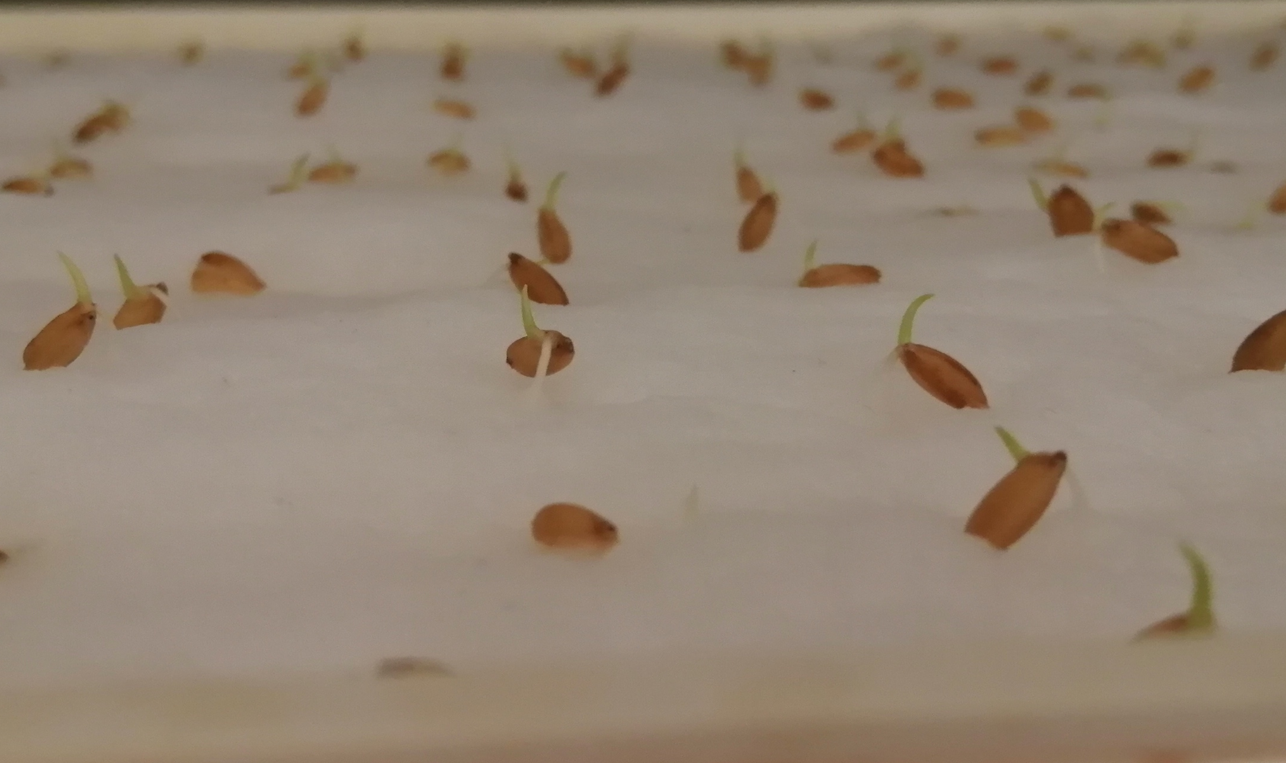
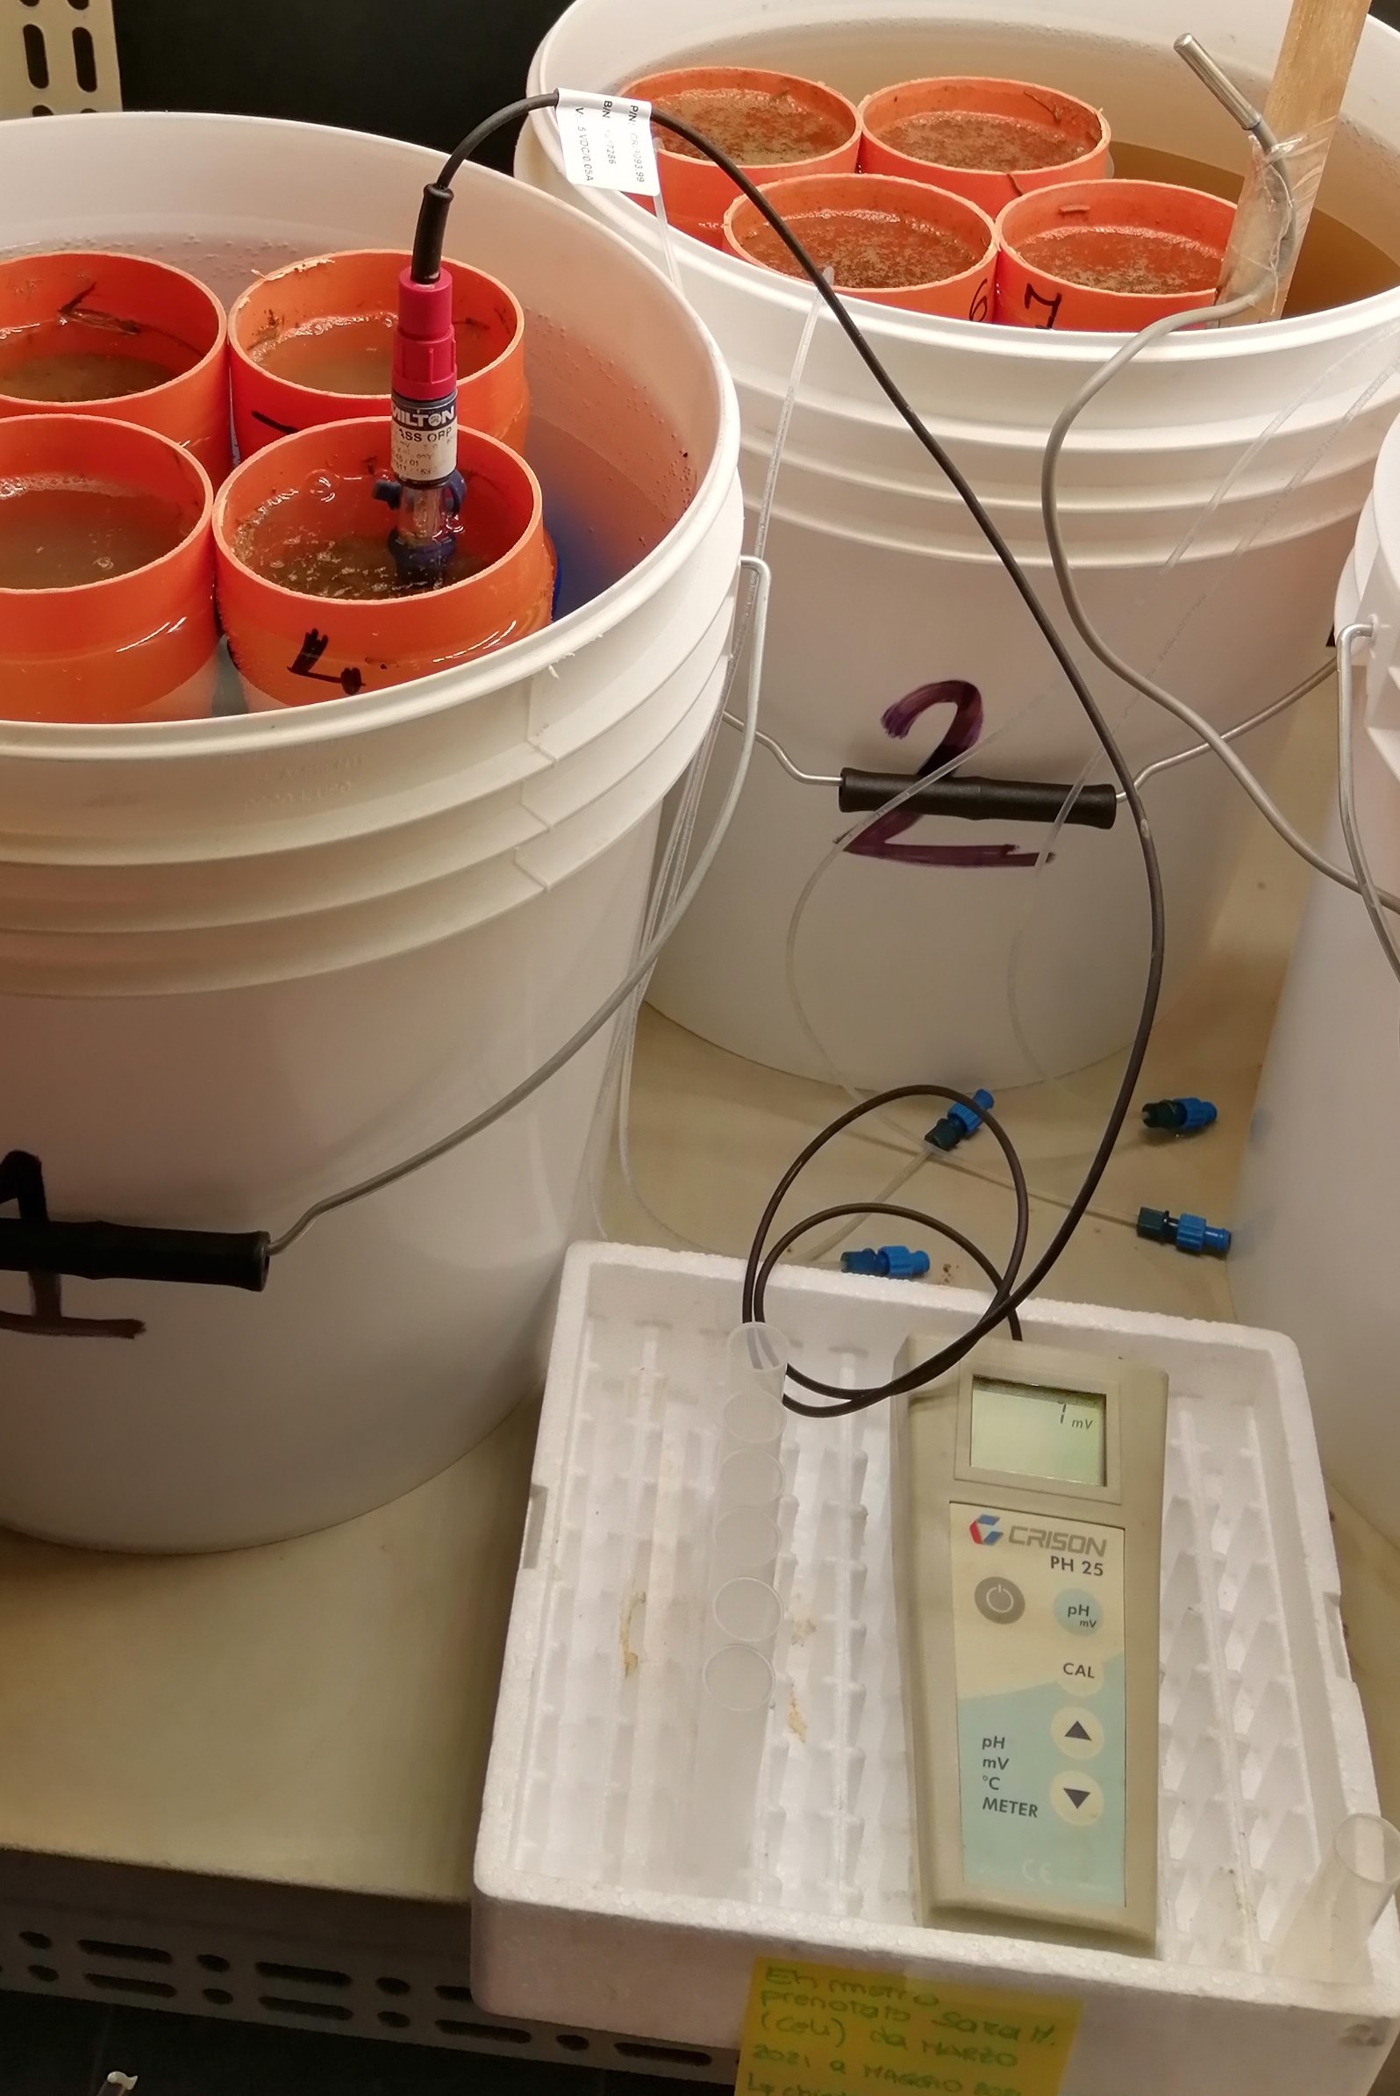
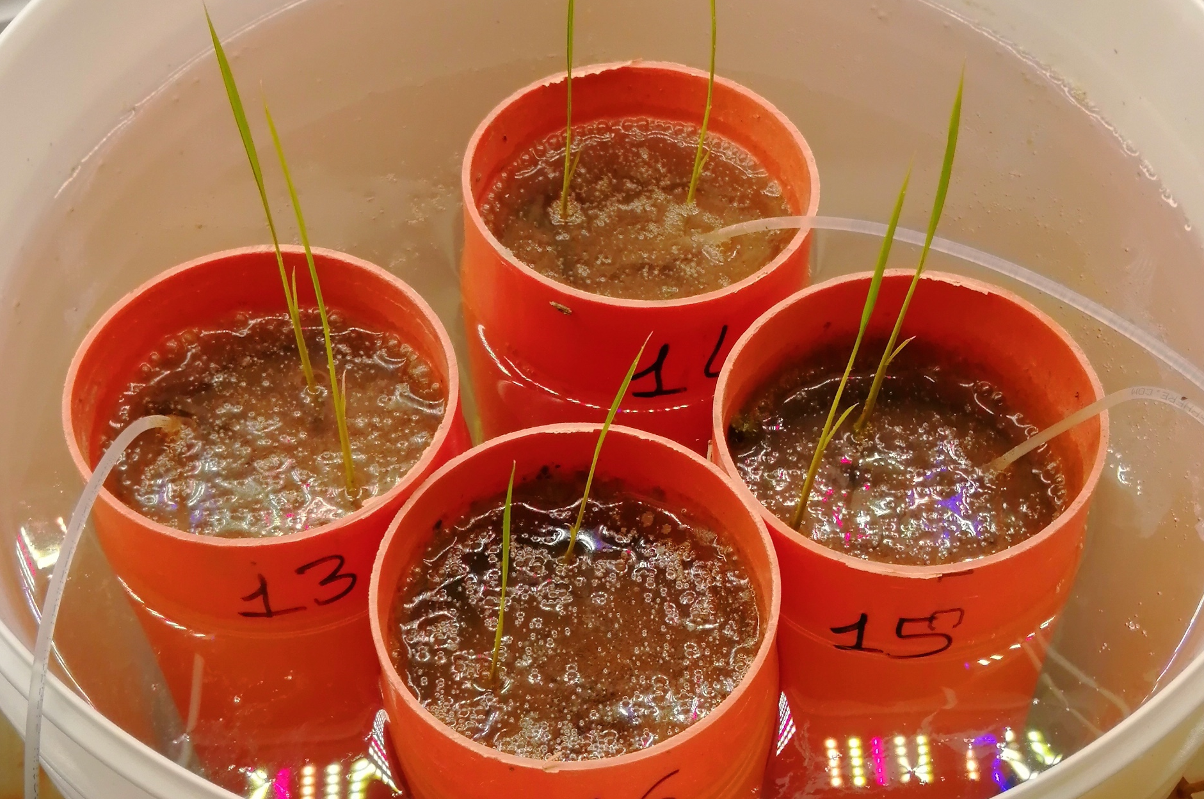
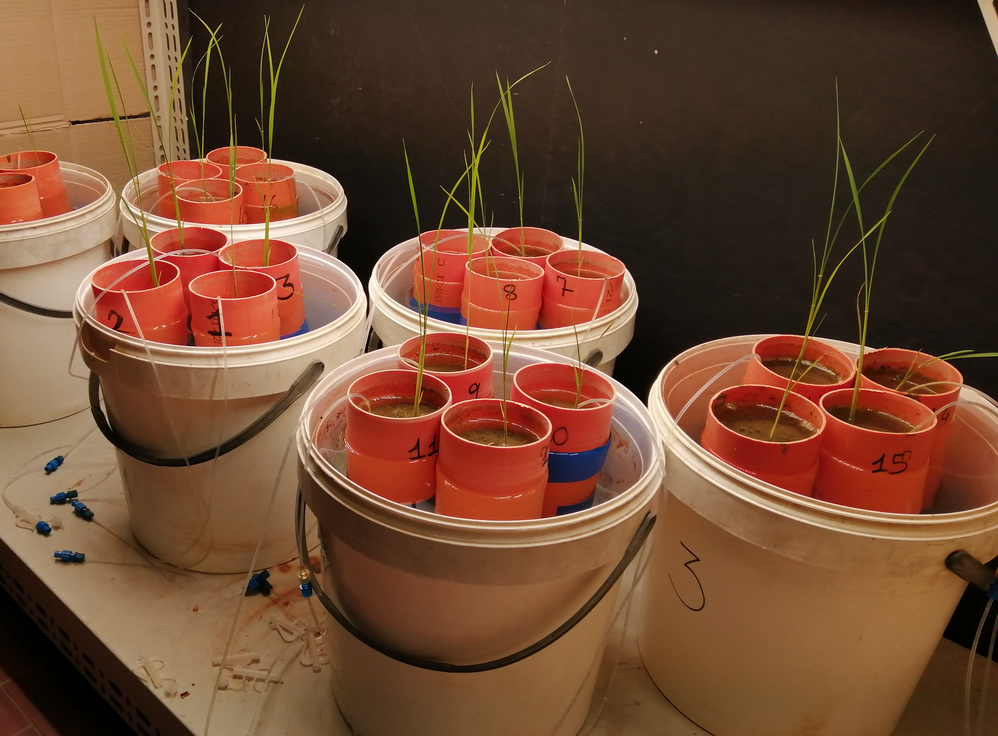
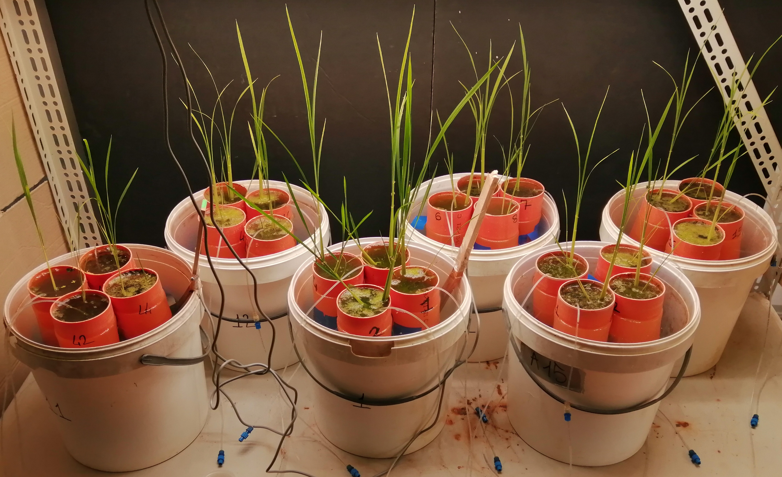
Methods
Pot experiment: 12 paddy soils (grouped in high, medium and low P)
High P
Medium P
Low P
PLANT HARVESTING
POT PREPARATION
60 days rice growth under continuos flooding
SOIL SAMPLES
SOIL SOLUTION SAMPLES
PLANT SAMPLES
soil P supply quantification
Release kinetics of:
Plant P uptake
Responces to P starvation
Iron - Fe(II)
Phosphorus (P)
P extractants
calcium chloride (soil solution P)
Olsen – Mehlich III (losely bound P)
anion exchange resins (desorbable P)
EDTA (Fe complexant)
Citrate-ascorbate
(P competitor; Fe reducer)
Oxalate (P competitor; Fe complexant)
Total P concentration in plant tissues
Root biomass;
Enzymatic activity;
P transporter gene expression

Slide 4

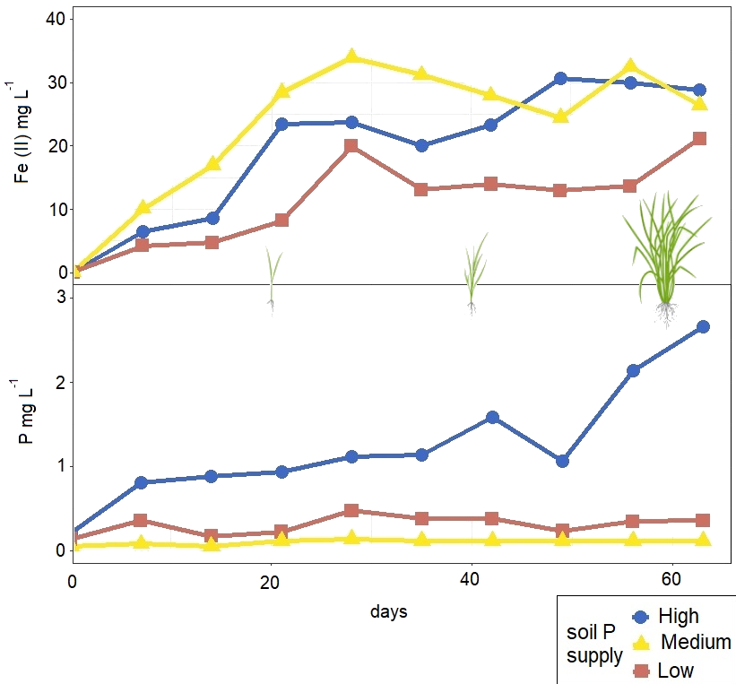
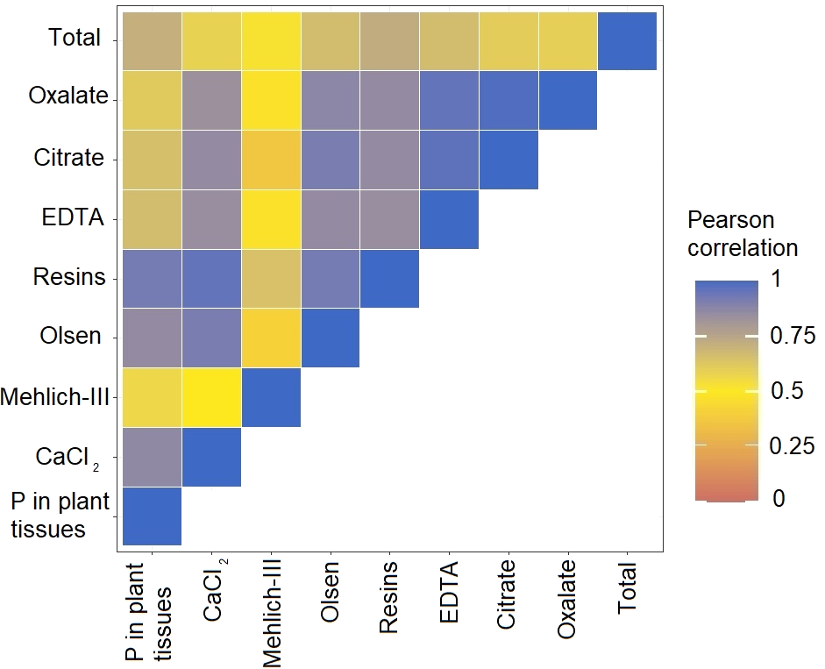

P availability and plant uptake
Precipitation of Fe in soil solution
Fe(II) increase due to reductive dissolution
BEST CORRELATION WITH P IN PLANT TISSUES
Increasing plant P demand from soil solution
Temporal shift between P relase from Fe minerals and plant uptake from soil solution
P release from Fe oxides dissolution
P decreasing due to co-precipitation

Slide 5

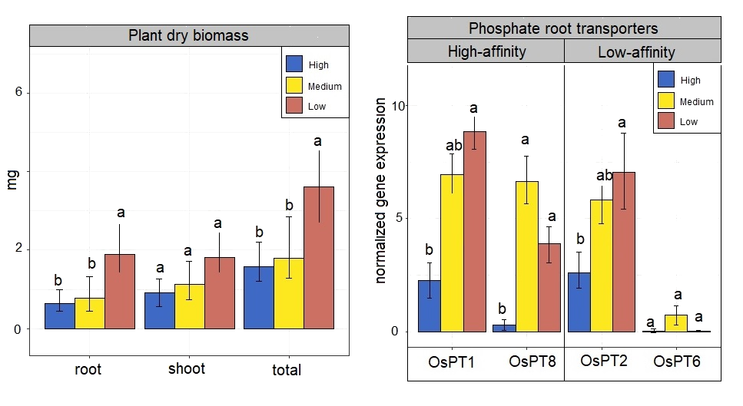
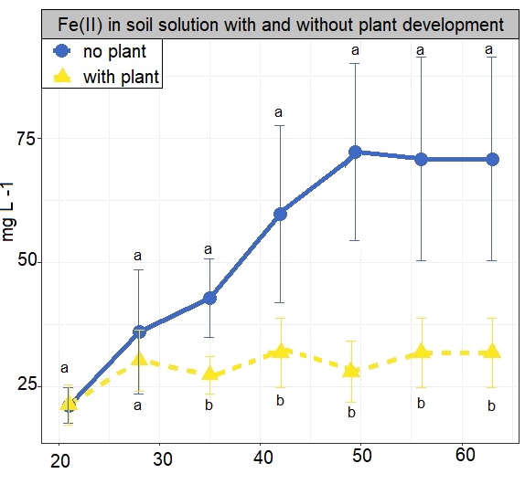
Plant responses to P availability
The rhizosphere layer could be more oxidized than the bulk soil
Increase in root biomass
Lower concentration of Fe(II) in solution
LP>MP>HP
Increase in root P transporter gene expression

Slide 6

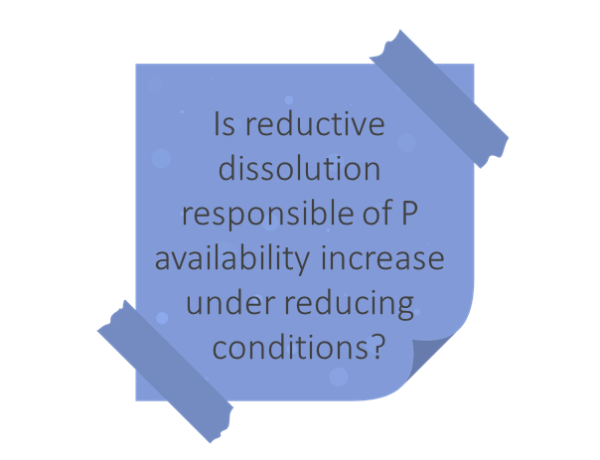
Conclusions
root anatomy modification
AERENCHYMATIC TISSUES
→ Radial Oxygen Losses
which extraction method best represents P availability under reducing conditions?
Fe²⁺ → Fe³⁺
Temporal shift between P relase from Fe minerals and plant uptake from soil solution
The rhizosphere layer could be more oxidized than the bulk soil
Root Fe-plaque formation
Fe-P complex at rhizospheric level
Although rice cultivation is under flooding, plant ROL makes the rhizosphere aerobic
Anion exchanging resins best predict P availability under reducing condition because they are an estimation of soil re-supply capacity
Fe
OXIDES
dissolution
how does plant affect P availability?
precipitation
SOIL
SOLUTION
REDUCTIVE DISSOLUTION
plant
uptake
Fe³⁺ → Fe²⁺
plant responses to differnt soil P availability
Root development
Enzymatic activity
Phosphate root transporter

Slide 7
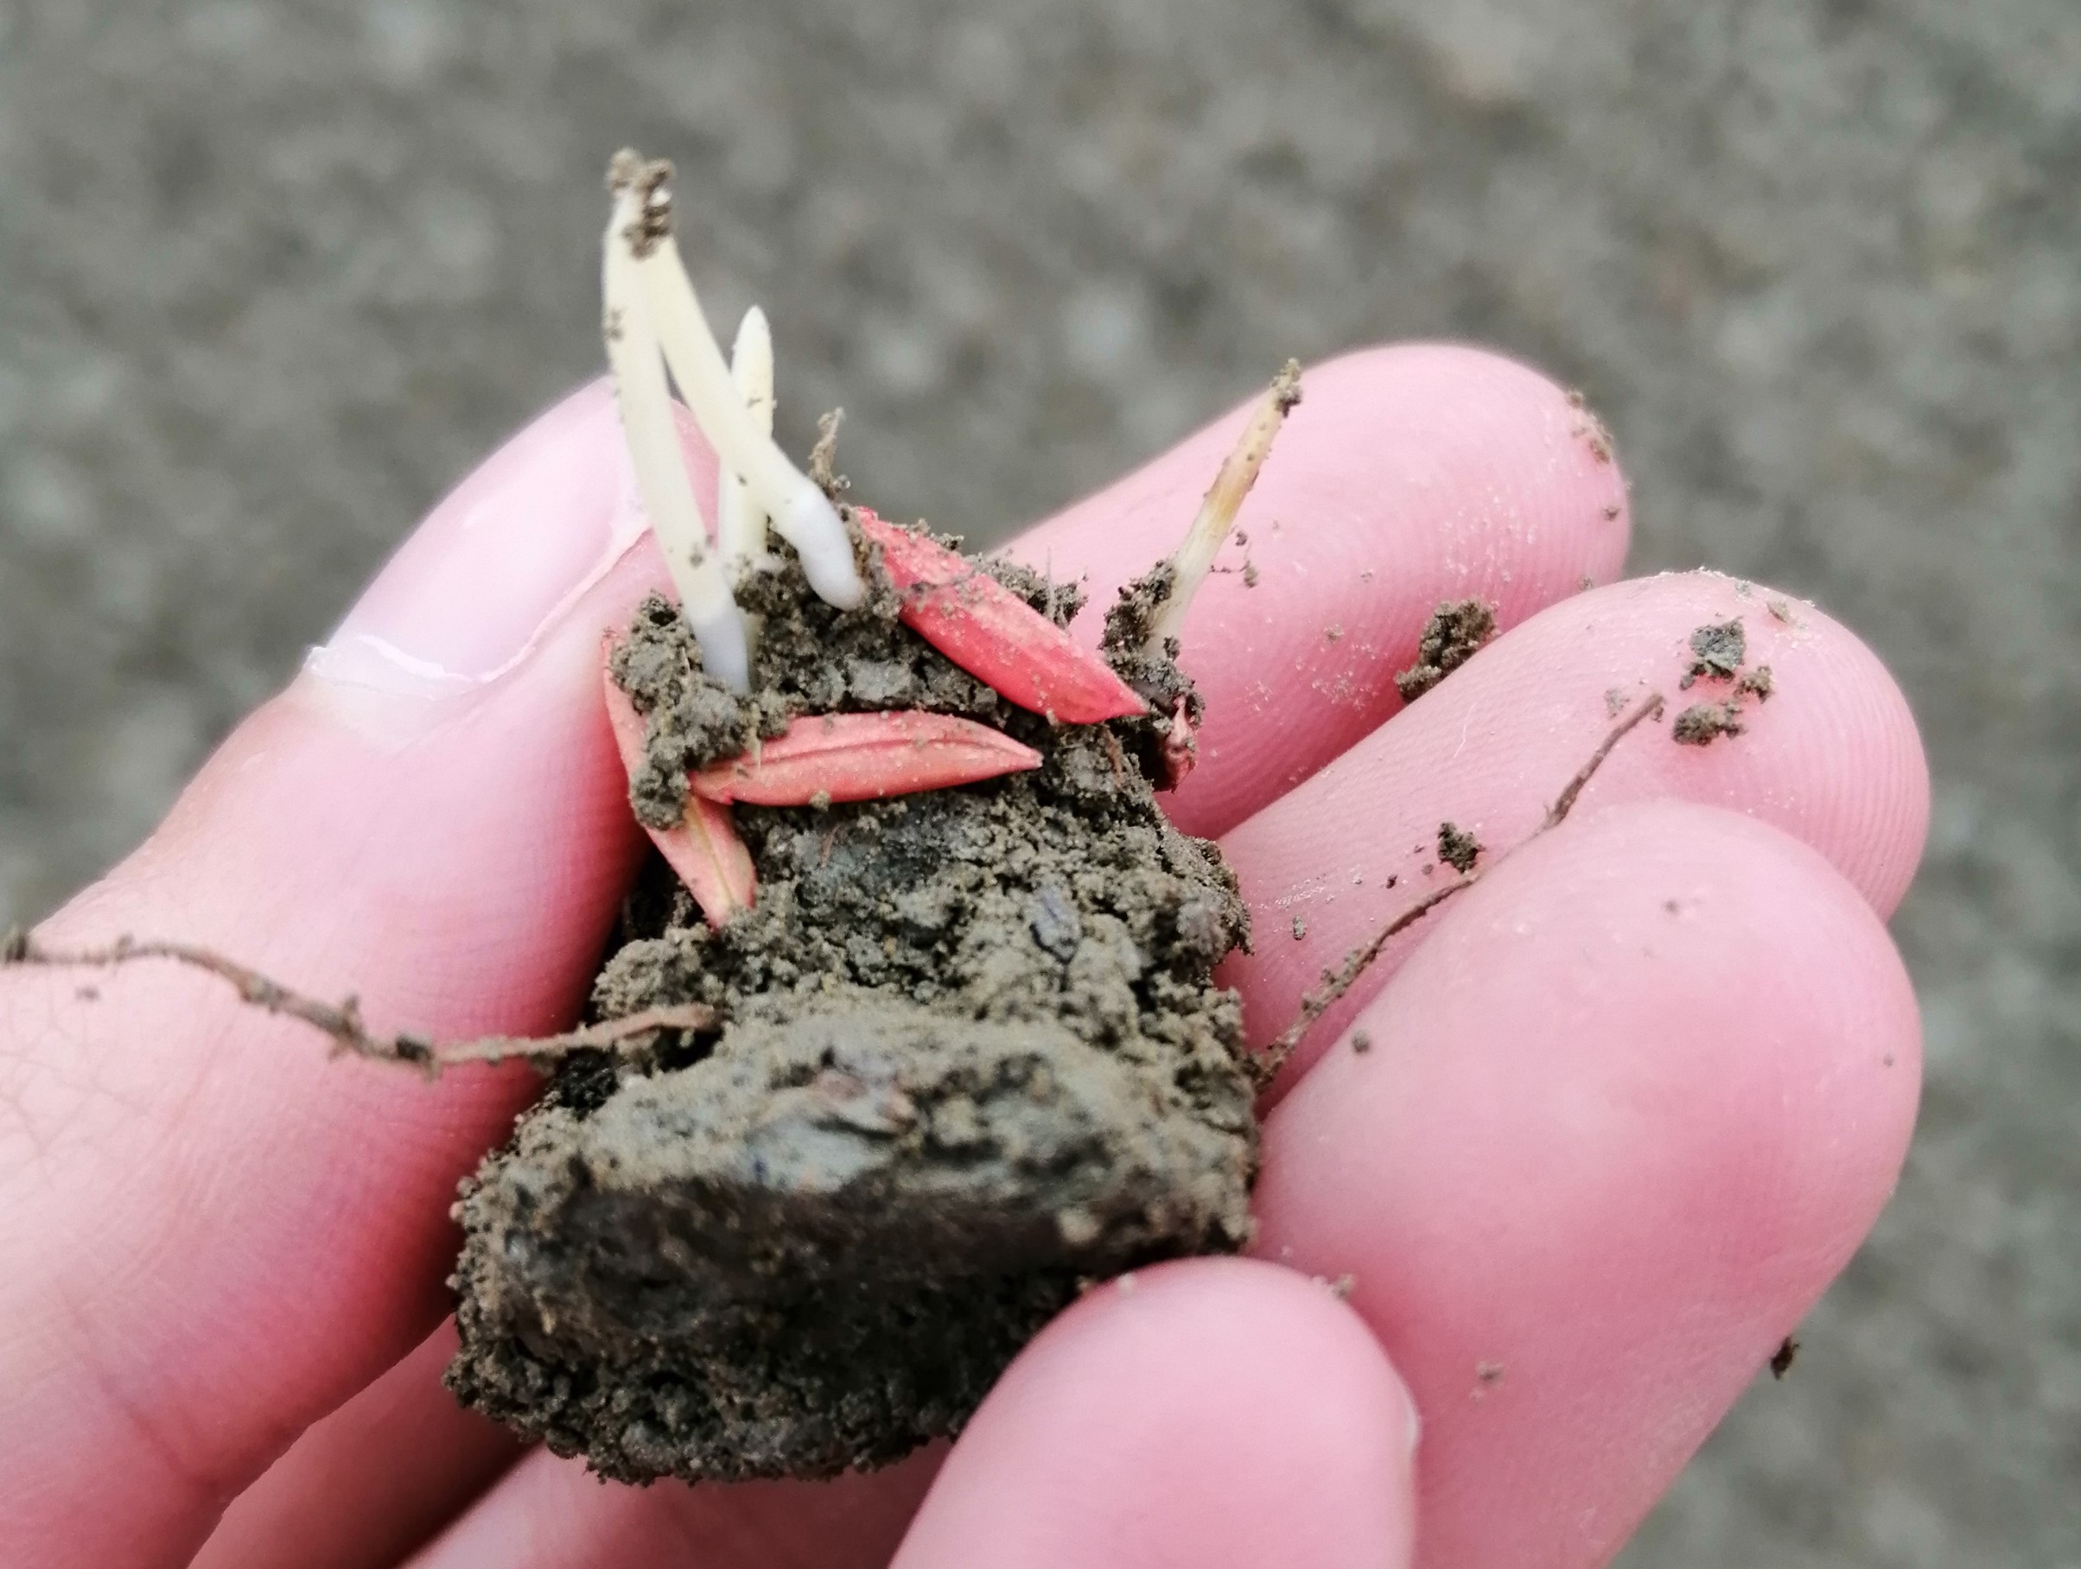


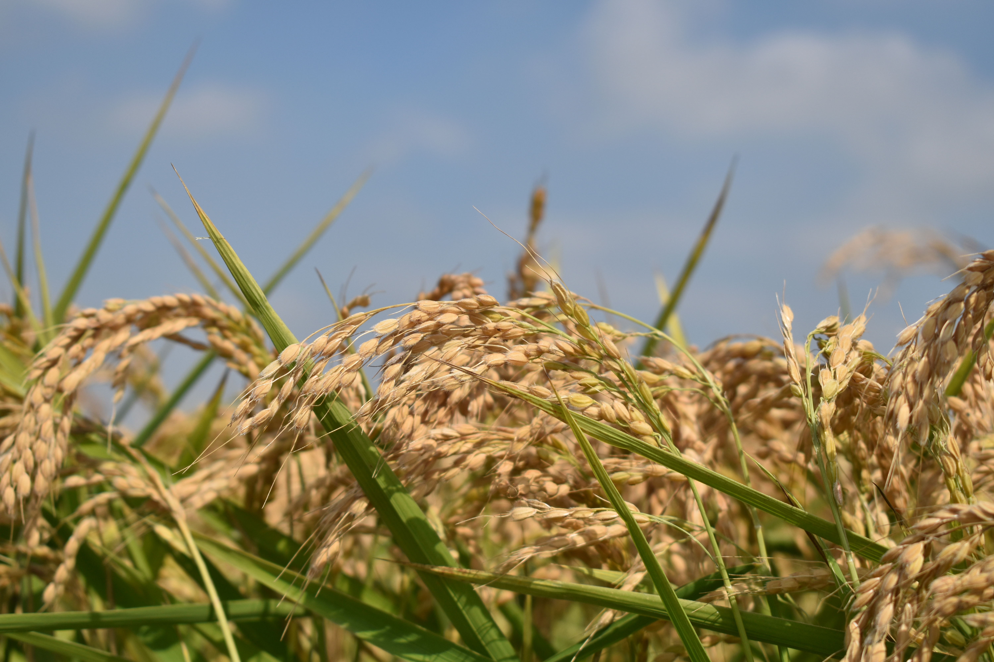

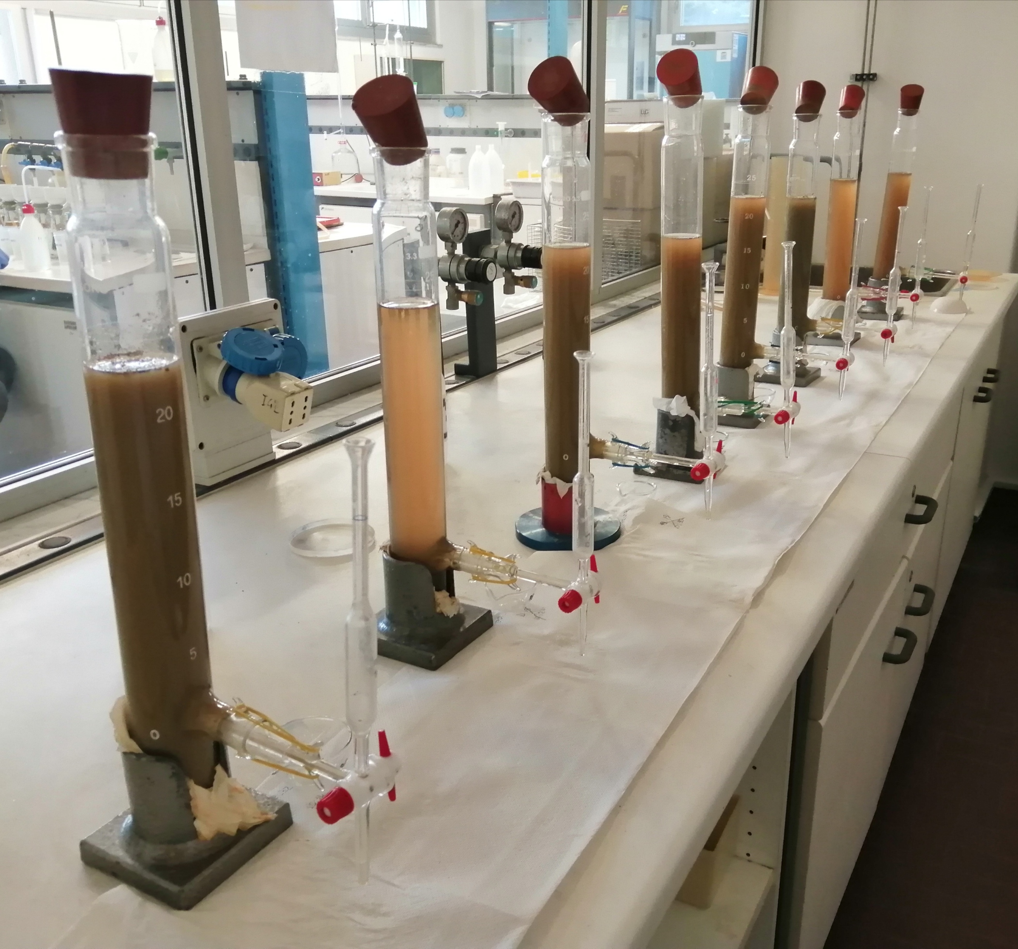


Thank you for the attention!
Funding: P-rice Fosforo in risaia: equilibrio tra produttività e ambiente nell'ottica delle nuove pratiche agronomiche
PSR Lombardia 2014-2020
Up for questions and suggestions!
sara.martinengo@unito.it
Sara Martinengo – DISAFA UniTO
Rice Agro-ecosystem and Environmental Research

