Slide 1
Construing Musical Heritage Through Multimodality and Multilingualism: The case of Gallery of Musical Instruments of Conservatory of Turin “Giuseppe Verdi”
By Karolina Tatar, University of Turin
A Linguistic Lens on Narratives in Professional Settings, Faculty of Education, Free University of Bozen-Bolzano, 17/05/24

Slide 2
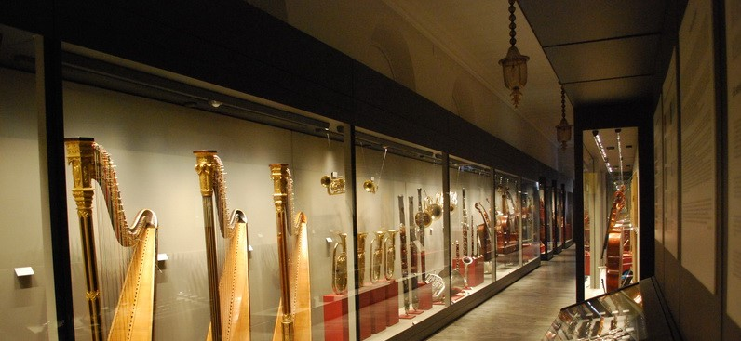
The Gallery of Musical Instruments of the G. Verdi Conservatory of Music in Turin
a distinctive tourist destination
an object of educational utility

Slide 3
the communication of the Collection
“Dal punto di vista epistemologico, per comunicazione culturale si intende un lento processo di comunicazione che partendo da sintesi eloquenti permetta l’approfondimento successivo in qualunque direzione (…). Il che presuppone un rigore scientifico tale da soddisfare il neofita ma anche lo specialista. Dal punto di vista della tecnica della comunicazione, significa invece avere consapevolezza della necessità di utilizzare tutti gli strumenti di comunicazione possibili, compresi quelli spettacolari e interattivi, per istituire un nuovo rapporto tra didattica e maieutica”
Virgilio Vercelloni Museo e comunicazione culturale (2005: 189)

Slide 4
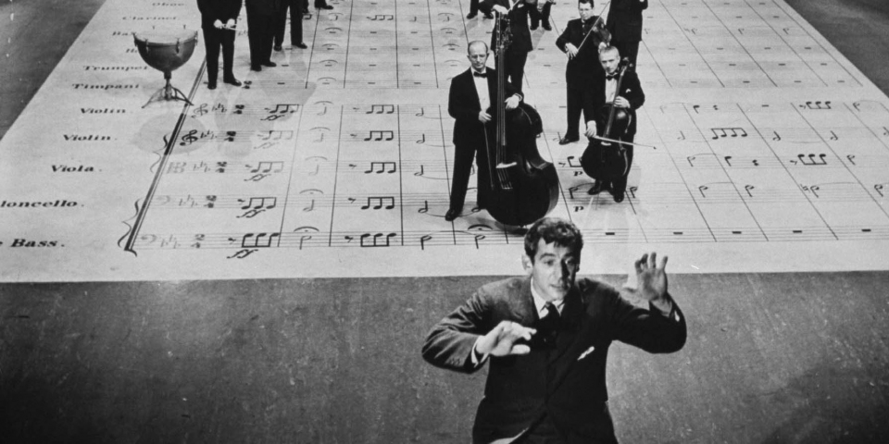
critical discourse analysis to seminal Music Education publications 1/2
Terminology?
Complexity?
Accessibility?
Narrative form?
Bernstein, L. (1959). The Joy of Music. Simon and Schuster
on musical analysis for a layman:
“Obviously we can’t use musical terminology exclusively, or we will simply drive the victim away. We must have intermittent recourse to certain extra-musical ideas, like religion, or social factors, or historical forces, which may have influenced music” p. 16
B. explains musicological terms with simple ones:
“It is the beginning of the coda, or the last big push before the end” p. 86
B. uses the literary tool of “imaginary conversations” with his family, friends and other people to transmit fundamental musicological and musical reflections
From https://leonardbernstein.com/about/educator/omnibus

Slide 5
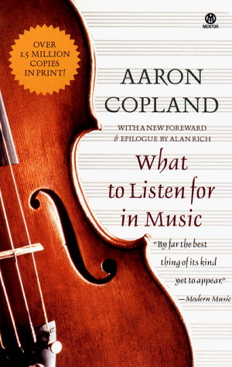
critical discourse analysis to seminal Music Education publications 2/2
Terminology?
Complexity?
Accessibility?
Narrative form?
Copland, A. (1999). What to Listen for in Music. Mentor
“most writers on music appreciation approach the problem from a standpoint of the educator or the music critic. This is a composer’s book.” p. xxix
“Unfortunately, whether the music is old or new, a certain number of technicalities have to be explained. Otherwise the reader cannot hope to grasp explanations of the higher musical forms.” p. xxxi
Signals where he stops his explanations in order not to give too much information
Addresses the reader directly by using the second person singular imperative

Slide 6
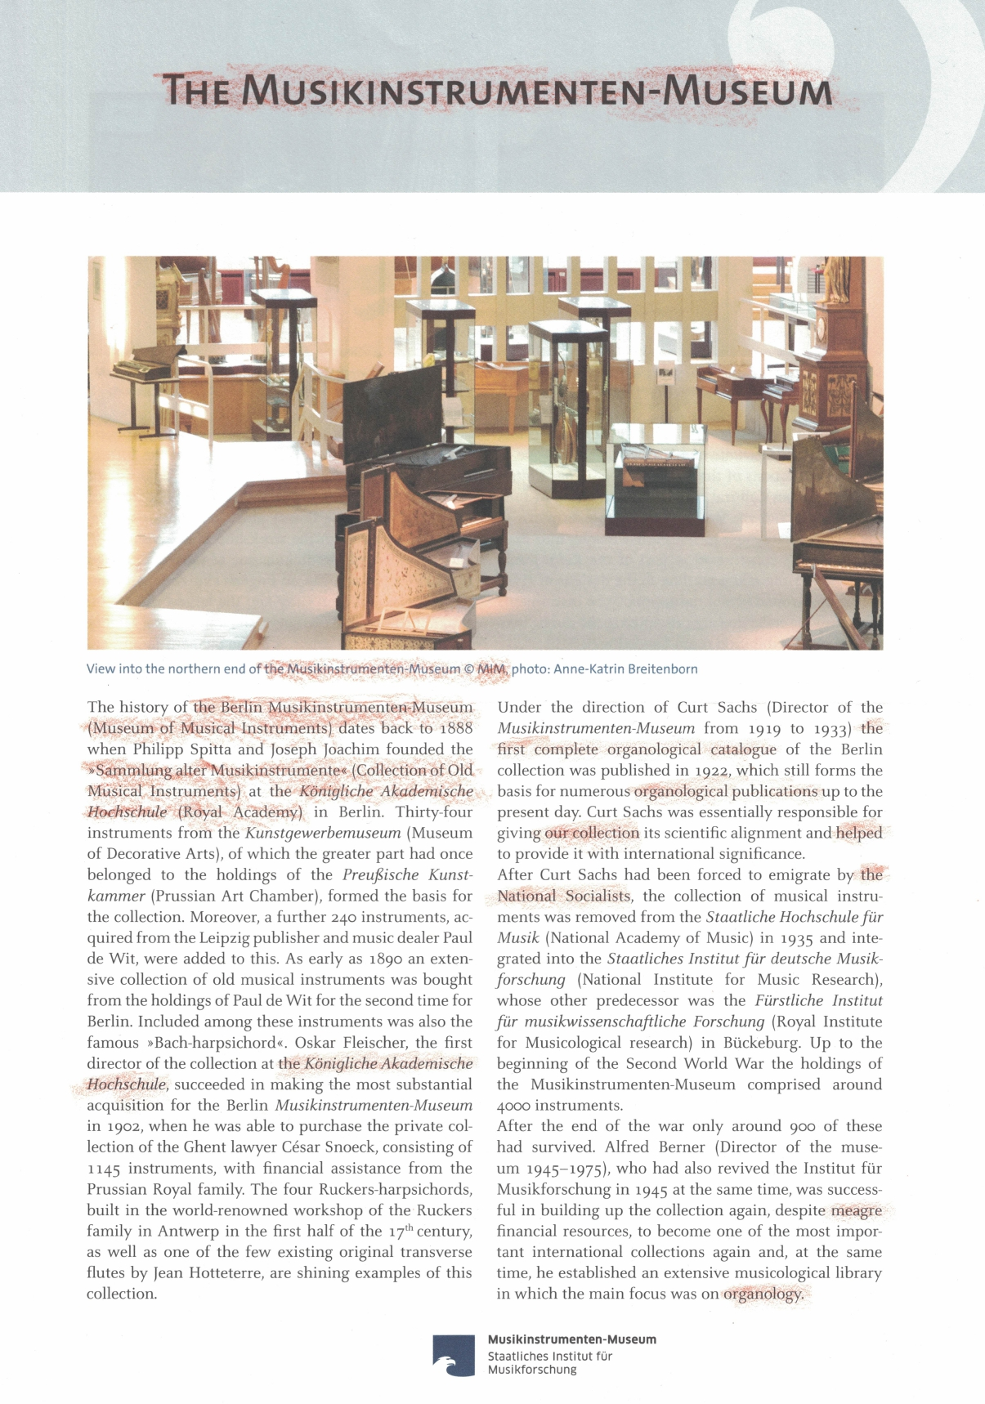
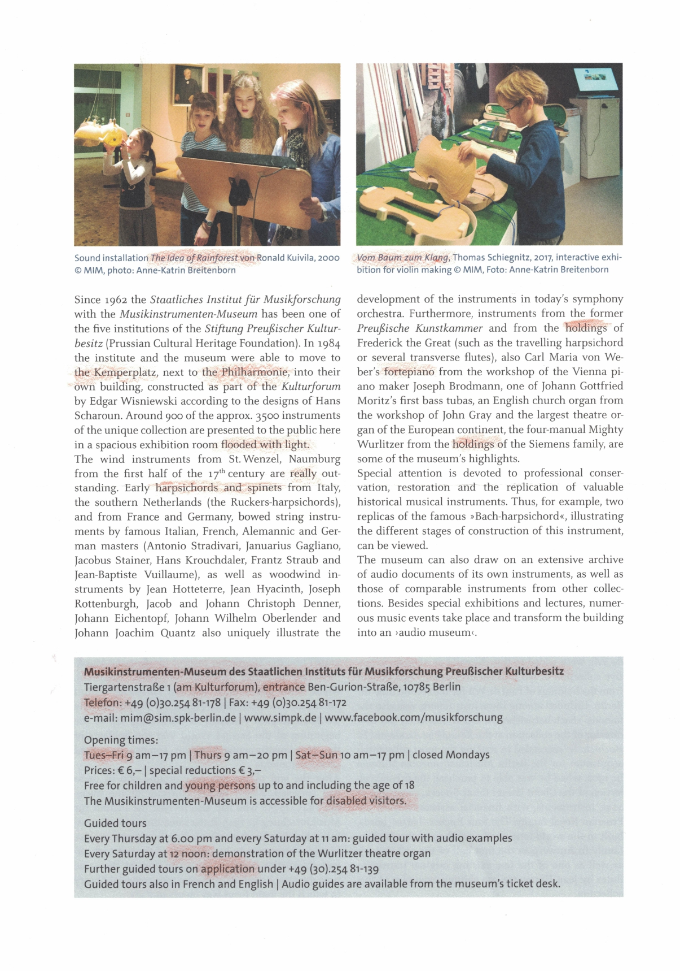
analysis of globally renowned Music Museums communication
Terminology?
Complexity?
Accessibility?
Narrative form?
“Musikinstrumenten-Museum” in Berlin, Germany

Slide 7
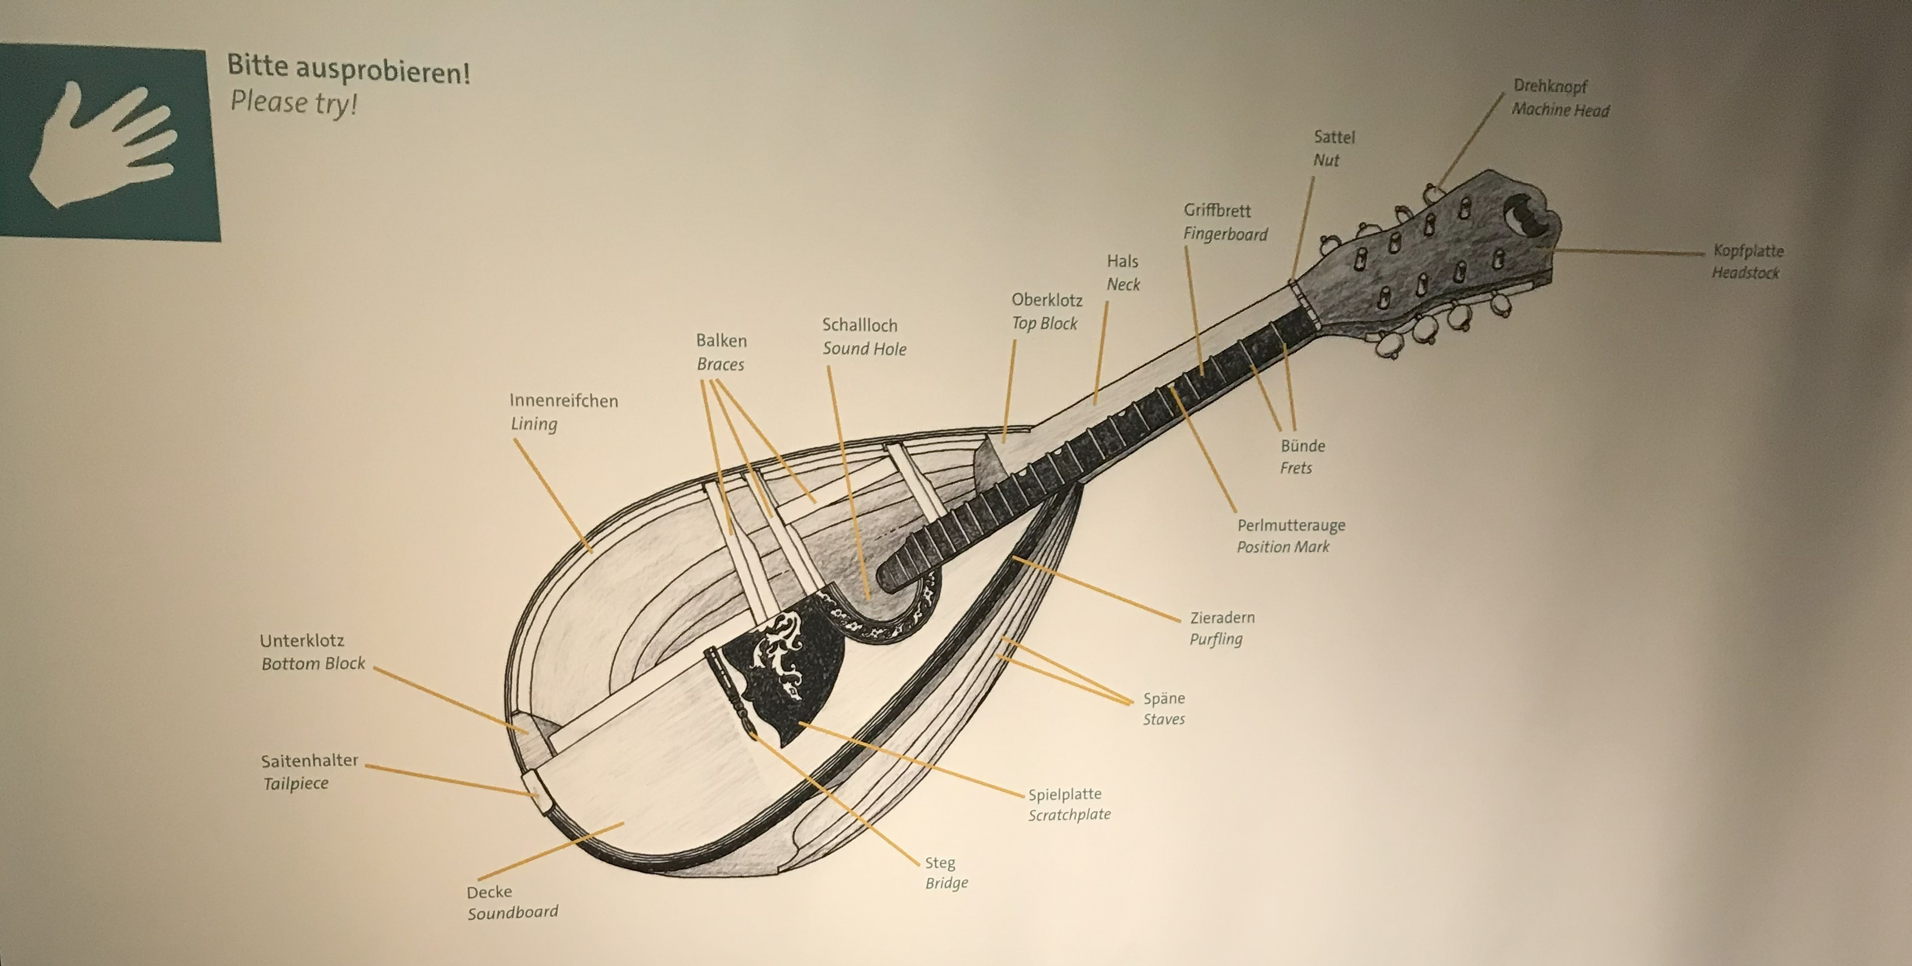
analysis of globally renowned Music Museums communication
Terminology?
Complexity?
Accessibility?
Narrative form?
“Musikinstrumenten-Museum” in Berlin, Germany

Slide 8
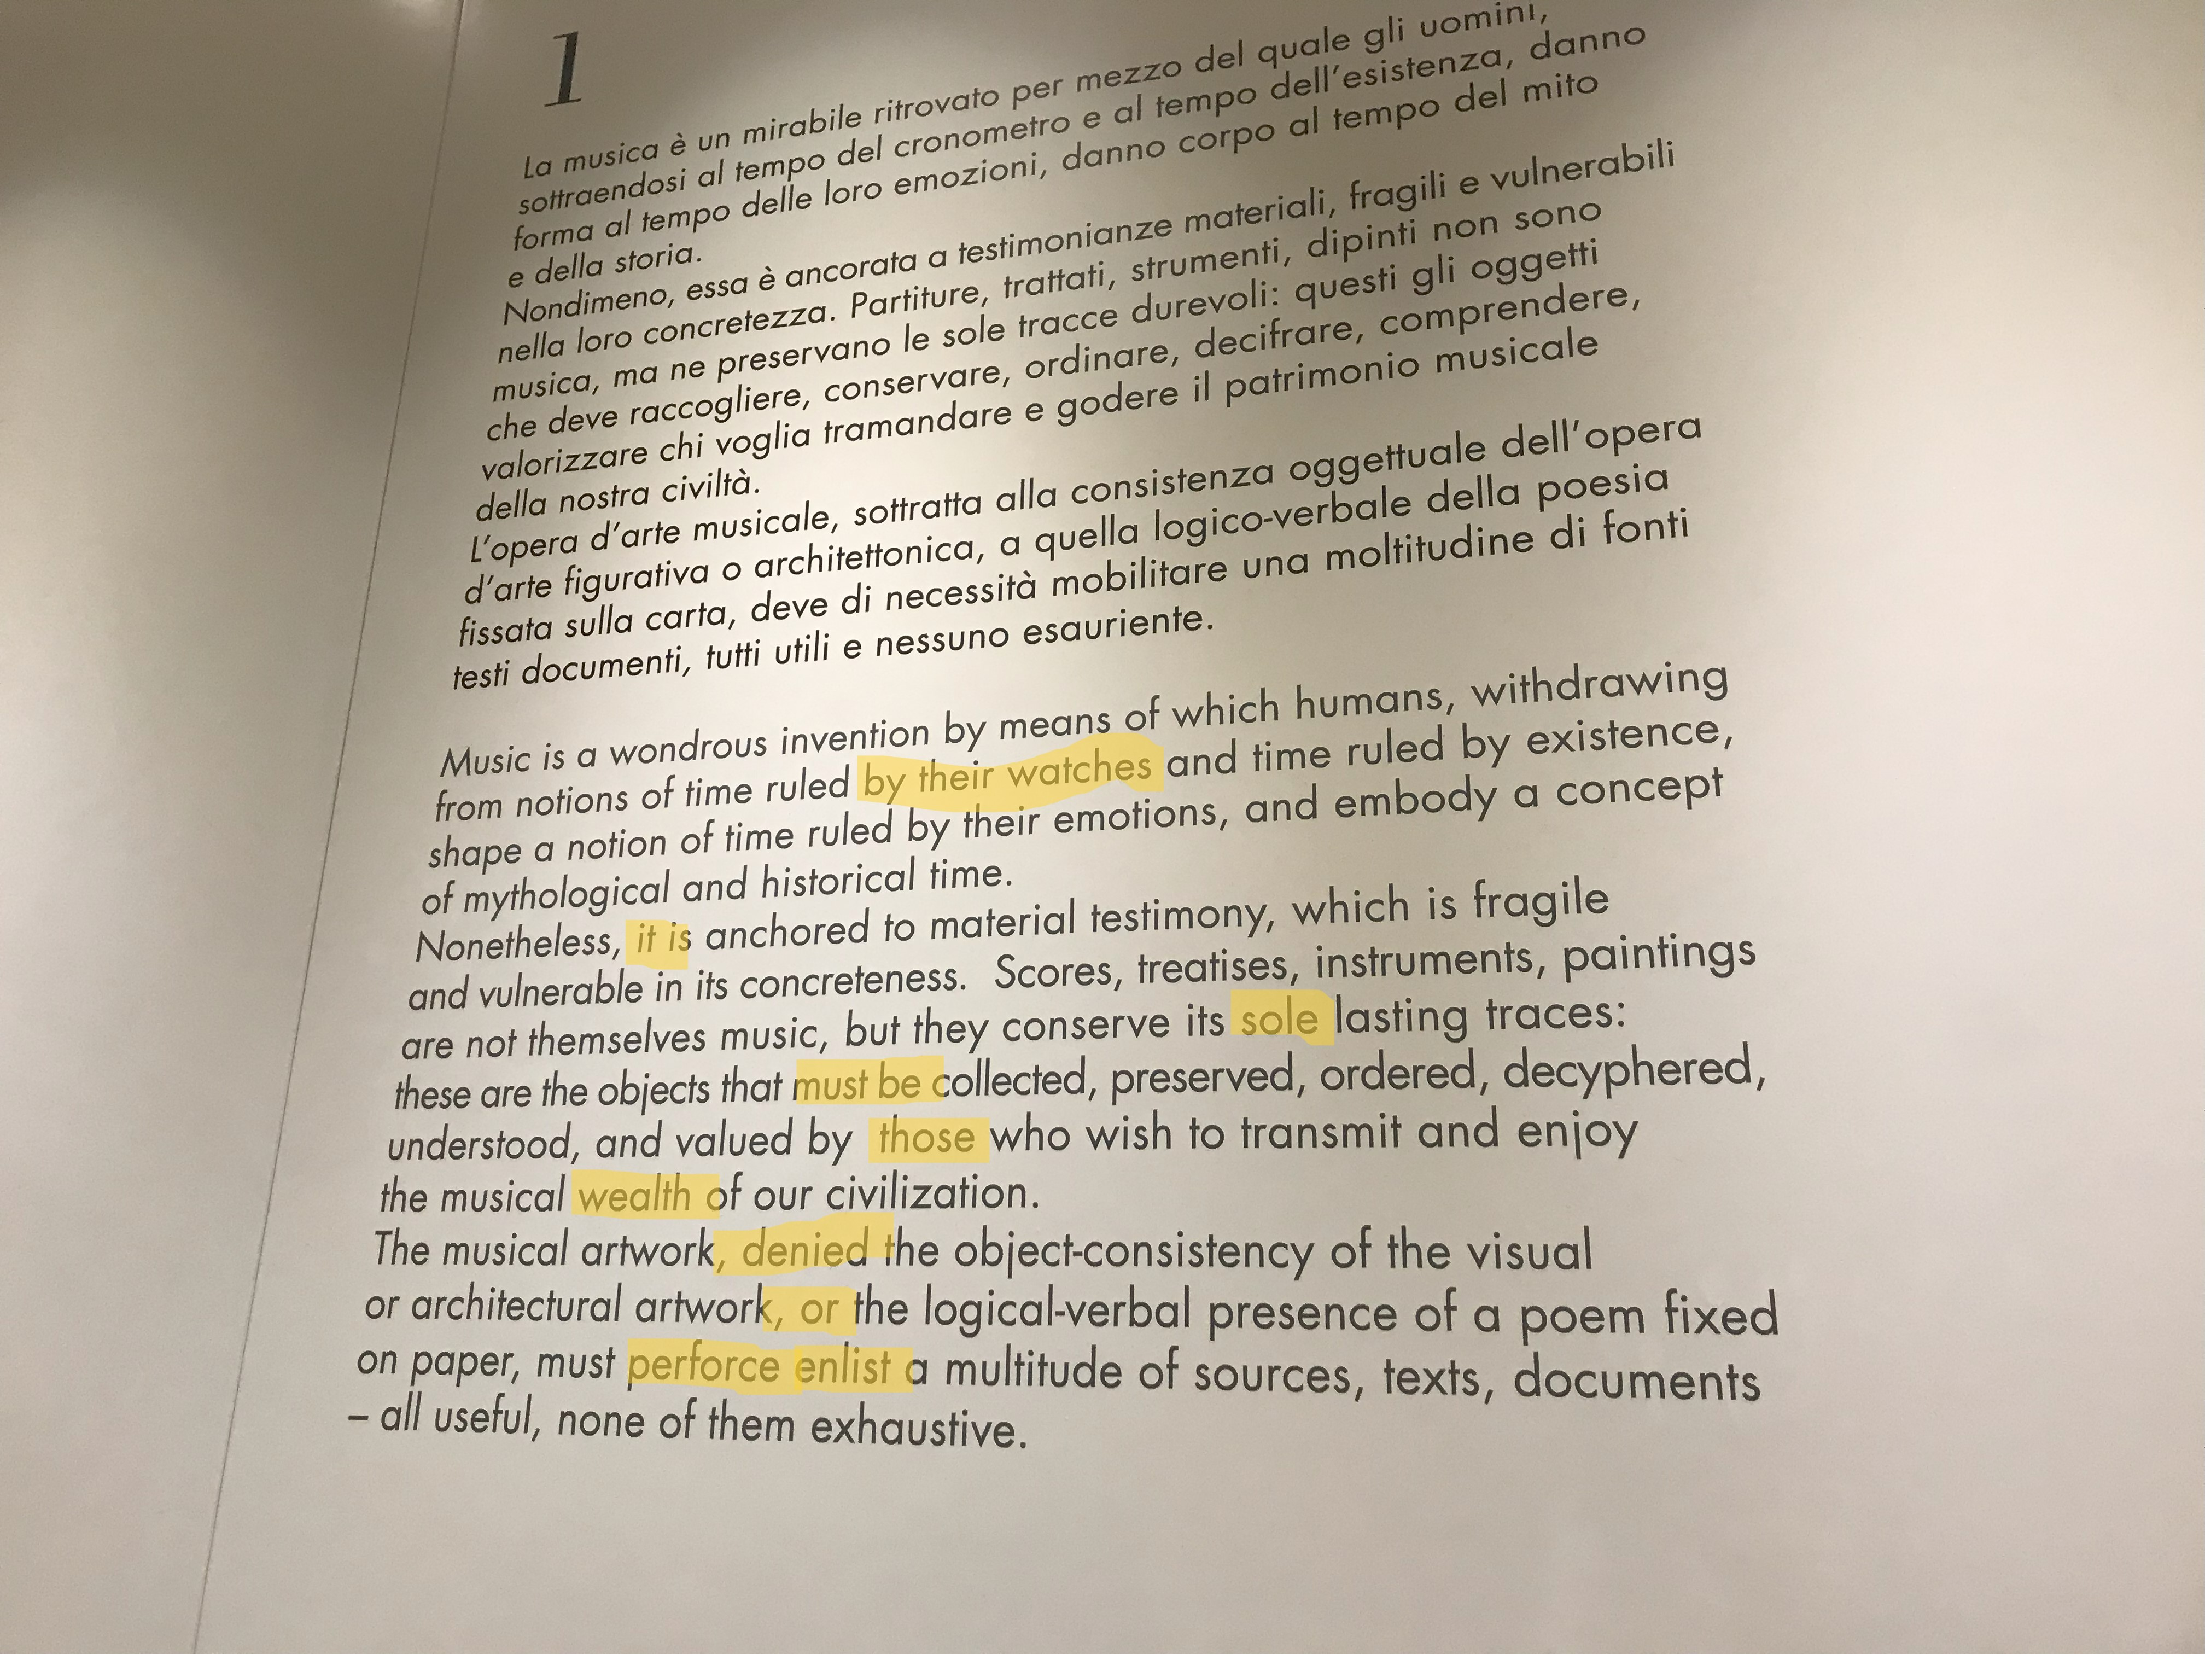
analysis of globally renowned Music Museums communication
“Museo della musica” in Bologna, Italy
Terminology?
Complexity?
Accessibility?
Narrative form?

Slide 9
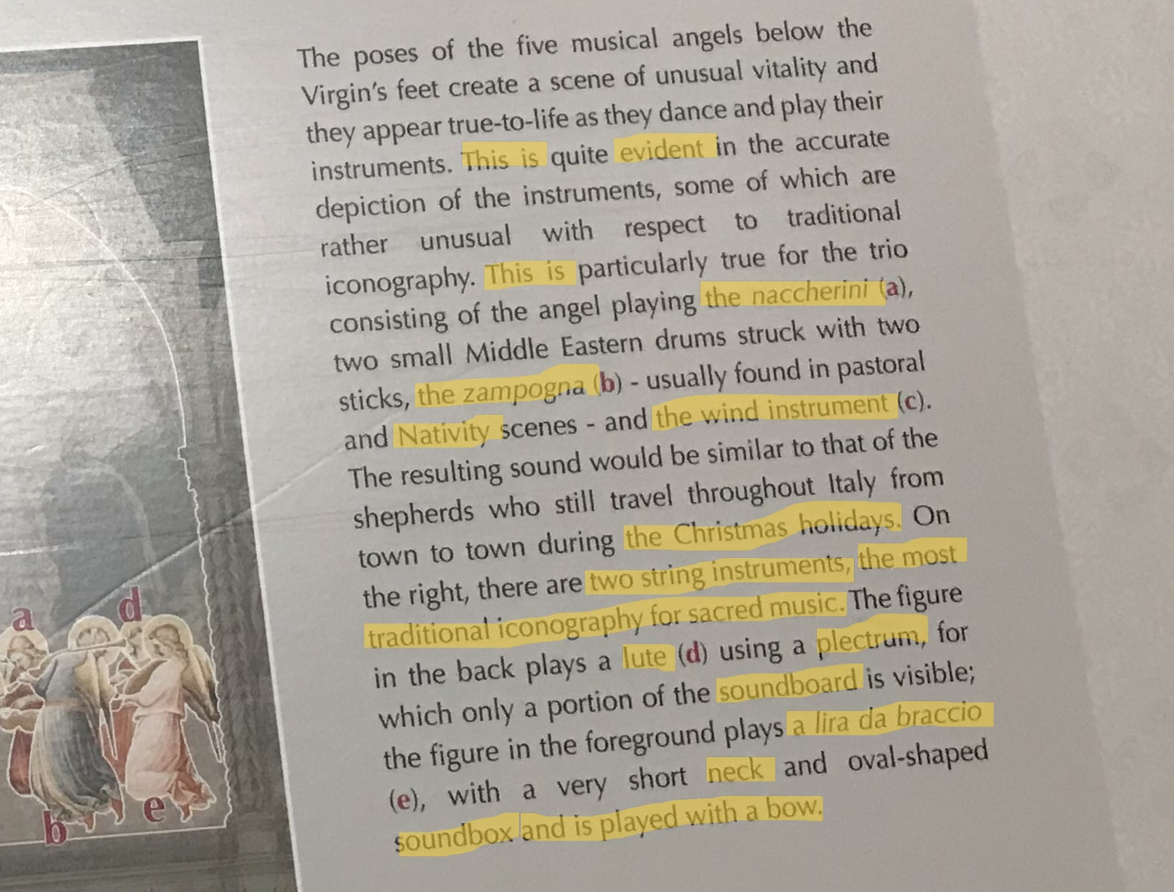
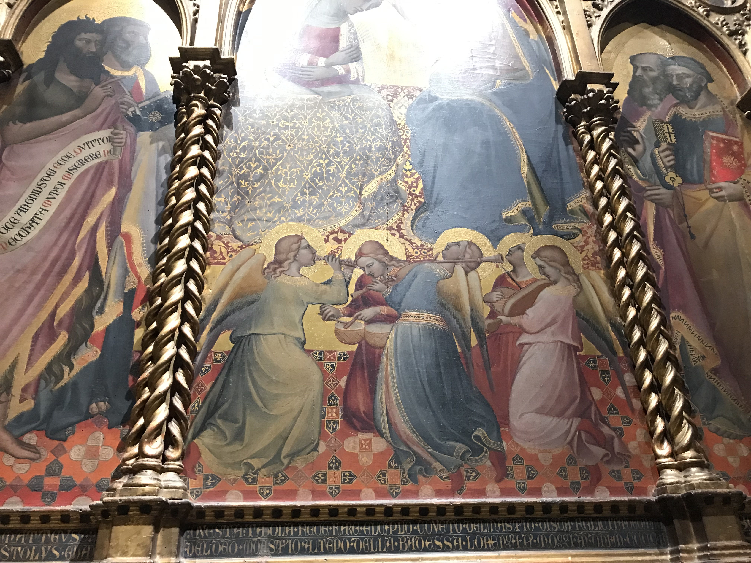
analysis of globally renowned Music Museums communication
Terminology?
Complexity?
Accessibility?
Narrative form?
Musical Instruments Collection of “Cherubini” Conservatory of Florence, Italy

Slide 10
museum communication publications
Maulini, A. (2019). Comunicare la cultura oggi. Editrice Bibliografica
“Nel campo della comunicazione culturale e museale lo storytelling ha la finalità specifica di attirare il fruitore di cultura con storie che rendano attraente il patrimonio culturale, museo, monumento archeologico o opera d’arte che sia: raccontare un museo attraverso piccole storie, aneddoti, curiosità legate alle collezioni, alle persone che lavorano al suo interno, ai personaggi che ne hanno scritto la storia, sono tutti argomenti strategici nella comunicazione culturale, che consentono un avvicinamento emotivo in grado di suscitare interesse nel pubblico” p. 174

Slide 11
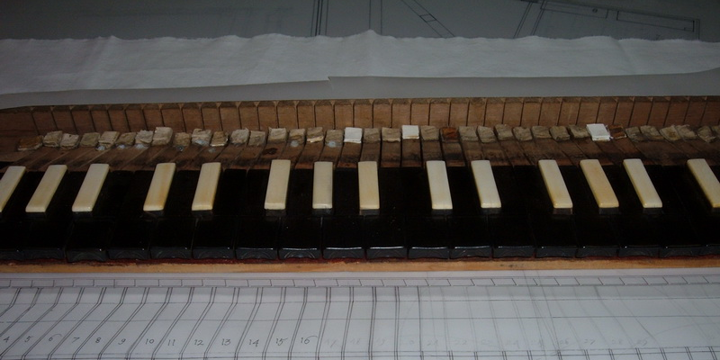
developing plural multilingual narrations 1/2
A template for each selected instrument:
What do I narrate? That is, where do I start?
Why is that instrument important?
What does it tell about its epoch?
Is there any anecdote connected to it which might interest visitors?
From https://www.conservatoriotorino.eu/studiare-qui/il-conservatorio/museo-degli-strumenti/

Slide 12
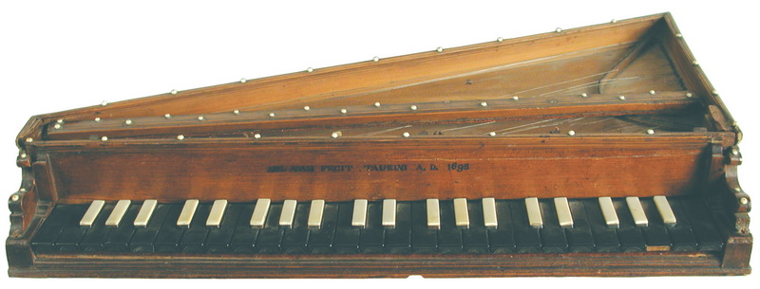
developing plural multilingual narrations 2/2
The example of Abel Adam’s octave spinet, 1698
a perfect study case to understand how early keyboard instruments felt and sounded
It is an extremely rare example of an instrument in original state of conservation
Materials used, technique and articulation
anecdotes: the instrument still has original 17th cent. crow quills which pluck the strings
Terminology?
Complexity?
Accessibility?
Narrative form? Autobiographical accounts?
The Gallery’s current designation as a distinctive tourist destination?
The Gallery’s educational utility?
From https://www.conservatoriotorino.eu/studiare-qui/il-conservatorio/museo-degli-strumenti/

Slide 13
Thank you for your attention!
karolinaanna.tatar@unito.it​

Slide 14
References
Bonacini, E. (2020). I musei e le forme dello storytelling digitale. Aracne.
Bernstein, L. (1959). The joy of music. Simon and Schuster.
Copland, A. (1999). What to Listen for in Music. Mentor.
Leonard Bernstein Office’s website. https://leonardbernstein.com/about/educator/omnibus
Maulini, A. (2019). Comunicare la cultura oggi. Editrice Bibliografica.
Turin Conservatory Musical Instrument Gallery website. https://www.conservatoriotorino.eu/studiare-qui/il-conservatorio/museo-degli-strumenti/
Vercelloni, V. (2005). Museo e comunicazione culturale. In G. Pinna (Ed.), Tre idee di museo. Jaca Book.

