Slide 1
From Sports Television Directing to Academic Research
A Reverse Trajectory of Research-Based Learning
Fabrizio Priami, Bruno Surace
University of Turin – CAM (Cinema, Arts, and Multimedia)

Slide 2
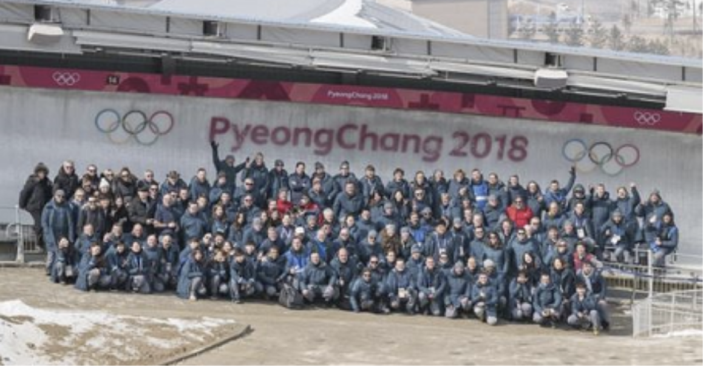
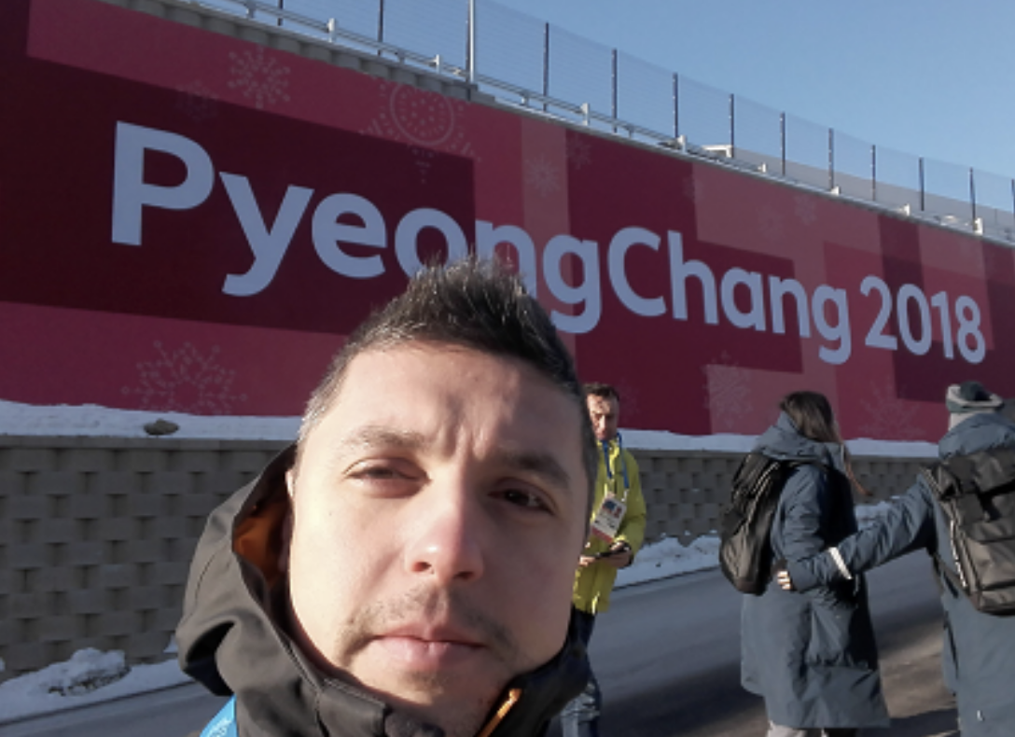
My Academic and Professional Journey
2009 - Started Master’s studies in Cinema,
Arts and Multimedia (University of Turin)
2010 - 2023 professional experience in
live sports broadcasting
2024 - Resumed and completing
the Master’s degree

Slide 3
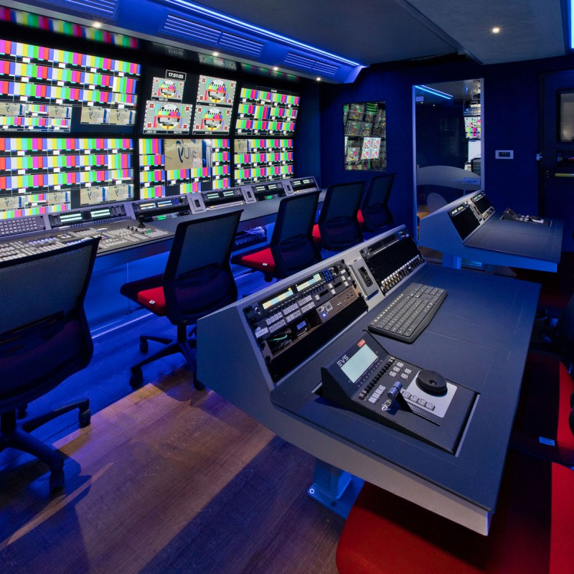
Research Aim and Motivation
Perception of live sports through technology
Link between engineering systems and broadcast practices
Emphasizing technical aspects through academic research

Slide 4
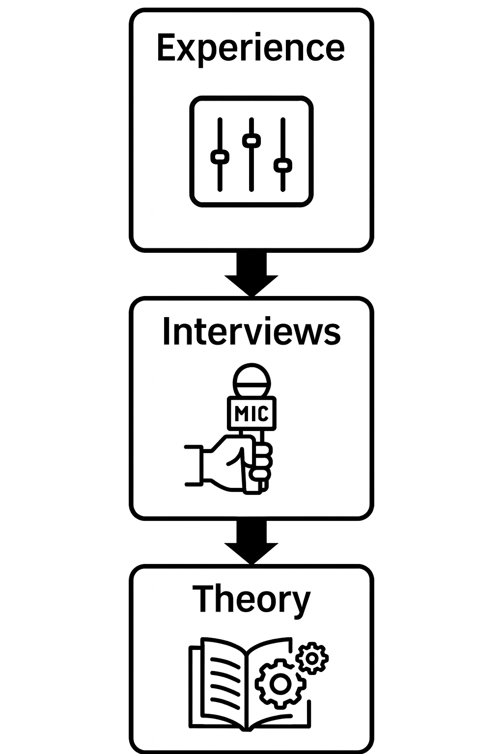
Research Methodology
Qualitative, practice-based approach
Triangulation of sources: academic texts + field interviews
6 semi-structured interviews (2 directors,
2 technicians, 1 producer, 1 vendor)
Cross-referenced with Jim Owens (Television Sports Production)

Slide 5
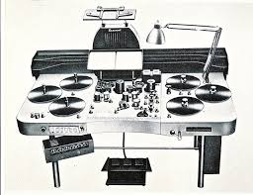
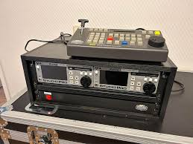
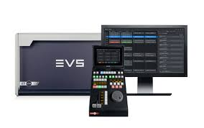
Case Study – Instant Replay and Ultramotion
Legacy vs. Current
+
Future systems
=
Visual language
1950 – 1970
Analog Film
1965 – 2005
Tape-based
Mechanical
2000 – Today
Digital

Slide 6
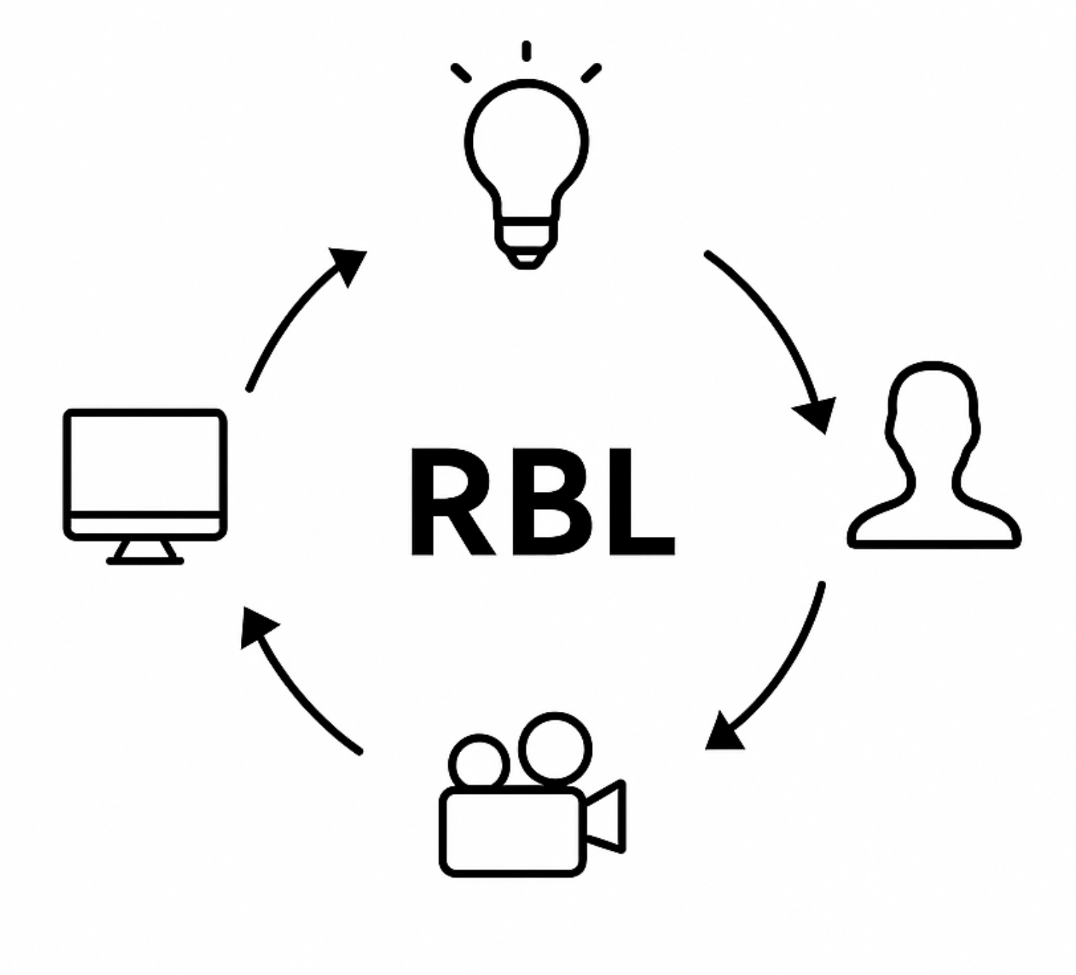
Key Findings and Reflections
Practical knowledge shaped the structure
Theory and practice critically aligned
Toward a humanistic vision of technology

Slide 7
Theoretical Insight
Empirical confirmation of cultural, technological, and media development through an “event-based” logic → the event as an effect that retroactively determines the cause and imposes a semantics (cf. Žižek 2014).
Necessary conjuncture between socio-technical systems and epistemic horizons: towards a technical humanism (cf. works by Eugeni; Latour).
Not interdisciplinarity, but inter-epistemology (a crossroads between technical, aesthetic, and ethical truth horizons) (cf. Stiegler 1994; Simondon).
Critical alignment of the sports domain within the audiovisual horizon.
Spherical perspective (multiperspectivity) in terms of skills, cultural affiliations, and professional experiences on the research object → transcendence of the research object.

Slide 8
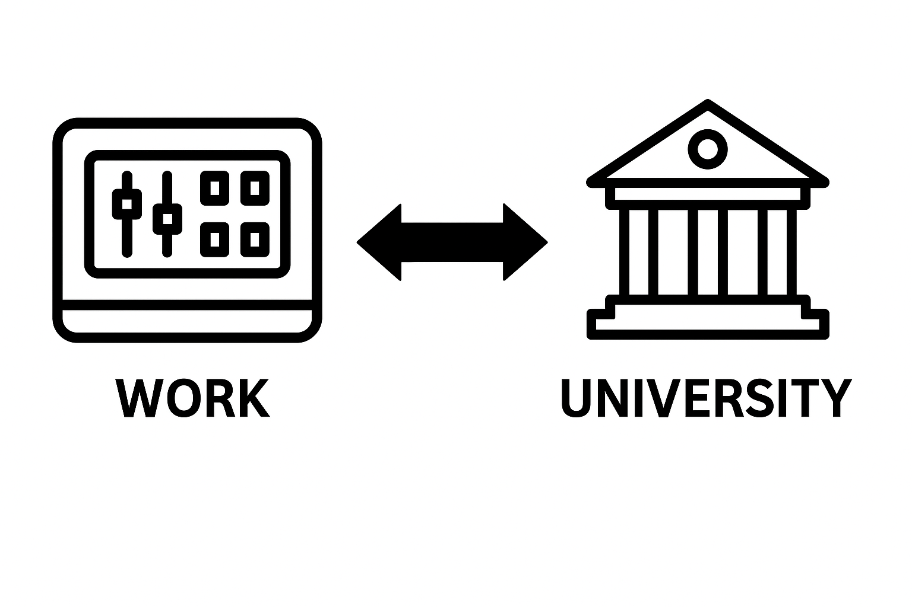
Why This Experience Matters
Validate non-linear learning journeys
Connect field experience with academic frameworks
Enrich teaching with real-world insight

Slide 9
Thank You
Fabrizio Priami with Bruno Surace University of Turin – CAM fabrizio.priami@unito.it – b.surace@unito.it

