Slide 1


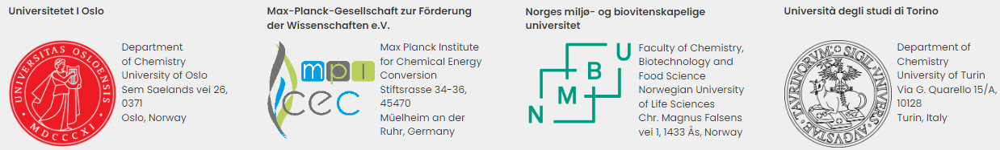


Barbara Centrella
Introducing sustainability as a pivotal parameter in the design of homogeneous and heterogeneous Cu-based catalysts

Slide 2



Sustainability
In collaboration with: Nicole Mariotti
When and how should be considered?
“It is important to include sustainability aspects in decision making at the product development stage, especially early in the development process”
Nowadays, it is a go/no-go aspect”
Industrial scale
Laboratory scale
LACK OF TIME
LOW DATA AVAILABILITY
Byggeth, S.; Broman, G.; Robèrt, K. H. A method for sustainable product development based on a modular system of guiding questions Journal of Cleaner Production, Volume 15, Issue 1, 2007, Pages 1-11
Hallstedt, S. I. Sustainability criteria and sustainability compliance index for decision support in product development.

Slide 3
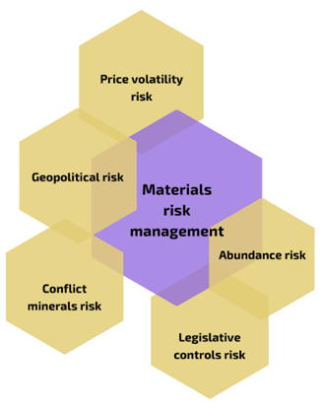


Sustainability at laboratory scale
First steps
MATERIALS SELECTION
SYNTHESIS
Raw materials
Auxiliaries and processes
Usually considered aspects in
materials selection
Usually considered aspects in
synthesis
EMERGING
MATERIALS
CONSTRAINTS
Element availability
Source (Fossil vs. Bio-based)
Toxicity
Cost
12 Green Chemistry Principles (Guideline)
Green metrics
Eco-scale (It considers costs)
Life Cycle Assessment
Ashby, M. Materials and sustainable development. Materials and Sustainable Development (2015). https://www.rsc.org/periodic-table/element/29/copper
Sheldon, R. A. Metrics of Green Chemistry and Sustainability: Past, Present, and Future. ACS Sustain. Chem. Eng. 6, 32–48 (2018).

Slide 4








Sustainability in catalysis
Introducing new parameters in the evaluation of a catalytic process
Beyond the classical parameters employed to determine the efficiency of a catalytic process (i.e. TON, TOF):
To assess the sustainability of a process, it is necessary to consider all the life-cycle phases: firstly, the row material selection, then, the sustainability of the synthetic process, and finally the recyclability of the obtained catalyst.
Environmental impact:
raw materials and production
Process costs:
raw material and production
Recyclability of the catalyst
MATERIALS SELECTION
SYNTHESIS
USE PHASE
END OF LIFE
Raw materials
Auxiliaries and processes
Selectivity, efficiency (TON, TOF)
Recyclability

Slide 5
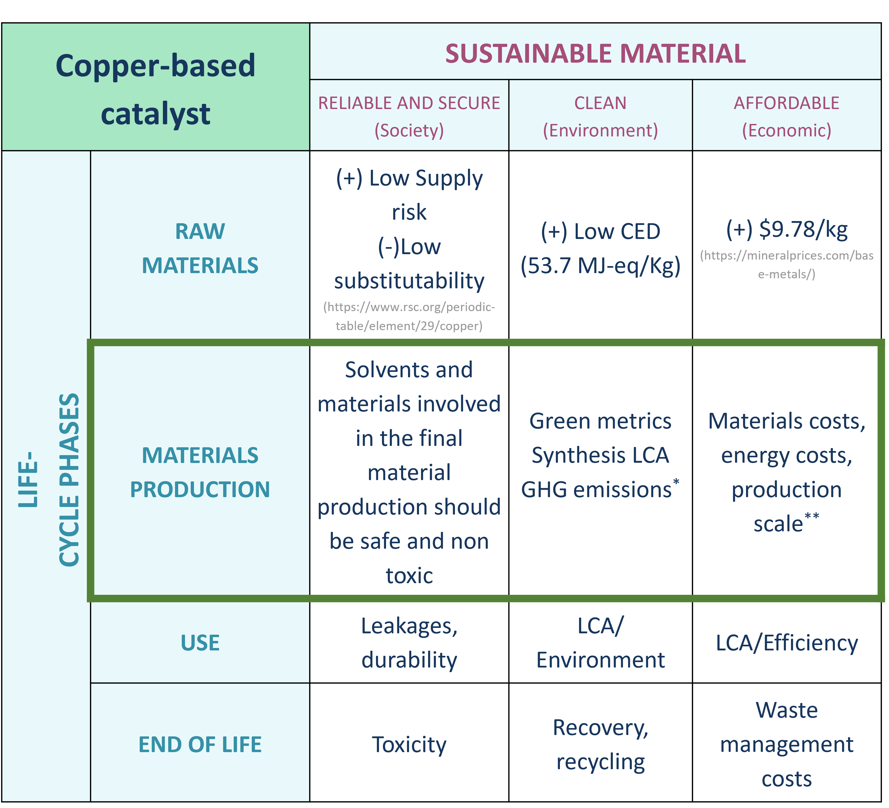
How to assess sustainability?
Let’s consider Copper based catalyst
,
,
LAB-SCALE
Green House Gas emissions*
*https://www.eea.europa.eu/
**https://it.vwr.com/store/

Slide 6

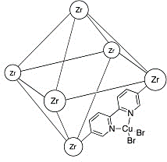
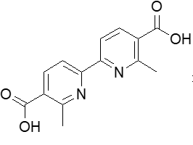
Selected catalysts and preliminary results
LAB-SCALE
A comparison between two comparable catalyst: homogenous VS heterogeneous
Homogeneous catalyst
Copper complex
The
homogeneous
catalyst is about
7 times cheaper
Heterogeneous catalyst
MOF
10% of bipy linker:
Anchoring site for Cu metal
*Assuming every metal site is active

Slide 7
Results and take-home message:
Toward a sustainable approach
Long and complex process
Requires iterative steps
The proposed analysis could represent the starting point of a go/no-go criteria
Similar cost in terms of euro/g
Factor of 7 when the cost is normalizes to the amount of copper
Need to evaluate activity and recyclability of the catalysts to complete the assessment
Sustainability assessment
Give us benchmarks
Economical social and political issues are implied

Slide 8


Acknowledgements
Prof. Mohamed Amedjkouh, Erlend Aunan, Prof. Claudia Barolo, Prof. Gloria Berlier, Prof. Francesca Carla Bonino, Dr. Matteo Bonomo, Prof. Silvia Bordiga, Dr. Elisa Borfecchia, Ning Cao, Barbara Centrella, Dr. Valentina Crocellà, Dr. George E. Cutsail III, Dr. Alessandro Damin, Prof. Serena DeBeer, Prof. Vincent Eijsink, Dr. Ivan Ayuso-Fernandez, Valeria Finelli, Dr. Benedikt Floeser, Isabelle Gerz, Ole Golten, Dr. Kelsi Hall, Dr. Sergio Jannuzzi, Dr. Christopher Joseph, Prof. Åsmund Røhr Kjendseth, Dr. Eva Kathrin Lang, Prof. Karl Petter Lillerud, Dr. Andrea Martini, Prof. Frank Neese, Dr. Chiara Negri, Dr. Ainara Nova Flores, Prof. Unni Olsbye, Dr. Carlotta Pontremoli, Natale Gabriele Porcaro, Dr. Raquel Jimenez Rama, Dr. Emilia Sannino, Dr. Matteo Signorile, Prof. Morten Sørlie, Tonje Berg Steensen, Dr. Olivia McCubbin Stepanic, Prof. Stian Svelle, Dr. Kaiqi Xu, Dr. Shengfa Ye
Financial support by the European Research Council (ERC) CUBE ERC-Synergy project (Grant agreement n° 856446).
https://www.cube-synergy.eu/

