Slide 1







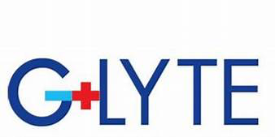
Toward transparent and colorless
Dye-Sensitized Solar Cells for non-intrusive BIPV
S. Galliano,ª A.Y. Segura Zarate,ª M. Rubes,ª M. Bokan,ª N. Barbero,^{a,b} M. Bonomo,ª R. Borrelli,^{c}
W. Naim,^{d} F. Grifoni,^{d} F. Matteocci,^{e} P. Chotard,^{f} S. Ceurstemont,^{f} F. Barath,^{f} A. Di Carlo,^{e}
F. Sauvage,^{d} and C. Barolo^{a,b,g}
a Dipartimento di Chimica, NIS Interdepartmental and INSTM Reference Centre, Università degli Studi di Torino, Torino, Italy
b Istituto di Scienza, Tecnologia e Sostenibilita ` per lo sviluppo dei Materiali Ceramici (ISSMC-CNR), Faenza (RA), Italy
c Dipartimento di Scienze Agrarie Forestali e Alimentari, Università degli Studi di Torino, Grugliasco (TO), Italy
d CNRS, Laboratoire de réactivité et Chimie du Solide (LRCS), Université Picardie Jules Verne, Amiens, France
e CHOSE, Dipartimento di Ingegneria Elettronica, Università di Roma Tor Vergata, Roma, Italy
f G-LYTE SAS, Amiens, France
g ICxT Interdepartmental Centre, Università degli Studi di Torino, Torino, Italy
Milano, 22-23/06/2023

Slide 2
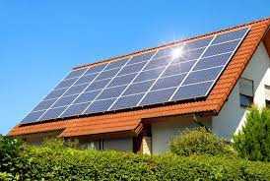
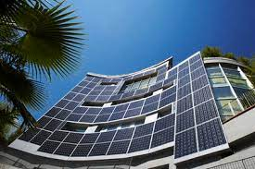
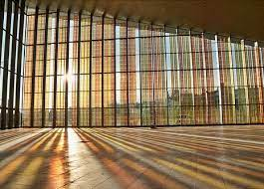
Building Integrated Photovoltaics
Façades
Windows
Rooftops
Agrivoltaics

Slide 3
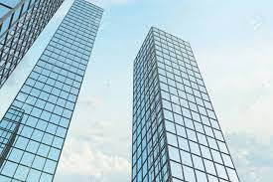
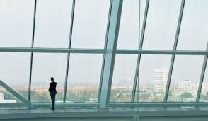
Building Integrated Photovoltaics
Replacing windows with
transparent and colorless solar cells
Façades
Windows
Rooftops
Agrivoltaics
Transparent PVs can reduce visual pollution without reciding from original design

Slide 4
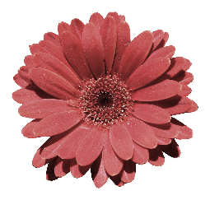
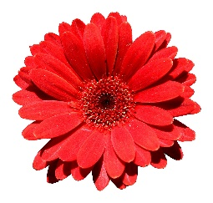
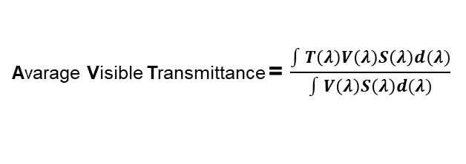
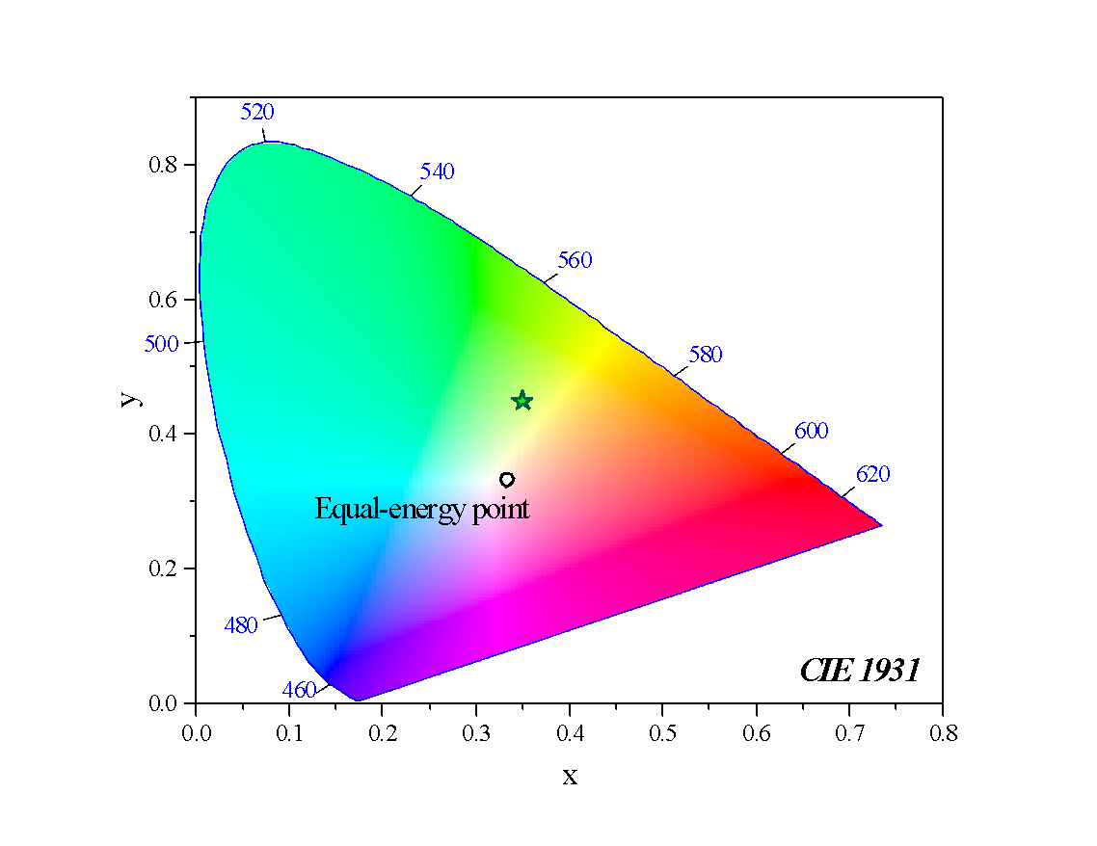
Wavelenght selective transparent photovoltaics
Only molecular-based devices can afford selective NIR-conversion
50% solar irradiance falls in the NIR
Figures of merit
Avarage Visible Transmittance = $\frac{\int{T\left(λ\right)V\left(λ\right)S\left(λ\right)d(λ)}}{\int{V\left(λ\right)S\left(λ\right)d(λ)}}$
Color purity
Light Utilization Efficency = PCE x AVT
a
b
Color Renderind Index
CRI>90 excellent quality
Low CRI
High CRI
x,y coordinates in CIE 1931
F. Grifoni, et al. Adv. Energy Mater. 2021.
International Commission on Illumination. Colorimetry. (CIE); 2004.

Slide 5
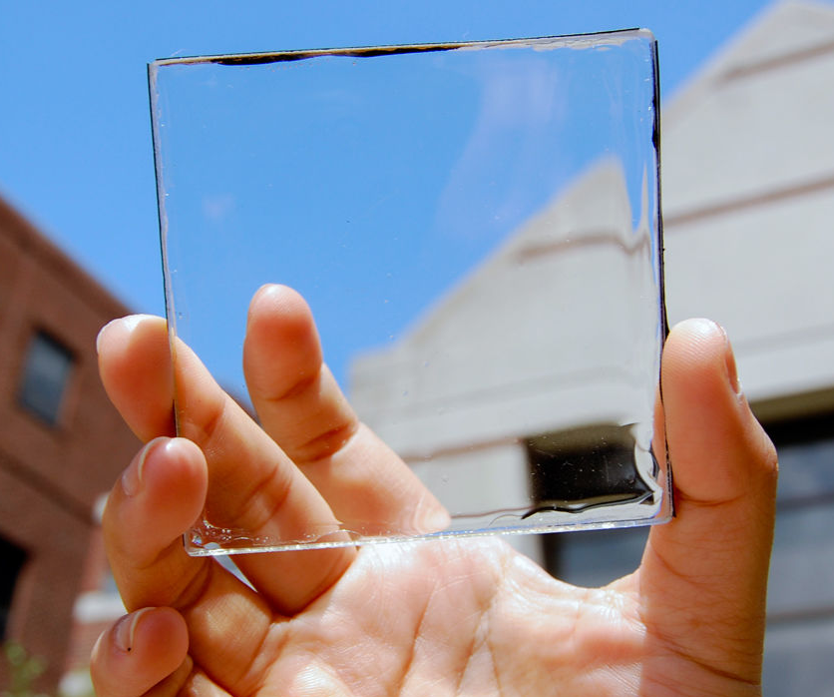
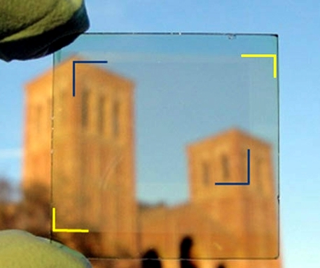
Wavelenght selective transparent Photovoltaics
Only molecular-based devices can afford selective NIR-conversion
50% solar irradiance falls in the NIR
Luminescent Solar Concentrators
Organic Solar Cells
High transparency (AVT=88.3%)
Low efficiency (PCE=0.4%)
Lower transparency (AVT=64%)
Higher efficiency (PCE=4%)
Figures of merit
Traverse, C. J. et al. Nat. Energy 2, 849–860 (2017).
Chen, C. et al. ACS Nano (2012).
Avarage Visible Transmittance = $\frac{\int{T\left(λ\right)V\left(λ\right)S\left(λ\right)d(λ)}}{\int{V\left(λ\right)S\left(λ\right)d(λ)}}$
Light Utilization Efficency = PCE x AVT
Color Renderind Index
CRI>90 excellent quality
Low CRI
High CRI
x,y coordinates in CIE 1931
F. Grifoni, et al. Adv. Energy Mater. 2021.

Slide 6
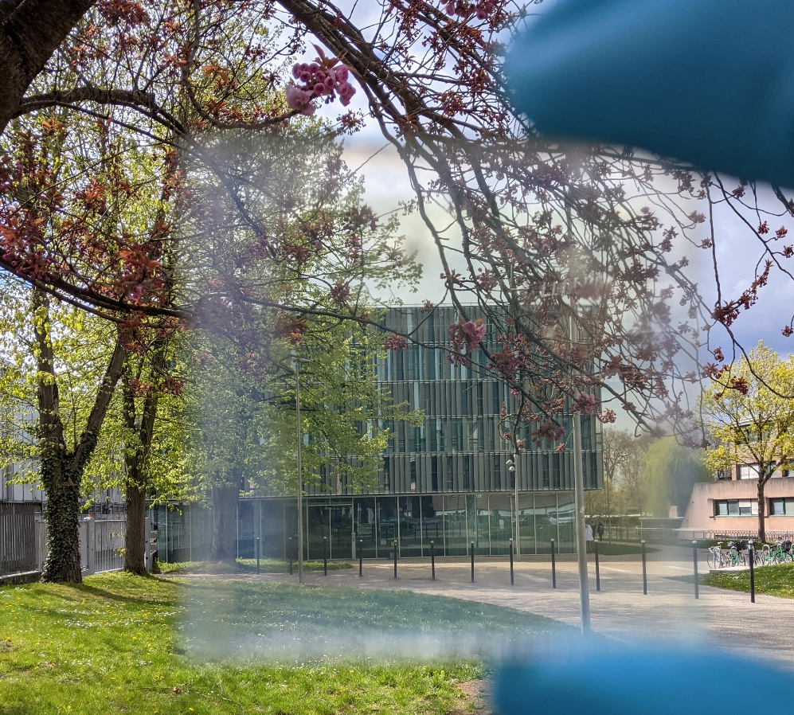
Wavelenght selective transparent Photovoltaics
Only molecular-based devices can afford selective NIR-conversion
50% solar irradiance falls in the NIR
Luminescent Solar Concentrators
Organic Solar Cells
High transparency (AVT=88.3%)
Low efficiency (PCE=0.4%)
Lower transparency (AVT=64%)
Higher efficiency (PCE=4%)
Figures of merit
Traverse, C. J. et al. Nat. Energy 2, 849–860 (2017).
Chen, C. et al. ACS Nano (2012).
Avarage Visible Transmittance = $\frac{\int{T\left(λ\right)V\left(λ\right)S\left(λ\right)d(λ)}}{\int{V\left(λ\right)S\left(λ\right)d(λ)}}$
Light Utilization Efficency = PCE x AVT
Color Renderind Index
CRI>90 excellent quality
Low CRI
High CRI
NIR Dye-Sensitized Solar Cells
x,y coordinates in CIE 1931
Filling the gap
F. Grifoni, et al. Adv. Energy Mater. 2021.

Slide 7
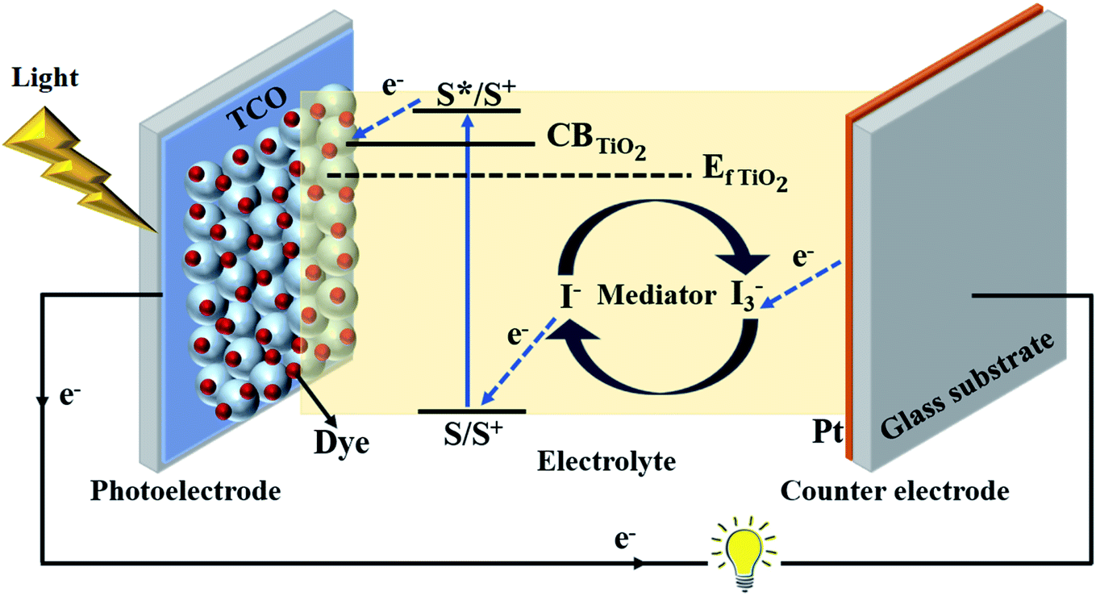
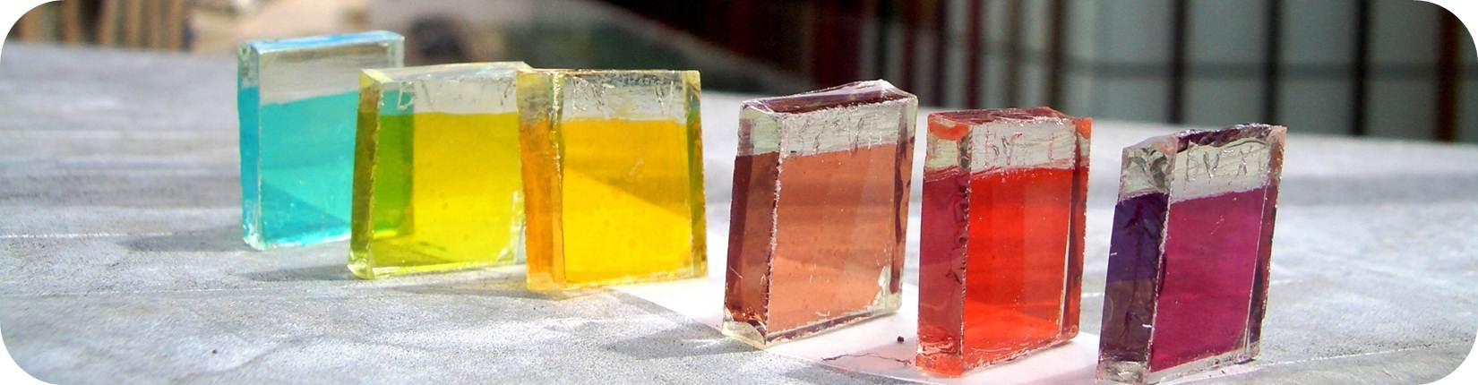
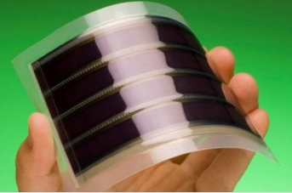
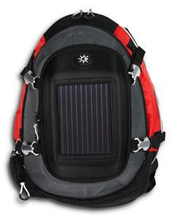
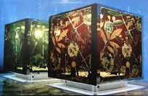
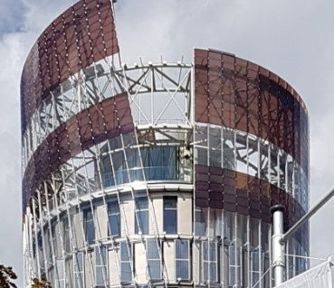
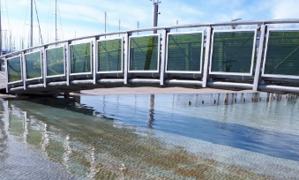
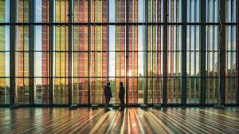
Dye-Sensitized Solar Cells
Simple preparation procedure
Low production cost
Work with weak/diffuse light
Efficiency 14% outdoor, >30% indoor
Transparency, flexibility, …
Material recyclability

Slide 8

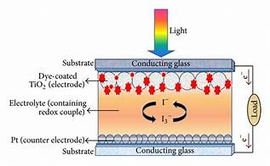
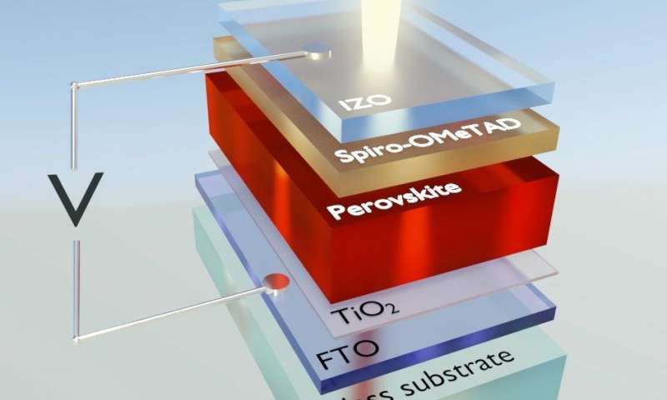
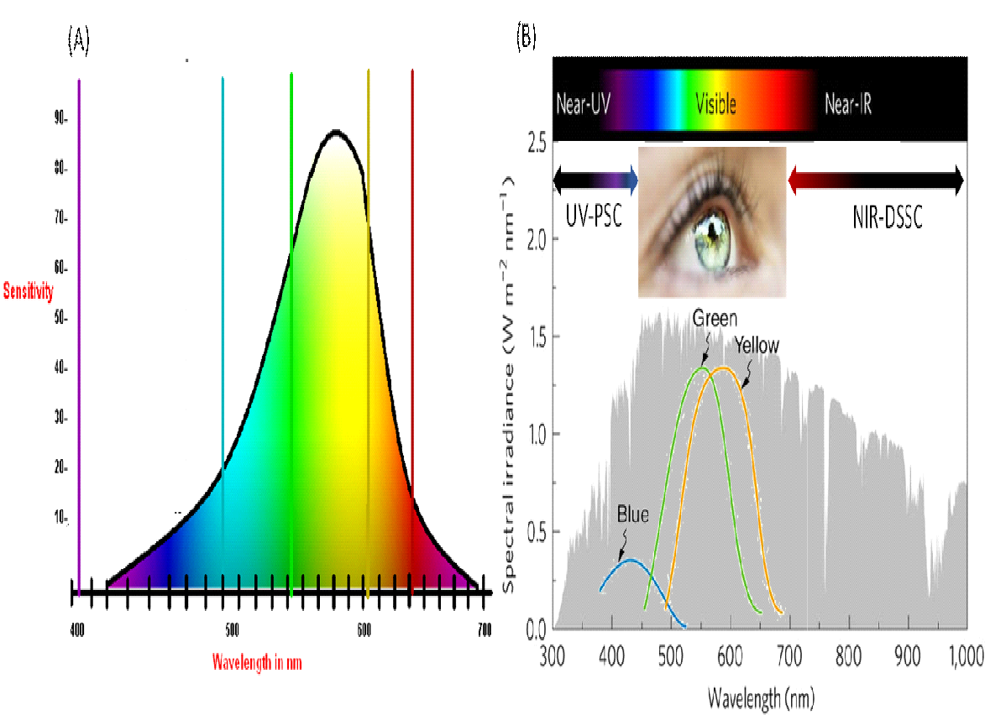
IMPRESSIVE Project
Ground-breaking tandem of transparent dye-sensitized and perovskite solar cells
Project Coordinator: Prof. F. SAUVAGE (Research Director at CNRS)
UV-perovskite solar cells
NIR-dye-sensitized solar cells
UV
NIR
Development of UV perovskite absorber (< 450 nm)
Development of transparent HTM
Development of transparent contacts
Objectives 75 % AVT - 6 % PCE
Development of NIR dyes (> 700 nm)
Development of transparent redox mediator
Development of transparent back-contact
Objectives 75 % AVT – 8 % PCE
4 terminal
Tandem cells and modules
Achieving 55% AVT - 14% PCE
https://impressive-h2020.eu
SC3-RES-2-2018
courtesy of Frederic Sauvage
Grant agreement 826013

Slide 9
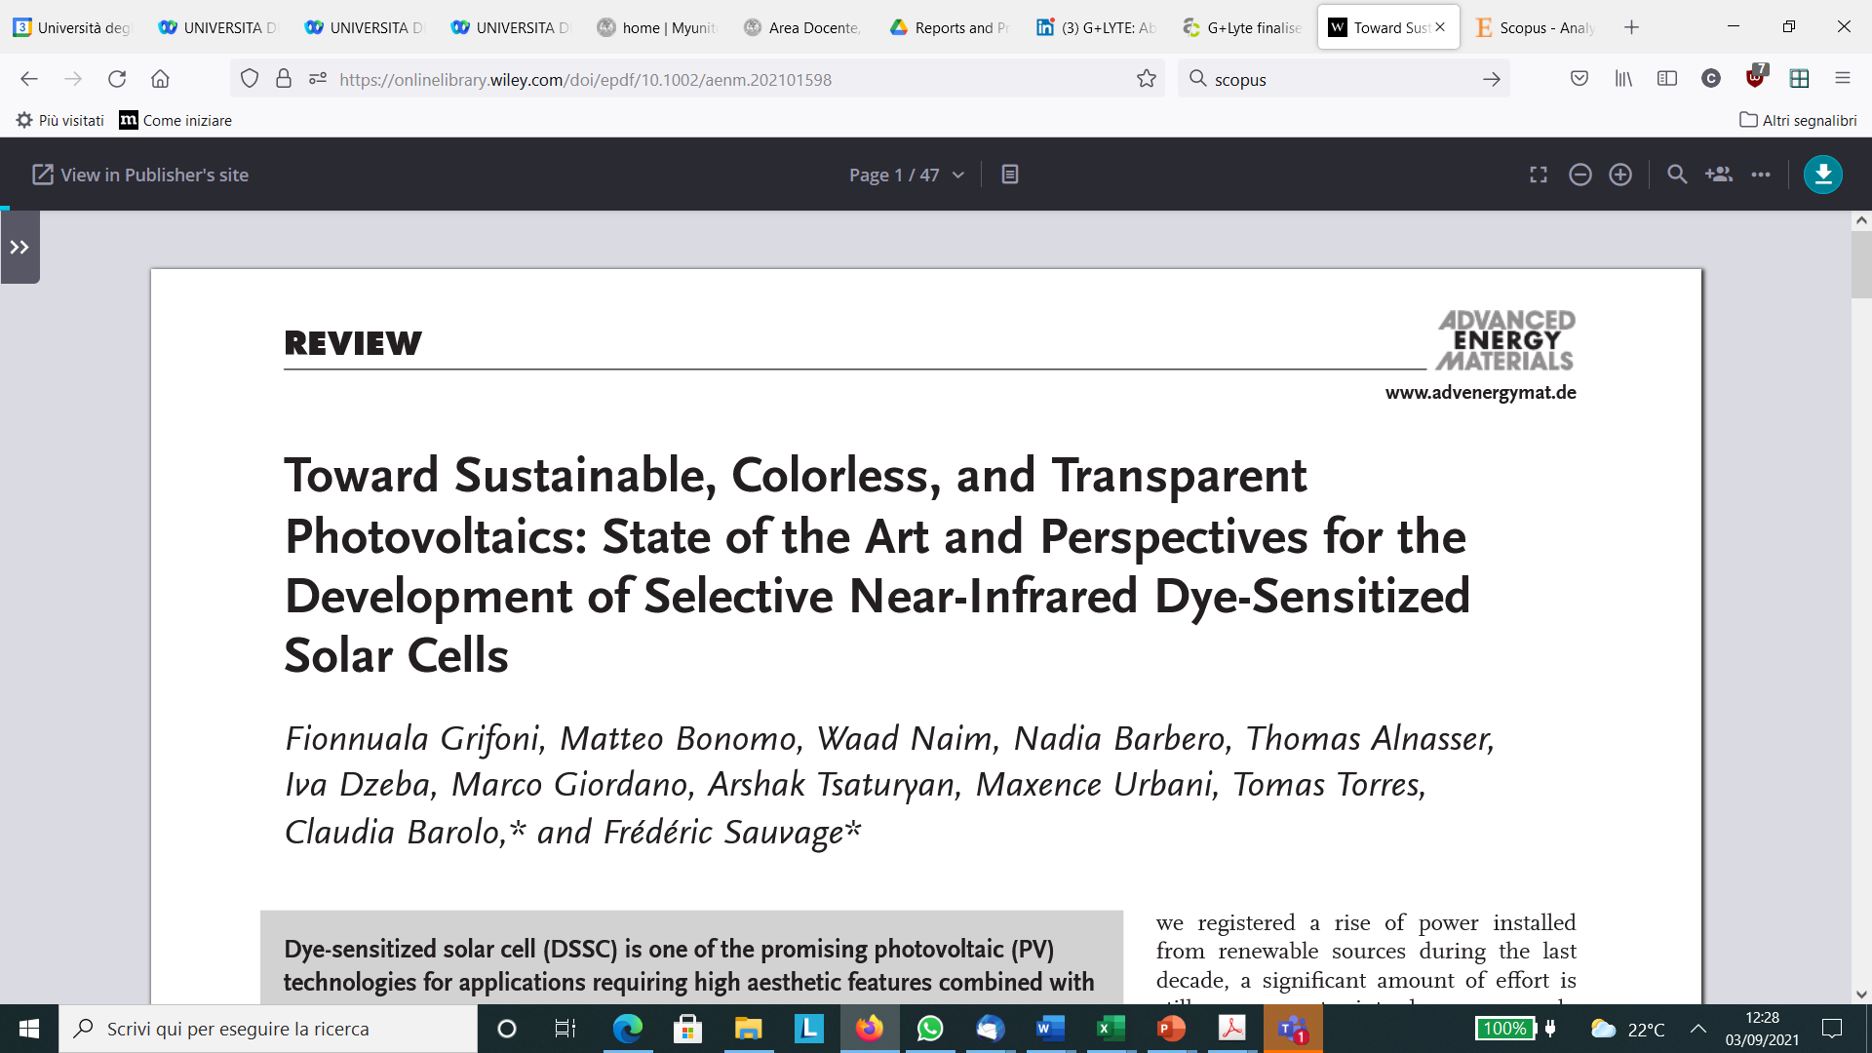
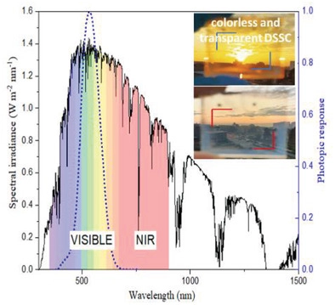

Development on NIR cell: DSSC cell with AVT ≥ 75% resulting in a high PCE
Transparent electrodes
Transparent redox couples
NIR-selective dyes
https://doi.org/10.1002/aenm.202101598

Slide 10
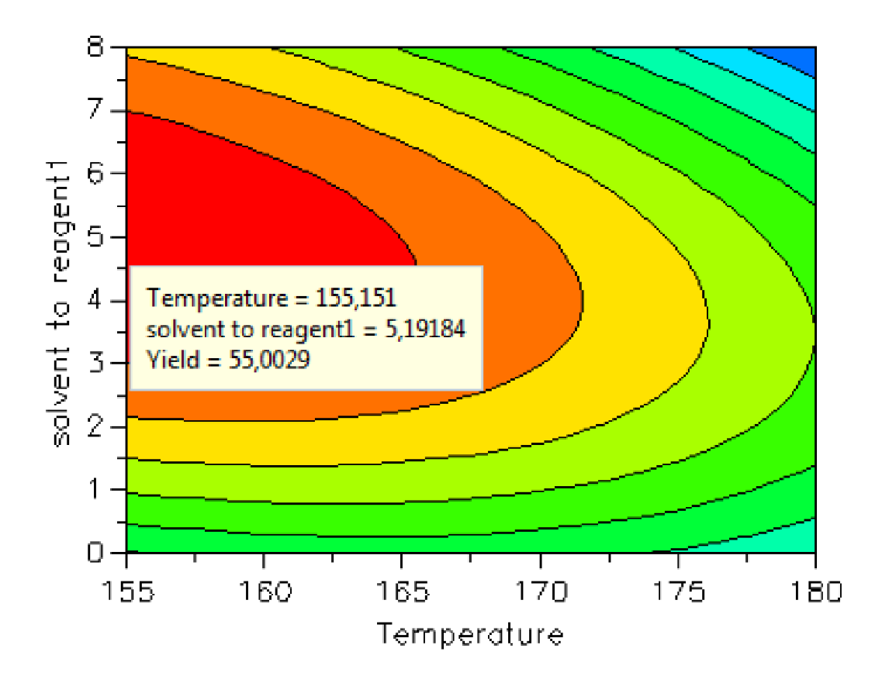
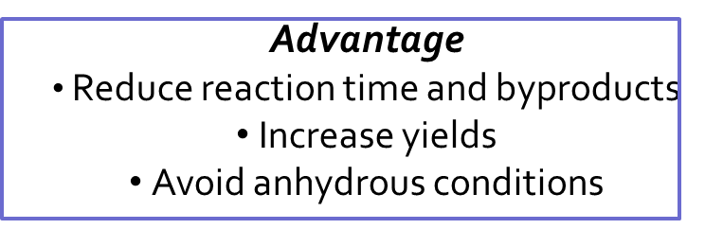
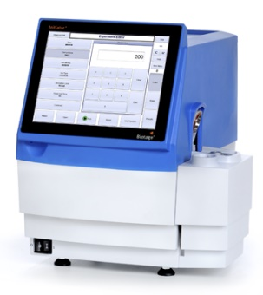
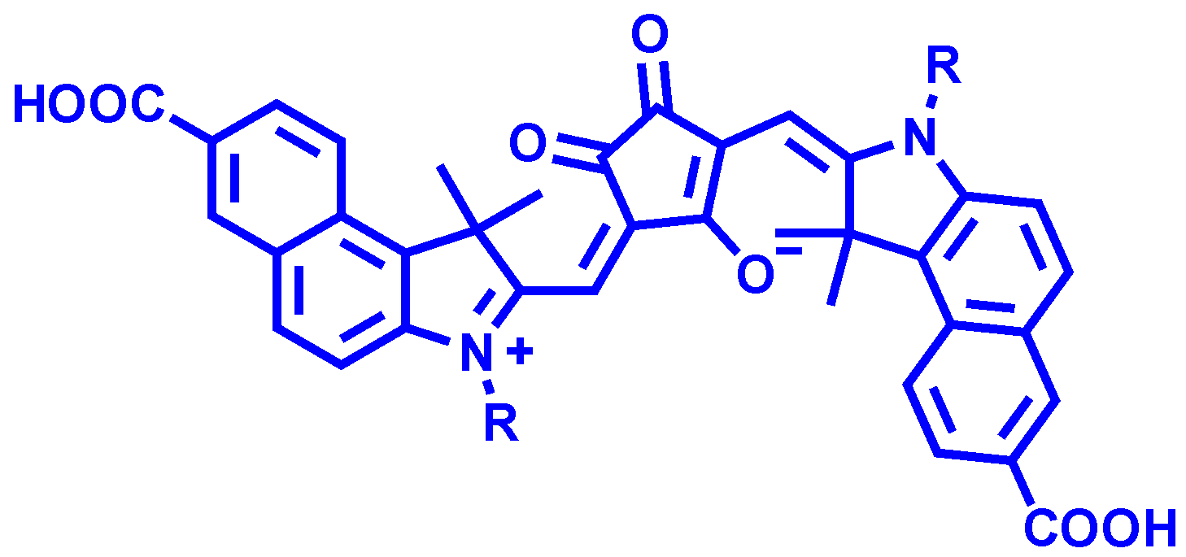
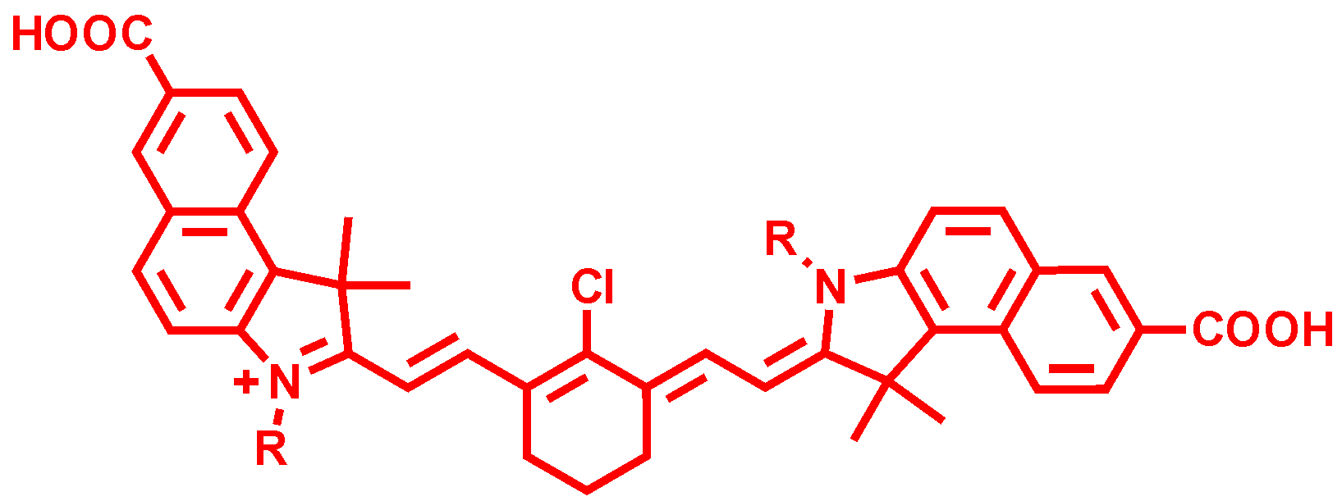
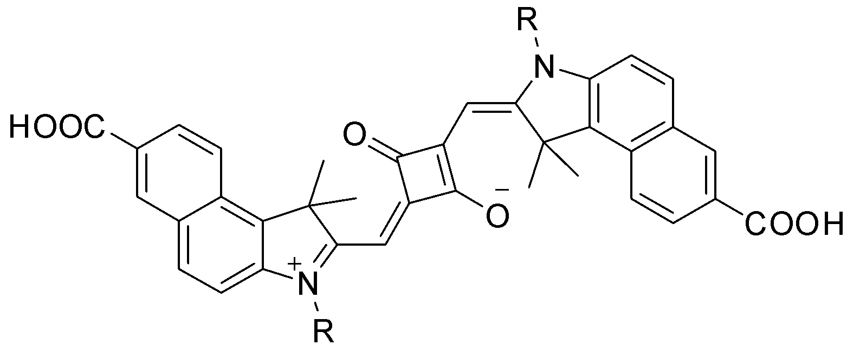
Polymethine-based dyes: far RED to NIR
Quaternization reactions in order to increase the acidity of the methyl group
DOE OPTIMIZATION
Squaraine VG10
Croconine VG25
Cyanine VG20
R = H, CH₂, C₄H₉, C₈H₁₇, C₁₀H₂₁, C₁₆H₂₄, Alk-X

Slide 11

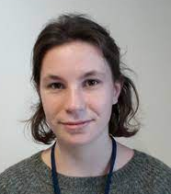
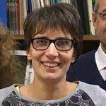
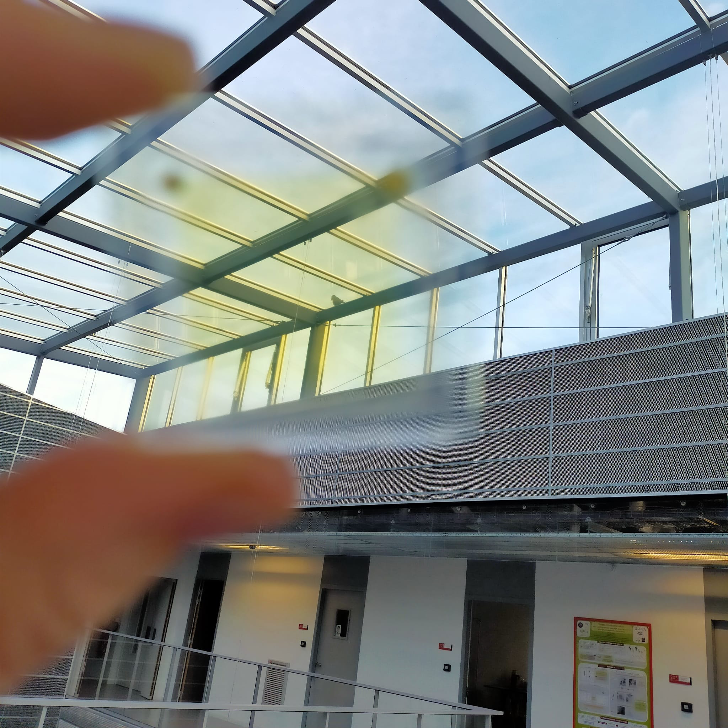
VG20-C16
R=-C₁₆H₃₃
BG: 1,45 eV
HOMO: -5,27 eV
LUMO: -3,82 eV
AVT 70%
CRI 92
https://impressive-h2020.eu/
Naim, W. et al. JACS Au 2021, 1, 409−426

Slide 12
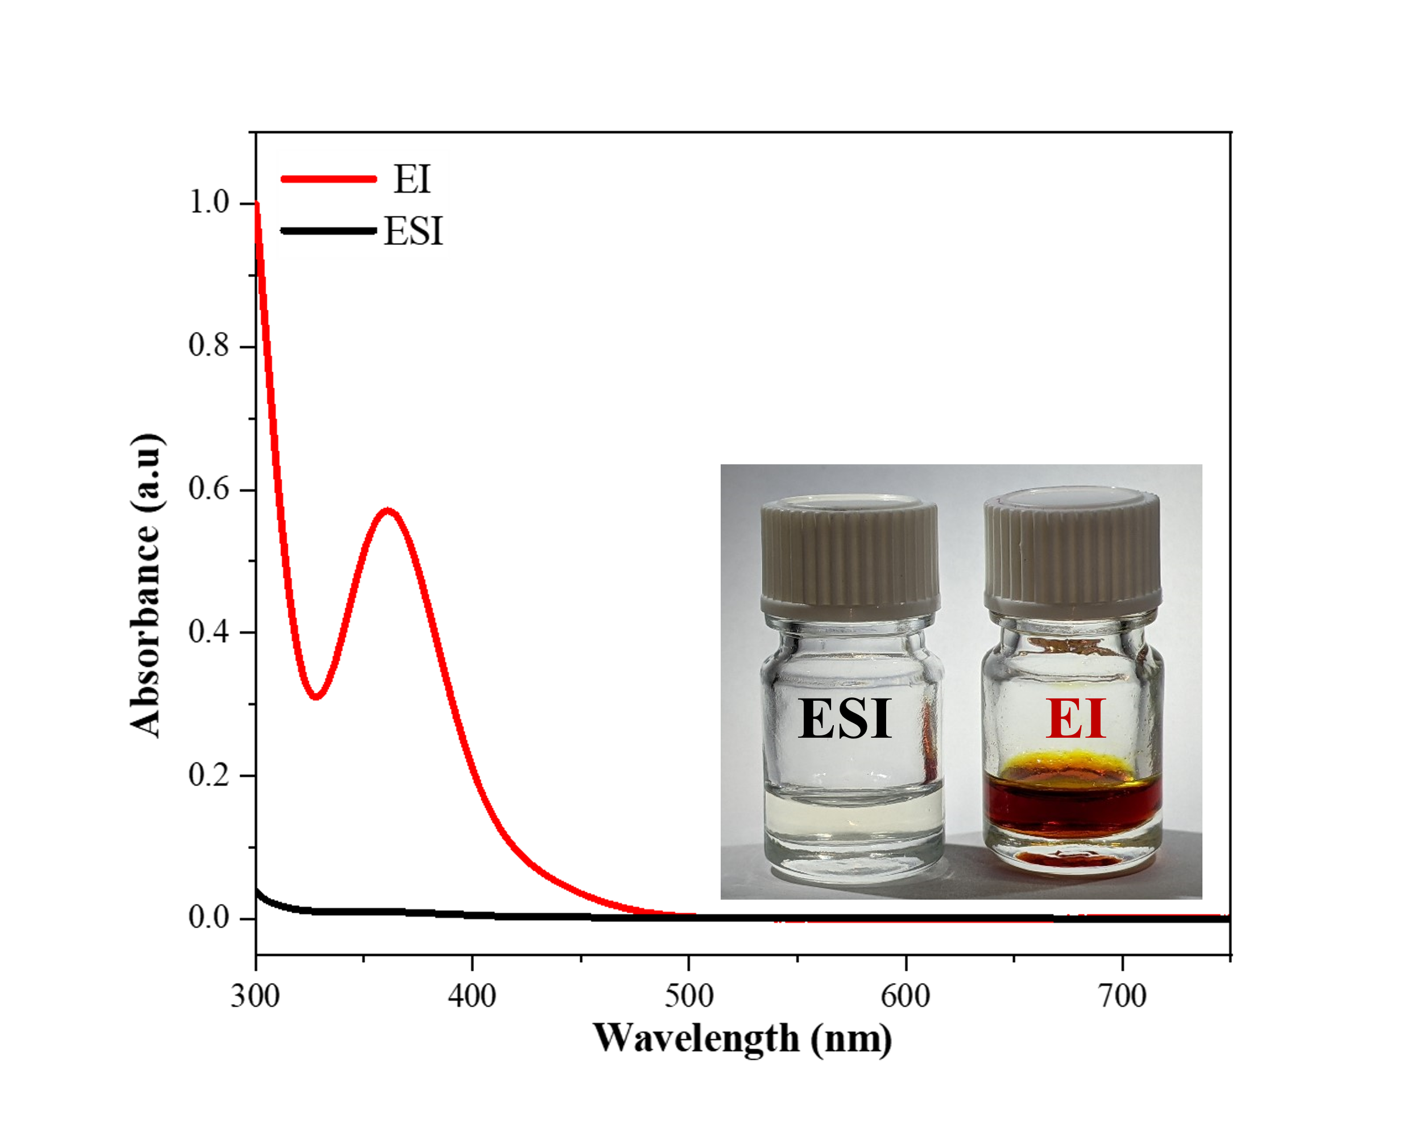
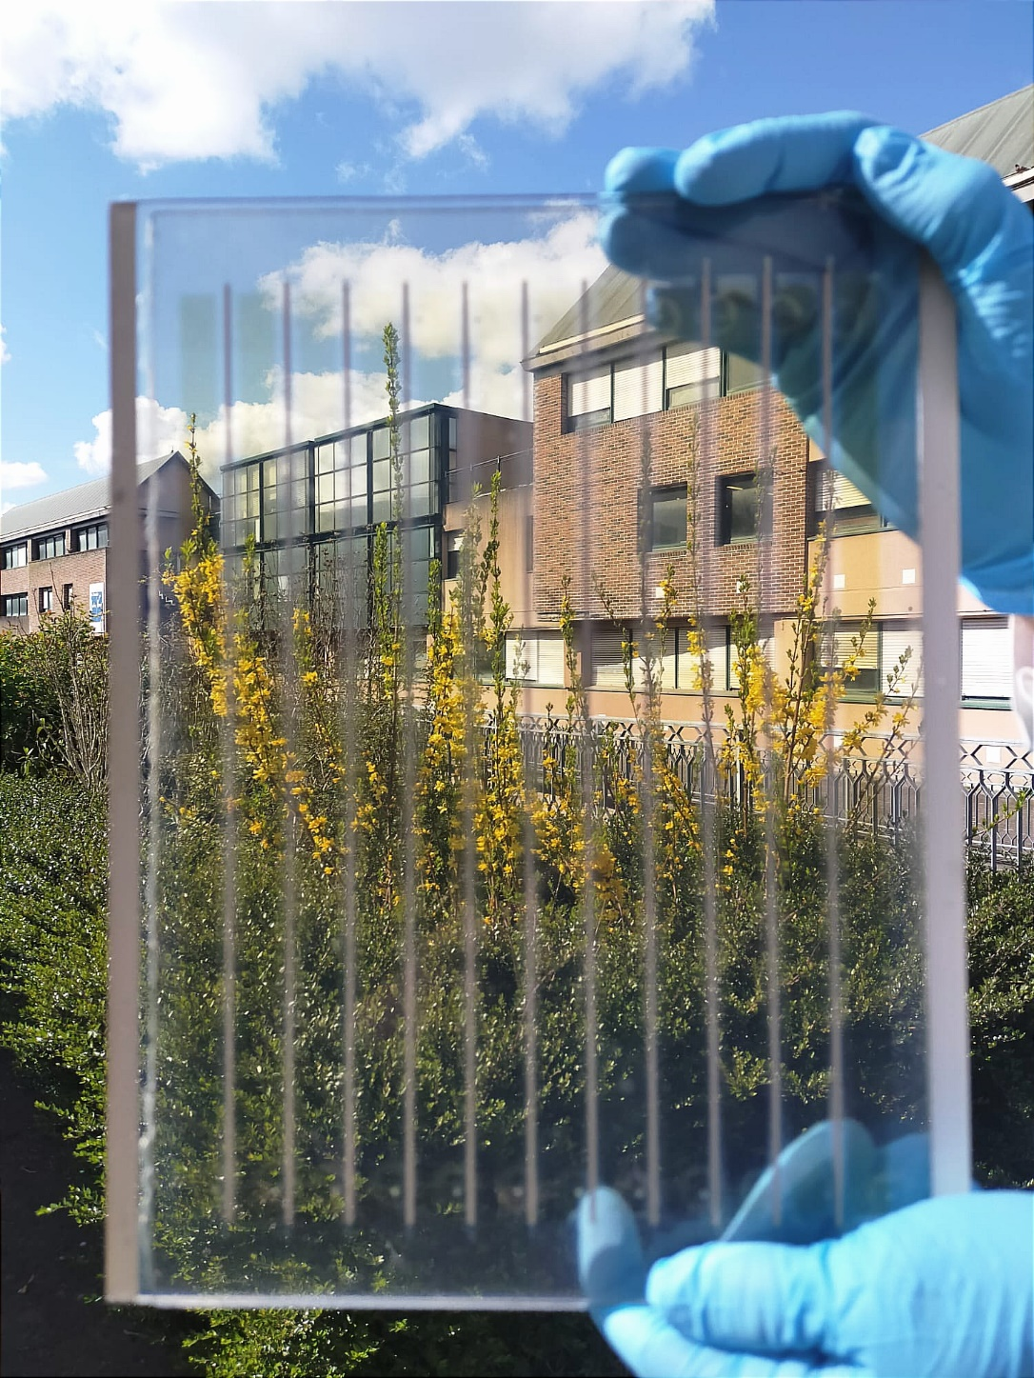
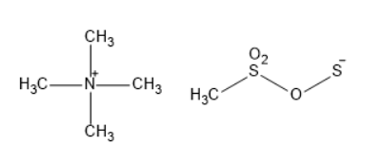
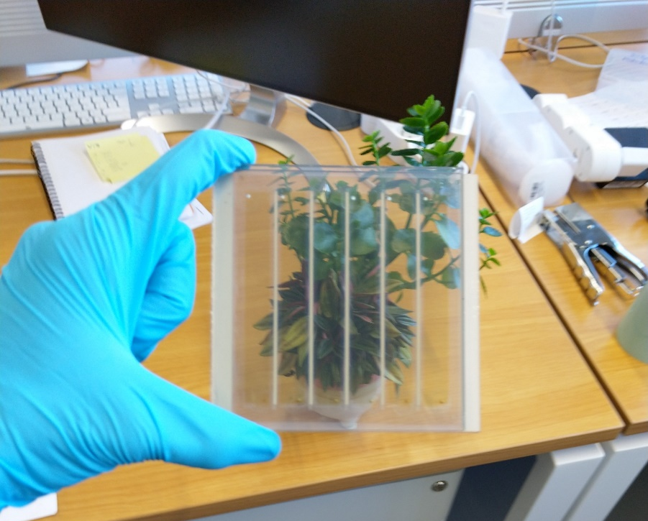
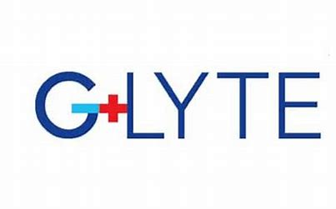

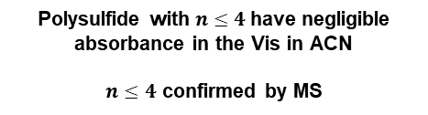
TMA⁺
Thiolate
$$S_{n}^{−} n≤4$$
Polysulfide with $n≤4$have negligible absorbance in the Vis in ACN
$n≤4$ confirmed by MS
Low-temperature sensitization approach affords reaching 3.1 % PCE (with scattering layer)
Electrolyte | V_{oc} (mV) | J_{sc} (mA/cm²) | Fill factor (%) | PCE (%)
ESI | 359 | 11.2 | 58 | 2.4
EI | 402 | 11.5 | 58 | 2.6
https://impressive-h2020.eu/
Grifoni F. et al. Manuscript in preparation

Slide 13
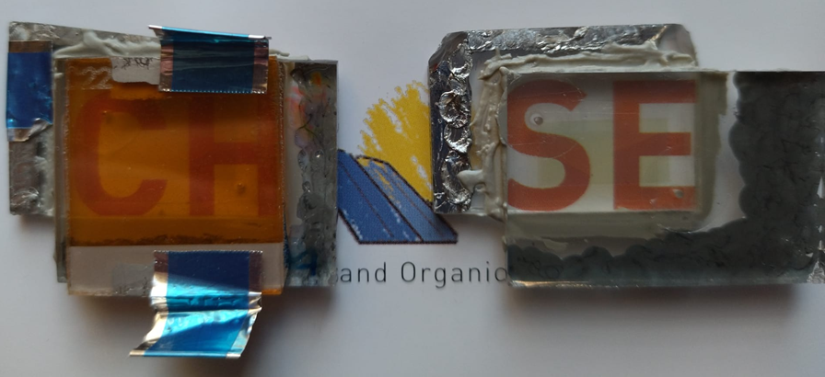
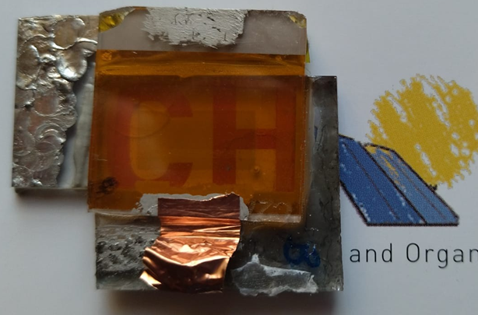
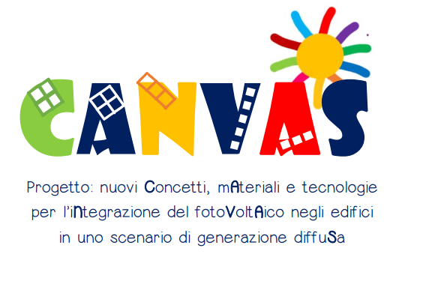
Some conclusions and more perspectives
Demonstrated the feasbility of selective NIR-DSSC with high transparency and color neutrality
We need to do better to overcame aggregation as a limitation for both performances and aesthetics
Obtained AVT=80%, CRI=96 with promising thiolate-based electrolyte.
Optimized the thickness for the best Light Utilization Efficiency
Technology completely non-intrusive with first modules
Still a lot of work to do…
4T-tandem UV-PSC/NIR-DSSC
New Dyes
Bonomo et al. Manuscript in preparation

Slide 14
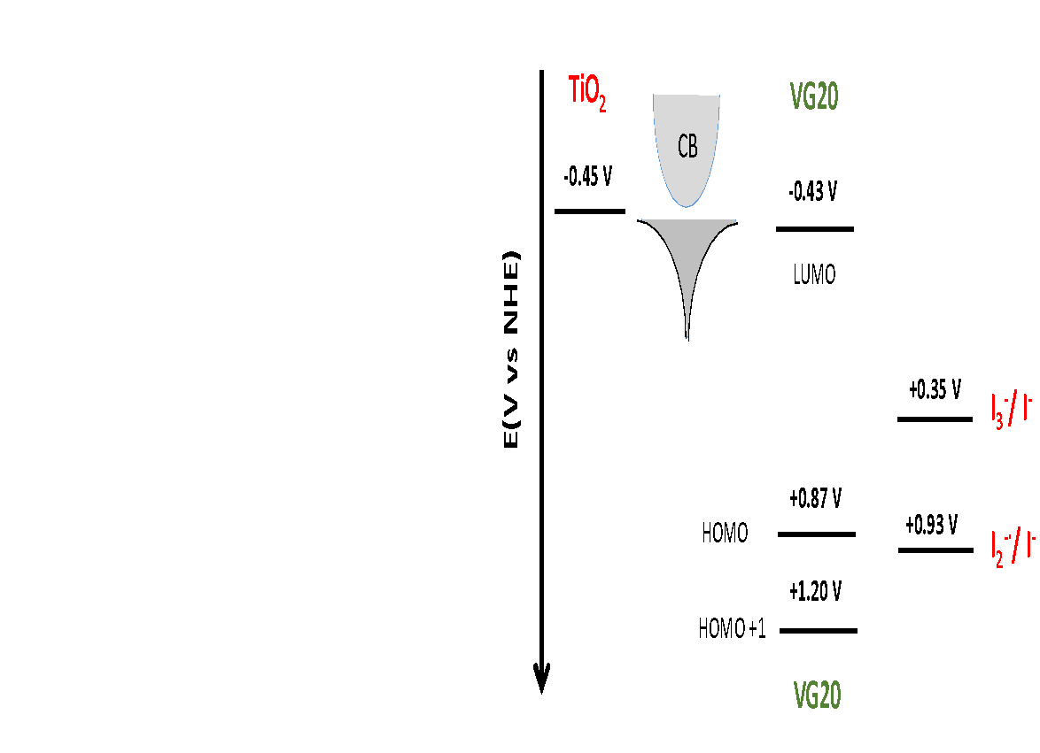
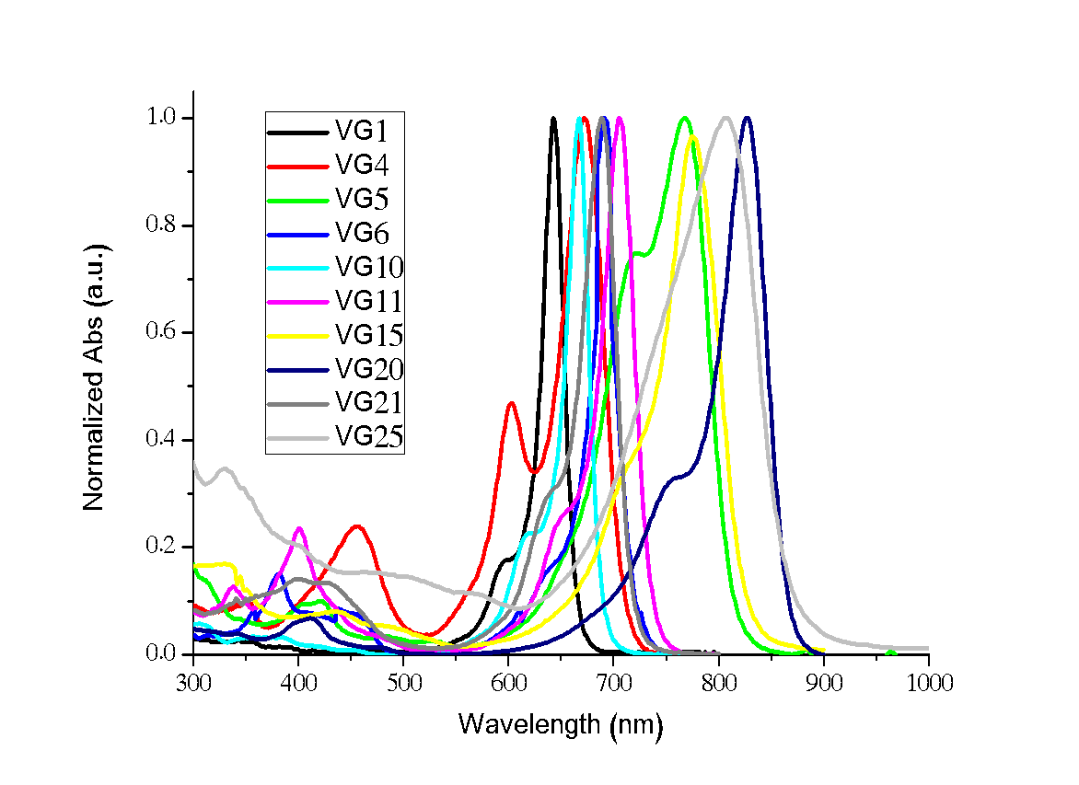
Far-Red / NIR polymethine dyes
λ_{max} from 643 to 827 nm

Slide 15
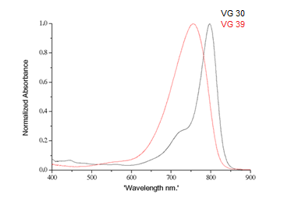
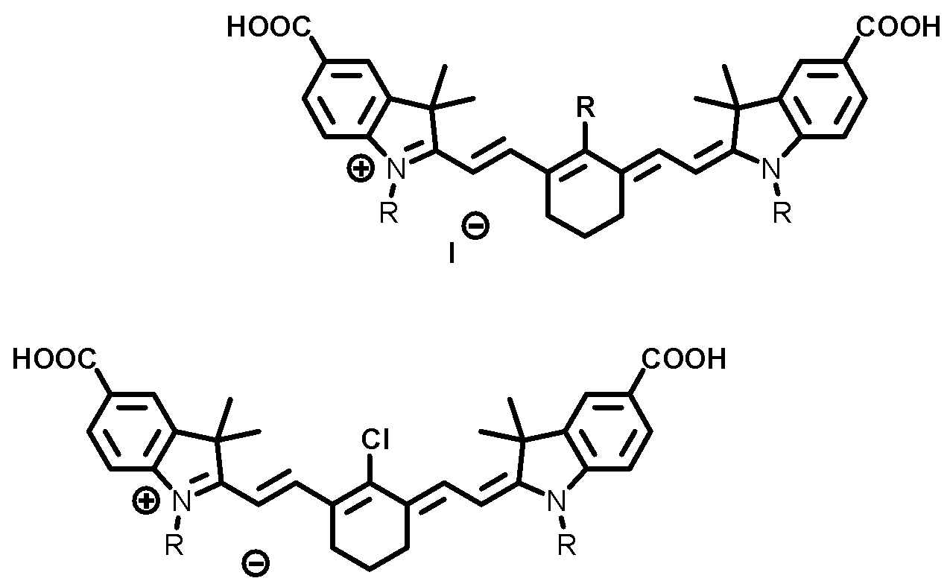
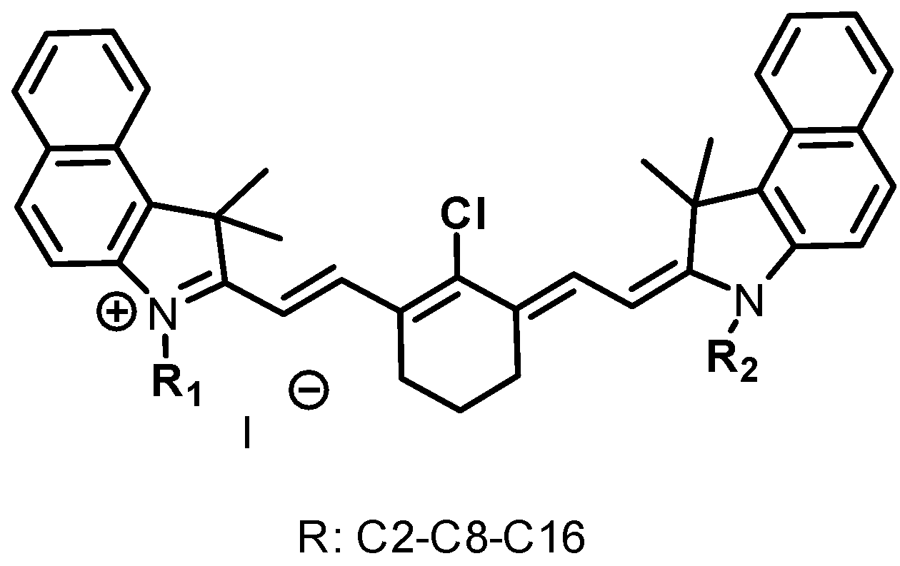
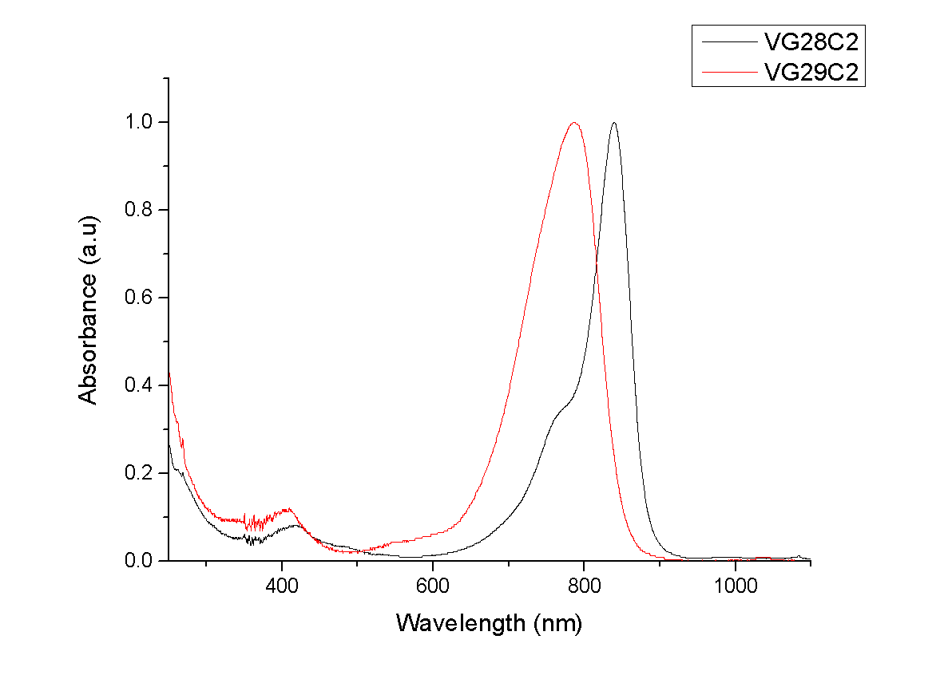


Evolution of Polymethine dyes
New synthesized compounds to improve the
chemical-physical properties of the selected dyes
substitutions on the linker chain
between the benzo[e]indole moieties
cyanine dyes without carboxylate groups (C2-8-16) and
with –COOH (C2-C8) anchoring group in the linker chain
between the benzo[e]indole moieties
(VG40 serie)
Starting from C2 to C8 alkyl chains and eventually synthetic strategies for C16 alkyl chains
Unpublished results

Slide 16


 | E_{1/2}/ V vs Ag/AgCl | E_{1/2}/ V vs Fc/Fc+ | HOMO / eV | E_{0/0} / eV | LUMO / eV
VG20 | 0.660 | 0.150 | -5.25 | 1.30 | - 3.95
VG30 | 0.840 | 0.330 | -5.43 | 1.55 | - 3.88
VG39 | 0.696 | 0.186 | -5.29 | 1,60 | -3.69
VG20 VG30 VG39
- 0.71
I⁻ / I₃⁻
BG = 1,30 BG = 1,55 BG = 1,60
+ 0.89
16

Slide 17

 | E_{1/2}/ V vs Ag/AgCl | E_{1/2}/ V vs Fc/Fc+ | HOMO / eV | E_{0/0} / eV | LUMO / eV
VG20 | 0.660 | 0.150 | -5.25 | 1.30 | - 3.95
VG30 | 0.840 | 0.330 | -5.43 | 1.55 | - 3.88
VG47 | 0.672 | 0.162 | -5.26 | 1.51 | - 3.75
VG20 VG30 VG47
B.G.
1.30
B.G.
1.55
B.G.
1.51
Unpublished results
Unpublished results
17

Slide 18


Dye | J_{SC} (mA/cm²) | V_{OC} (mV) | η (%)
VG20-C16 | 13.0 | 375 | 3.1
VG20-C2 | 7.8 | 415 | 2.2
VG28-C2 | 8.1 | 275 | 1.4
VG29-C2 | 9.1 | 422 | 2.4
VG30-C2 | 7.2 | 340 | 1.9
VG47-C2 | 1.3 | 328 | 0.32
https://impressive-h2020.eu/
Grifoni F. et al. Manuscript in preparation

Slide 19
Some conclusions and more perspectives
Demonstrated the feasbility of selective NIR-DSSC with high transparency and color neutrality
We need to do better to overcame aggregation as a limitation for both performances and aesthetics
Obtained AVT=80%, CRI=96 with promising thiolate-based electrolyte.
Optimized the thickness for the best Light Utilization Efficiency
Technology completely non-intrusive with first modules
Still a lot of work to do…
4T-tandem UV-PSC/NIR-DSSC
New Dyes
Bonomo et al. Manuscript in preparation

Slide 20

UV-PSC
NIR-DSSC
3.0% 3.0% 3.6%
4T-tandem UV-PSC/NIR-DSSC
https://impressive-h2020.eu/
Bonomo et al. Manuscript in preparation

Slide 21

Thanks for your kind attention!
Staff: G. Viscardi, C. Barolo, N. Barbero,
P. Quagliotto, A. Fin, M. Bonomo,
I. Benesperi, F. Cardano
PostDoc: M. Bokan, C. Pontremoli, S. Neirotti, D. Pasculli
PhD: D. Alencar, A. Segura, B. Centrella,
M. Rubes, B. Charrier, M. Franzini, D. Dereje, V. Maruzzo, G. Viada, D. Gallo
A. Di Carlo, F. Matteocci
R. Borrelli
F. Barath,
P. Chotard,
S. Ceurstemont
F. Sauvage, W. Naim, F. Grifoni
Grant agreement 826013
Grant agreement 826013

