Slide 1


Università degli Studi di Torino
Ufficio Servizi Bibliografici Digitali
Maria Vittoria Muzzupapa
Marco Stefano Tomatis

Slide 2

PREMISES
2014 - UniTO started the service “TUTTO” with a live chat reference integrated in it
Patrons asked for virtual reference to exploit the UniTo library services for bibliographic research
Analysis of chat logs from 2014 to 2016 was carried out
Automatic editing of FAQ for the UniTO Library System
Extending the live chat reference service at the University of Turin - a case study

Slide 3
AIM OF THE PROJECT
Respond to the question:
Is the amount of live chat exchanges addressed to the UniTo psychology library F. Kiesow so consistent to require the activation of a dedicated chat instance on the Kiesow library website?
Extending the live chat reference service at the University of Turin - a case study

Slide 4
OPERATING CONTEXT
The Psychology library Kiesow is part of the University of Turin “Polo delle Biblioteche Scientifiche” (scientific library group)
Extending the live chat reference service at the University of Turin - a case study

Slide 5
OPERATING CONTEXT
Polo delle Biblioteche Scientifiche:
Human Movement Science
Chemistry (Ponzio)
Earth Science (Spezia and Malaroda)
Informatics
Physics
Mathematics (Peano)
Pharmacy (Guareschi)
Biology
Psychology (Kiesow)
Extending the live chat reference service at the University of Turin - a case study

Slide 6
CONTENT ANALYSIS
How could we answer the project question?
Analysis of all the reference chat log files via text mining solutions:
Automatic selection of chat fragments tied to the different libraries of the Polo Scientifico by using subject-specific keywords
Enumeration of the selected texts
Extending the live chat reference service at the University of Turin - a case study

Slide 7
CONTENT ANALYSIS
Next step
Further selection of all the Psychology-related chat exchanges by defining a new set of useful keywords
Extending the live chat reference service at the University of Turin - a case study

Slide 8
WHICH FILTERS?
Keywords were carefully chosen according to the following criteria:
Institutional
Semantic
Extending the live chat reference service at the University of Turin - a case study

Slide 9
WHICH FILTERS?
Institutional criteria:
Keywords which explicitly mention the University of Turin Psychology library or its resources
e.g.:
“Kiesow”
“PsycArticles”
“PsycInfo”
Extending the live chat reference service at the University of Turin - a case study

Slide 10
WHICH FILTERS?
Semantic criteria:
Keywords expressing specific psychology subjects
e.g.:
“Disturbo” (disturbance)
“Apprendimento” (learning)
“Disorder”
Extending the live chat reference service at the University of Turin - a case study

Slide 11
QUALITATIVE APPROACH
Usage of READ Scale to define a set of tagging codes to:
Perform further manual analysis to identify the different skills the reference librarian is asked to exercise to reply patron requests
Extending the live chat reference service at the University of Turin - a case study

Slide 12
METHODOLOGICAL APPROACH
Preliminary steps:
Save all chat sessions in CSV format log files
Merge all chat logs into a single file
Extending the live chat reference service at the University of Turin - a case study

Slide 13
METHODOLOGICAL APPROACH
Design of scripts for:
Removing administrative and non-pertinent information
Delimiting each chat exchange via XML tags “<chat>…</chat>”
Tokenize the entire log file
Extending the live chat reference service at the University of Turin - a case study

Slide 14
TEXT MINING
Design Regular Expressions
into
GAWK scripts
for
using Pattern Matching facility
to
Retrieve all the chat exchanges responding to our selection criteria - keywords
Extending the live chat reference service at the University of Turin - a case study

Slide 15
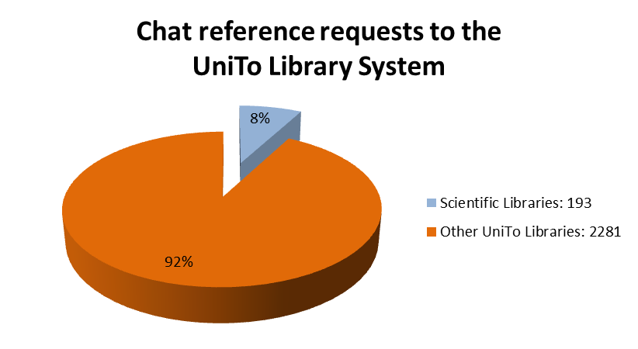
Extending the live chat reference service at the University of Turin - a case study

Slide 16
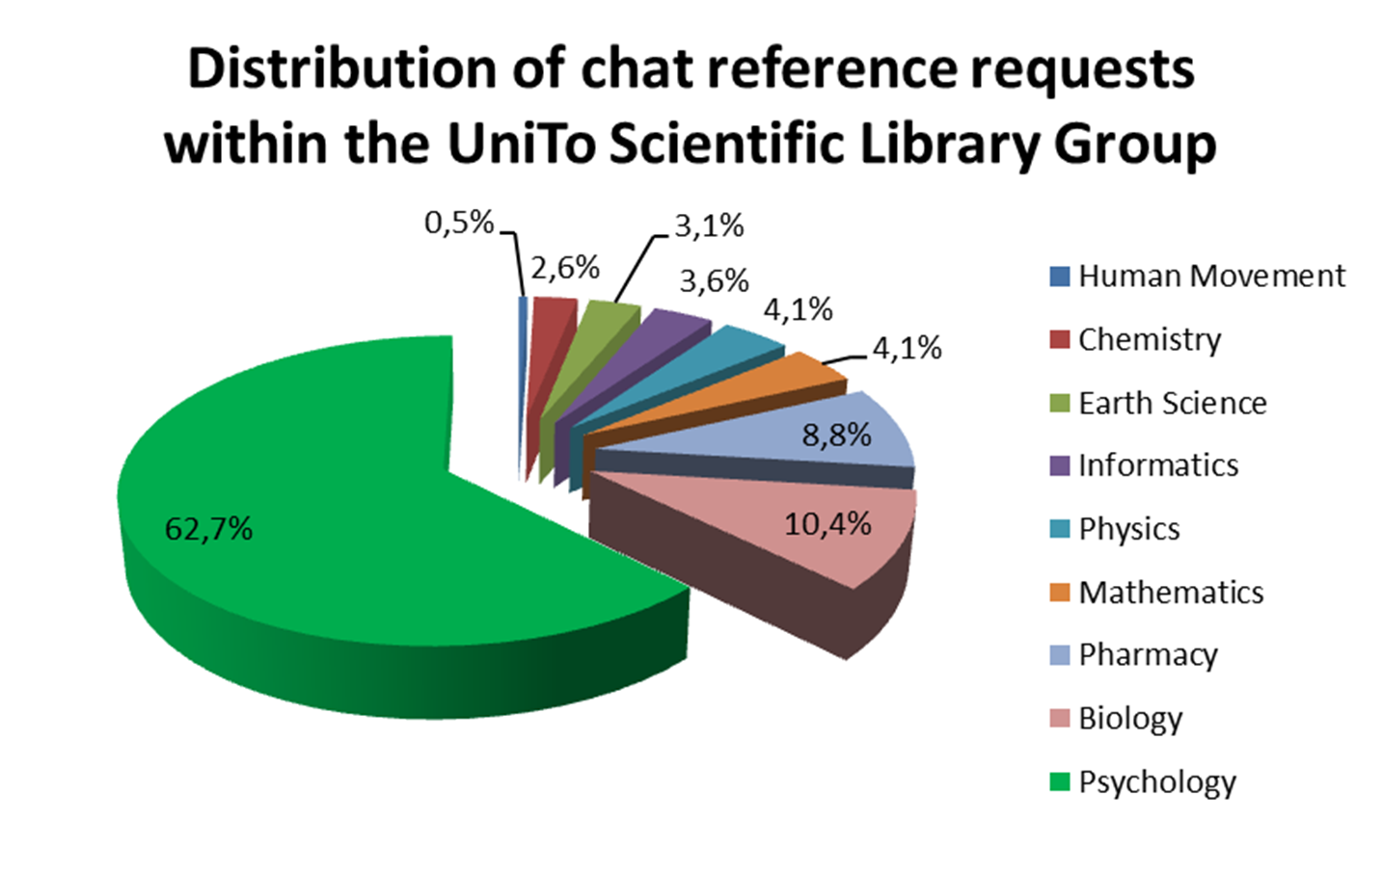
Extending the live chat reference service at the University of Turin - a case study

Slide 17
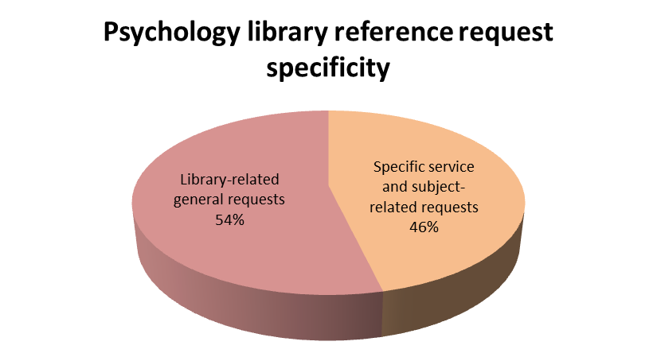
Extending the live chat reference service at the University of Turin - a case study

