Slide 1




Do donkeys grazing in woody-encroached Alpine pastures behave as mixed-feeders?
A case study from Gran Paradiso National Park
Session FS 3.203
European Mountain Livestock Farming: Challenges and Solutions
Volpe Jacopo¹, Pittarello Marco², Nota Ginevra¹, Lonati Michele¹, and Lombardi Giampiero¹
¹ Department of Agriculture, Forest and Food Sciences, University of Torino, Largo Paolo Braccini 2, 10095 Grugliasco, TO, Italy
² Department of Veterinary Sciences, University of Torino, Largo Paolo Braccini 2, 10095 Grugliasco, TO, Italy

Slide 2
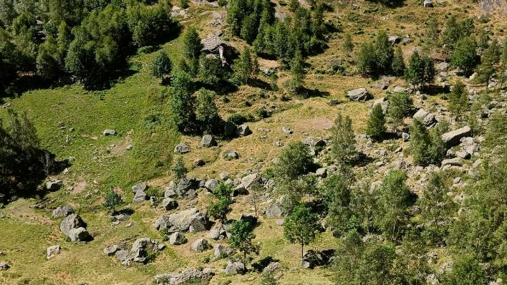
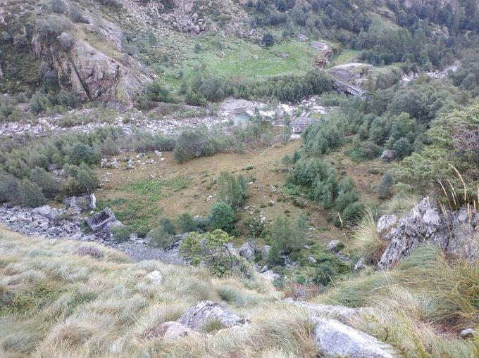
Alpine semi-natural pastures
Conclusions
Results & Discussions
Materials & Methods
Introduction
Actuality
Decline since the 1950s following the economic boom
Woody tree and shrub species encroachment
Loss of ecological services

Slide 3
Alpine semi-natural pastures
Conclusions
Results & Discussions
Materials & Methods
Introduction
Actuality
Decline since the 1950s following the economic boom
Restoration
Hardy breeds
Consumption of woody species
Woody tree and shrub species encroachment
Loss of ecological services

Slide 4
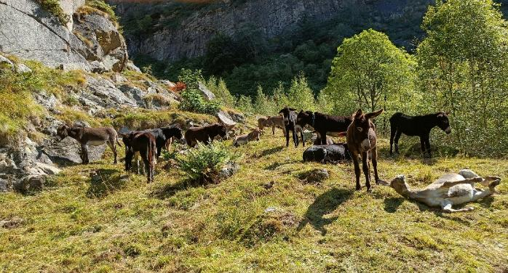
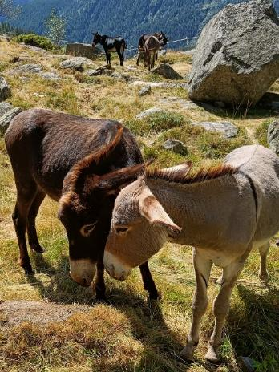
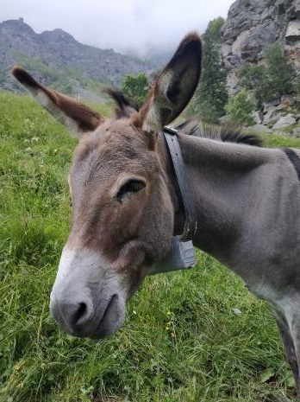
Alpine semi-natural pastures
Conclusions
Results & Discussions
Materials & Methods
Introduction
Actuality
Decline since the 1950s following the economic boom
Restoration
Hardy breeds
Domestic donkey
Historical and biodiversity value
Consumption of woody species
Woody tree and shrub species encroachment
Loss of ecological services
Progressive decline

Slide 5
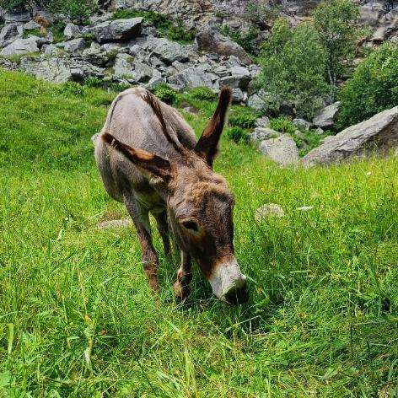
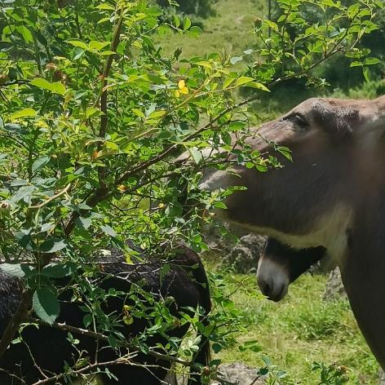
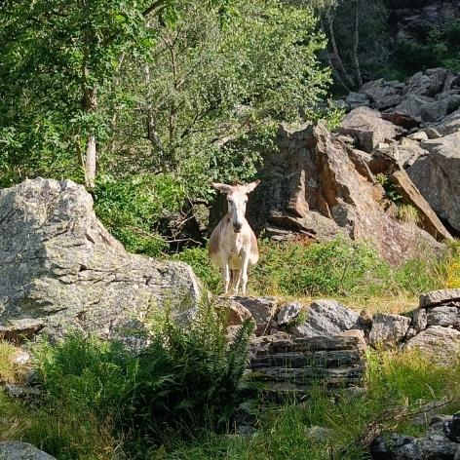
Conclusions
Results & Discussions
Materials & Methods
Introduction
Objectives
Diet composition
Abundance-consumption relationships

Slide 6
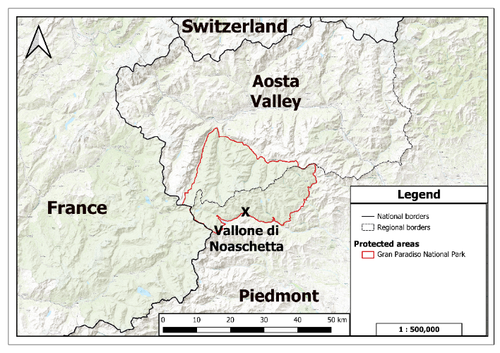
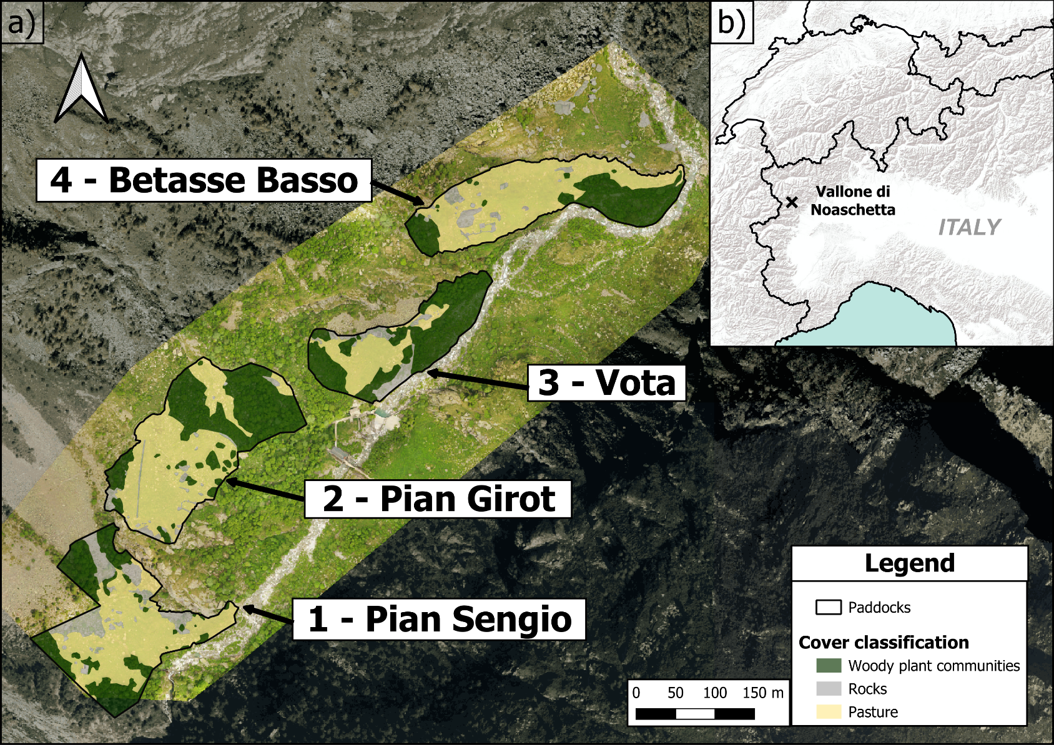
Geographical framework
Conclusions
Results & Discussions
Materials & Methods
Introduction
Gran Paradiso National Park
Encroached surface
1 - Pian Sengio | 31%
2 - Pian Girot | 43%
3 - Vota | 61%
4 - Betasse Basso | 31%

Slide 7

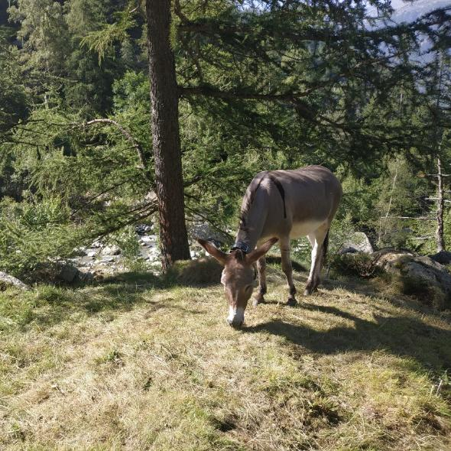
Conclusions
Results & Discussions
Materials & Methods
Introduction
Survey protocol
Direct observations:
Each observer selects a donkey
15 seconds of observation and 20 seconds of pause
OBSERVATIONS
PAUSE
OBSERVATIONS
PAUSE
OBSERVATIONS
15 sec
20 sec
15 sec
20 sec
15 sec
Relative abundance and consumption for each species (0-100%)
(e.g.: Abundance 80% species A, 20% species B
Consumed 40% species A, 60% species B)
One meter of buffer around the head, tow meters hight
2 m
I m

Slide 8
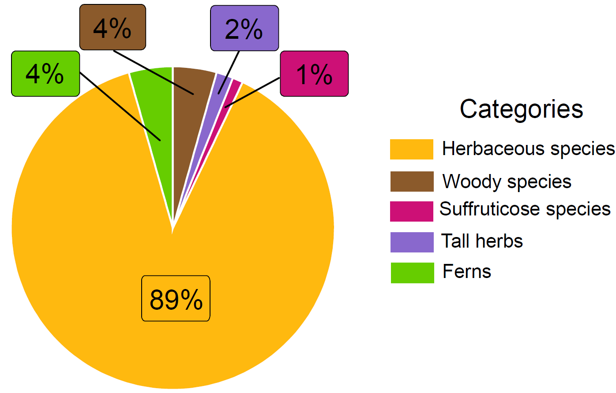
Diet composition
Conclusions
Results & Discussions
Materials & Methods
Introduction

Slide 9
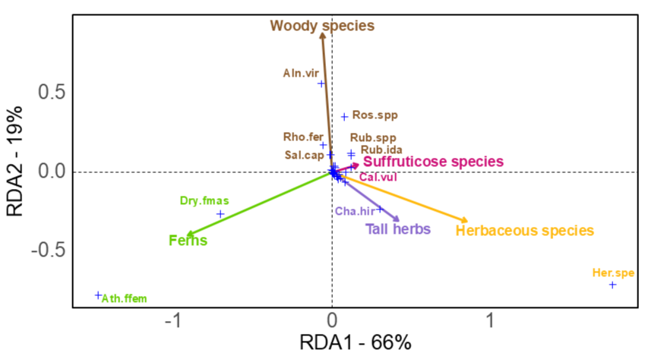
Redundancy Analysis
Conclusions
Results & Discussions
Materials & Methods
Introduction

Slide 10
Redundancy Analysis
Conclusions
Results & Discussions
Materials & Methods
Introduction

Slide 11
Conclusions
Results & Discussions
Materials & Methods
Introduction
Redundancy Analysis

Slide 12
Redundancy Analysis
Conclusions
Materials & Methods
Introduction
Results & Discussions

Slide 13



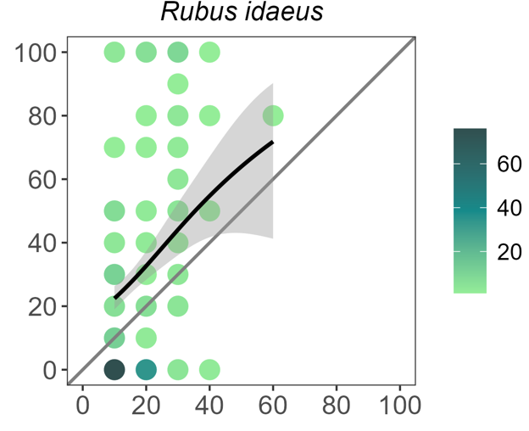
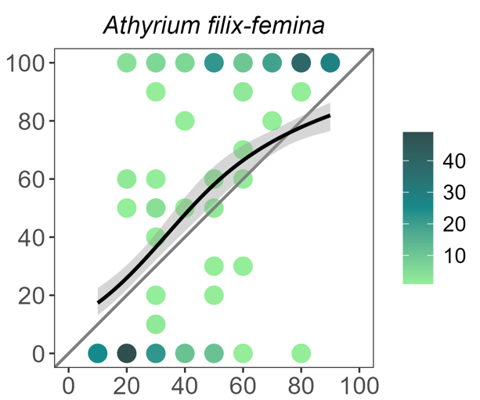
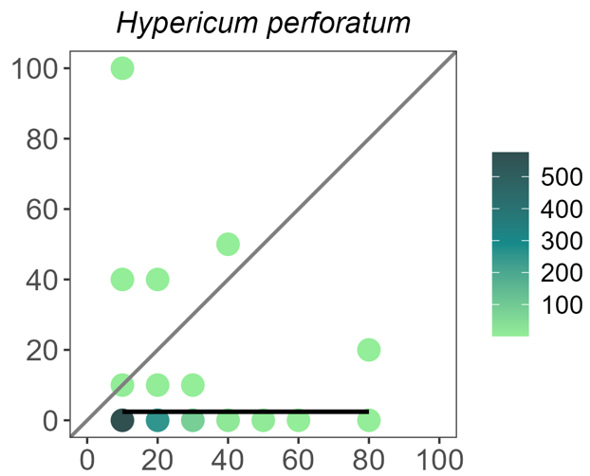
Abundance-consumption relationship
Conclusions
Results & Discussions
Materials & Methods
Introduction
Generalized Additive Models (GAM)
Different relationships between abundance and consumption of the species
More than
proportional selection
Proportional
selection
Less than
proportional selection

Slide 14
Species selection
Conclusions
Results & Discussions
Materials & Methods
Introduction
3 woody species: Rubus ideas, Salix caprea, Sorbus aria
INDIFFERENT SPECIES
4 woody species: e.g. Alnus viridis, Cytisus scoparius, Rosa spp.
2 suffruticose: Callina vulgaris and Vaccinium myrtillus
AVOIDED SPECIES
6 tall herbs: e.g. Hypericum perforatum, Rumex obtusifolius
3 woody species: Betula pendula, Juniperus nana, Larix decidua
1 suffruticose: Genista germanica
2 ferns: Athyrium filix-femina and Dryopteris filix-mass
PREFERRED SPECIES

Slide 15




Conclusions
Conclusions
Results & Discussions
Materials & Methods
Introduction
Preference for herbaceous species
Ability to adapt the diet in silvopastoral contexts by consuming woody species(e.g. A. viridis, Rubus ideaus or S. caprea) and ferns(e.g. A. filix-femina)
Mix-herds with: Domestic grazers (e.g. goats Boer or Cashmere); Non-selective sheep (e.g. Skudden); Rustic cattle (e.g. Highlands or Dexter)

Slide 16
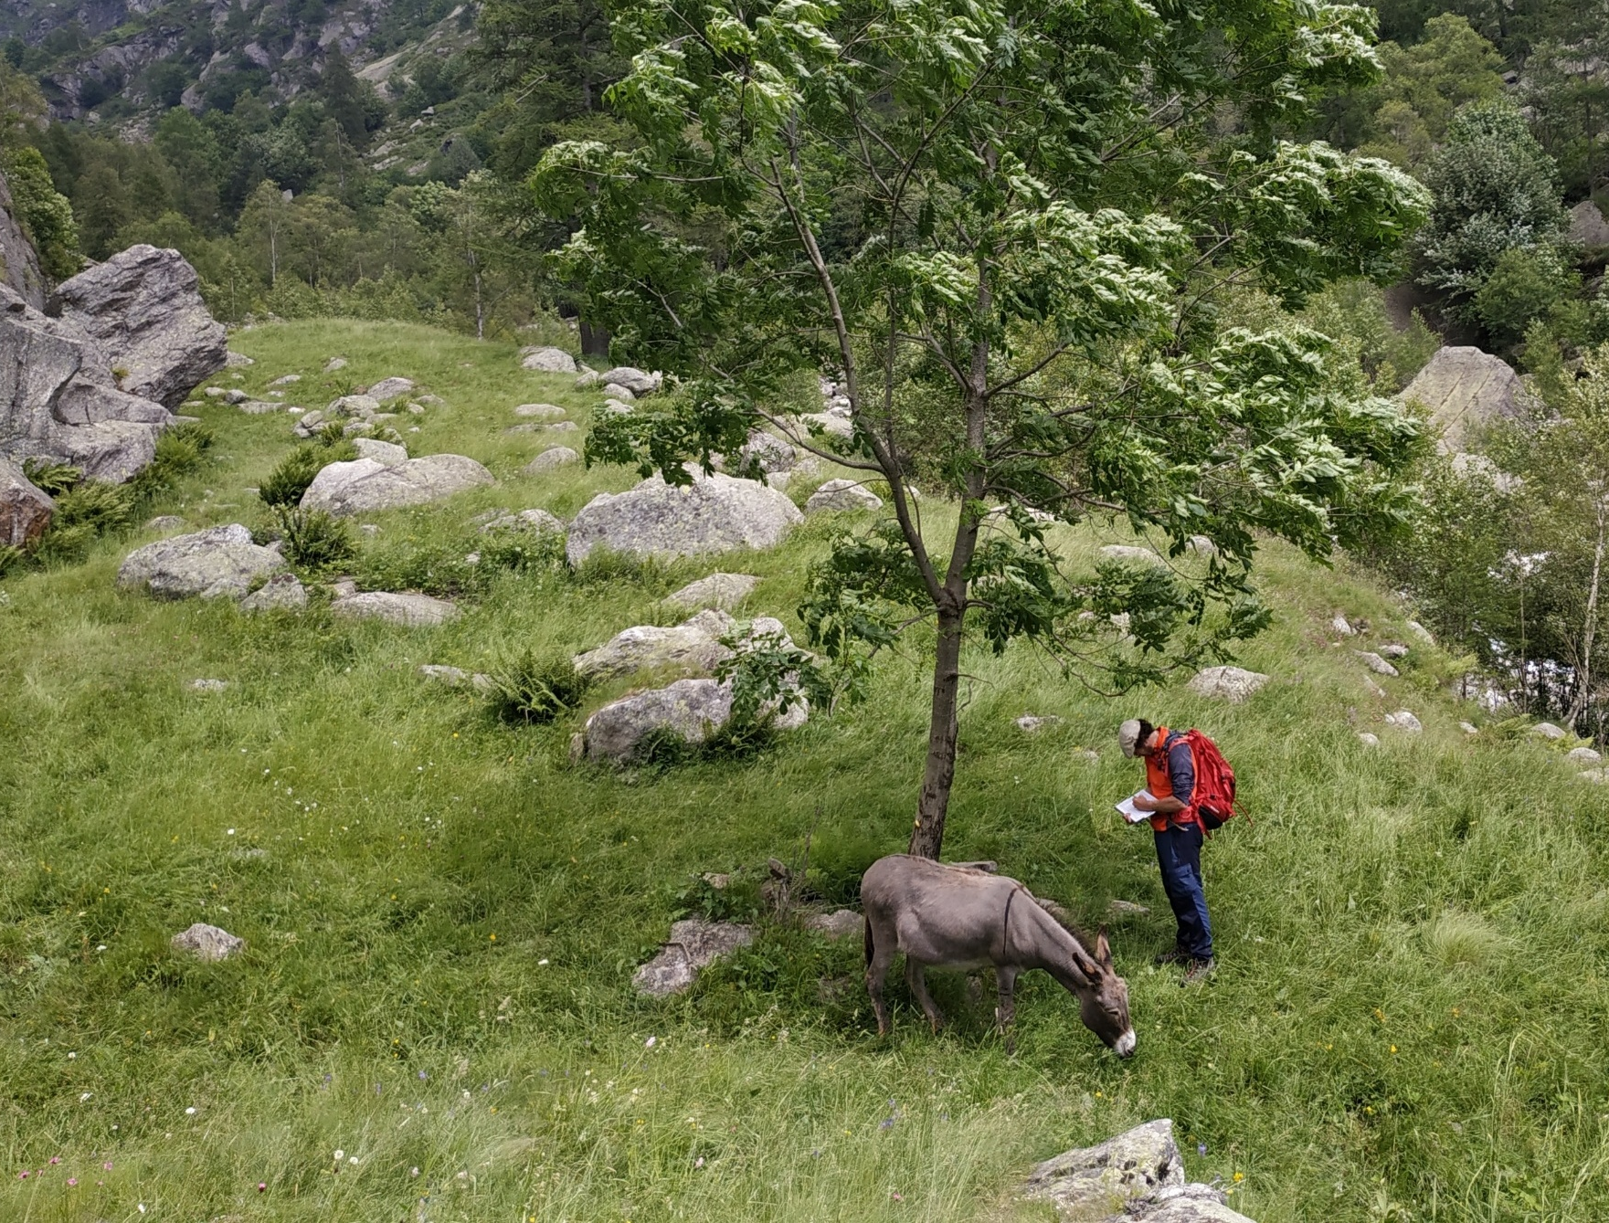
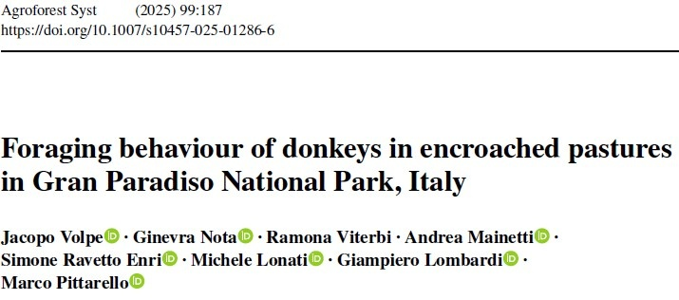




Thank you for your attention
Contact:
Jacopo Volpe
jacopo.volpe@unito.it

