Slide 1





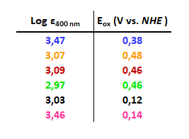
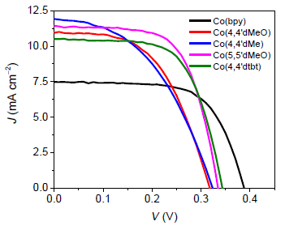

Synthesis of NIR Rylene Dyes and Cobalt-based Redox Couple for Colourless Dye-sensitized Solar Cells
Marco Giordanoª, G. Giobbioª, F. Cardanoª, A. Fin^{b}, N. Barberoª, R. Borrelli^{c}, Y. Ren^{d}, S. M. Zakeeruddin^{d}, M. Grätzel^{d}, C. Baroloª, G. Viscardiª, F. Sauvage^{e}
ª Dipartimento di Chimica, NIS Interdepartmental and INSTM Reference Centre, Università di Torino, Torino, Italy
^{b} Dipartimento di Scienza e Tecnologia del Farmaco, Università di Torino, Torino, Italy
^{c} Dipartimento di Scienze Agrarie Forestali e Alimentari, Università di Torino, Grugliasco, Italy
^{d} Laboratoire de Photonique et interfaces, Ecole Polytechnique Fédérale de Lausanne, Lausanne, Switzerland
^{e} Laboratoire de Réactivité et Chimie des Solides, CNRS UMR7314, Université de Picardie Jules Verne, Amiens, France
E-mail: marco.giordano@unito.it
Photovoltaic cells (PV) assembled with semiconductor technology techniques are, nowadays, the most efficient systems for solar energy conversion.^{1,2} Dye-Sensitized Solar Cells (DSSCs) represent one of the best performing technologies developed in the last decades to overcome the limitations of the well-known silicon-based photovoltaics cells^{1,2}. Building Integrated PhotoVoltaics (BIPV) based on DSSC are a promising application to make DSSC more attractive in the energy production field. An innovative approach resides on the implementation of a new class of colourless DSSCs based on NIR rylene dyes along with transparent cobalt complexes redox couples.^{3,4} The overall properties of the dyes and complexes will be investigated and modulated to achieve the photophysical and electronical requirements to assembly innovative devices able to shorten the gap with the silicon-based photovoltaic cells.
Cobalt complexes
Bi- and ter-pyridine-based ligands, decorated with various substituents, will be synthetized to produce a large library of cobalt (II) complexes as redox mediator for BIPV devices. One of our redox mediator was already tested in NIR-DSSC with the cyanine dye VG20-C16 showing a promising efficiency of 1,81%.
PCE% 0% to 2,5% depending on cell condition
Very low absorbance in the visible window!!
Absorption data were acquired in acetonitrile. The CVs data were performed in acetonitrile, 0.1 M TBAPF₆ as a support electrolyte
We thank Dr. Yameng Ren for I-V curves data
Rylene dyes
Our group will stepwise extend the rylene aromatic core to tune the electronical properties of the dyes, while introducing various substituents on the bay positions to improve the processability of the final materials. Our synthetic strategies allows to obtain two families of dyes. The "asymmetrical" rylene dyes bearing a bromine group will allow the insertion of a wide range of push pull substituents.
On going synthesis…
References
Acknowledgement
[1] M. Freitag, J. Teuscher, Y. Saygili, X. Zhang, F. Giordano, P. Liska, J. Hua, S. M. Zakeeruddin, J.-E. Moser, M. Grätzel, M. et al., Nature Photonics, 2017, 11, 372-379. [2] N. Barbero, F. Sauvage, in Materials for Sustainable Energy Applications: Conversion, Storage, Transmission and Consumption, CRC Press, 2016, 87-147. [3] M. Wang, C. Grätzel, S. M. Zakeeruddin, M. Grätzel, Energy Environ. Sci., 2012, 5, 9394. [4] C. Ji, W. Cheng, Q. Yuan, K. Müllen, M. Yin, Acc. Chem. Res., 2019, 52, 2266-2277.
This project has received funding from the European Union’s Horizon 2020 research and innovation program under grant agreement No 826013 (IMPRESSIVE).

