Slide 1
DIDACTICAL SUITABILITY CRITERIA USED BY ITALIAN TEACHERS IN LESSON STUDIES
Carola Manolino¹
Viviane Hummes²
Adriana Breda²
Alicia Sánchez²
Vicenç Font²
¹Università di Torino, ²Universitat de Barcelona

Slide 2
Research Objective
Analyse which Didactical Suitability Criteria were implicitly used by a group of Italian Primary school teachers in their Lesson Plans, written during the documentation of a Lesson Study experiment in which they were involved.

Slide 3
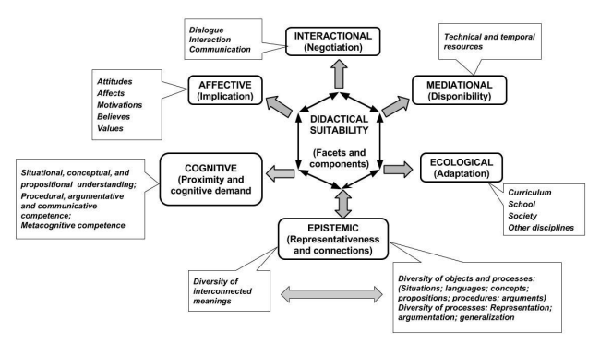
Didactical Suitability Criteria
Godino, Batanero, Font, Contreras & Wilhelmi (2016)

Slide 4
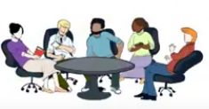
Lesson Study in the Italian context
Definition of educational goals and lesson planning
Research lesson implementation and observation.
Reflection and discussion on the collected data
Redesign

Slide 5
Methodology
Five primary teachers, three first grade teachers (M1, M2 and M3), a third-grade teacher (M4) and a participating-teacher.
First session: LS was presented and the contents of the lesson were chosen.
Second session: training of the group in the mathematical contents of the first set of lessons: the institutionalization of the + sign.
Third session: LS cycle began.

Slide 6
Sought to select considerations they applied to ground the lesson they proposed in their classes.
Analyzed whether these reflections can be considered as evidence of implicit use of some of the DSC components.
This analysis was triangulated with an expert in the use of DSC.

Slide 7
Results and Considerations
Among the participating teachers, consensus emerges on aspects that are implicitly valued as positive in a teaching-learning process.
These can be reinterpreted in terms of DSC’s components (Hummes, Font & Breda, 2019):
1) Epistemic, Cognitive and Interactional are very present.
2) Affective and Ecological to a lesser extent.
3) Mediational sparsely.
To elaborate mathematics teachers’ professional development programs using Lesson Study extend the experimentation and to deepen the analysis based on the DSC.
The texts are considered to contain content that allows to infer the criteria that teachers consider valuable for designing, implementing and redesigning their classes.

Slide 8
Thank you so much for your attention!
carola.manolino@unito.it
vhummes@ub.edu
adriana.breda@ub.edu
asanchezb@ub.edu
vfont@ub.edu

